Slide 1
Update from the Implementation and Capacity Development Committee
Dominique Pelletier, CFIA

Slide 2



What is the IC?
The Implementation and Capacity Development Committee (IC) develops, monitors and oversees an integrated programme to support the IPPC implementation and strengthen the phytosanitary capacity of contracting parties.
Implementation Support
Oversees implementation of the IPPC, ISPMs, and CPM recommendations globally.
Capacity Development
Development of IPPC Guides and other implementation materials to strengthen the capacities of the contracting parties
IPPC Strategic Direction
Manages four key development agenda items in the 2020-2030 Framework.

Slide 3
AFRICA
ASIA
EUROPE
LATIN AMERICA & CARIBBEAN
NEAR EAST & NORTH AFRICA
NORTH AMERICA
EXPERT
SOUTHWEST PACIFIC
EXPERT
EXPERT
EXPERT
RPPO Representative
SC Representative
EXPERT
7 regional representatives,
5 experts,
1 representative from RPPOs and
1 representative of the Standards Committee.

Slide 4
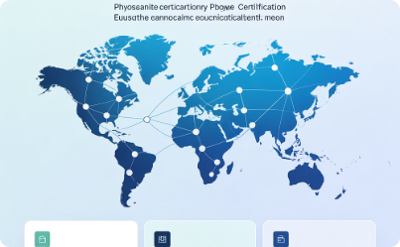
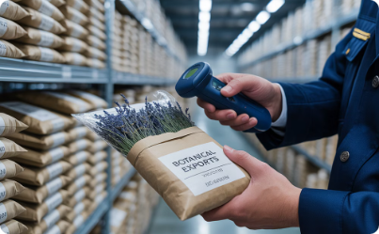
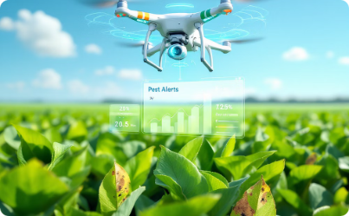
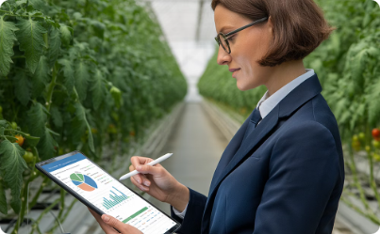
IC contribution to the IPPC Strategic Framework 2020-2030
Electronic Data Exchange
E-commerce Pathways
Pest Outbreak Alert Systems
Third-party Authorization
Harmonizing digital phytosanitary certification systems globally to facilitate secure, efficient trade.
Strengthening early detection and rapid response capabilities for emerging plant pests.
Developing guidelines for delegating phytosanitary actions to authorized entities.
Addressing phytosanitary risks in postal and courier channels.

Slide 5
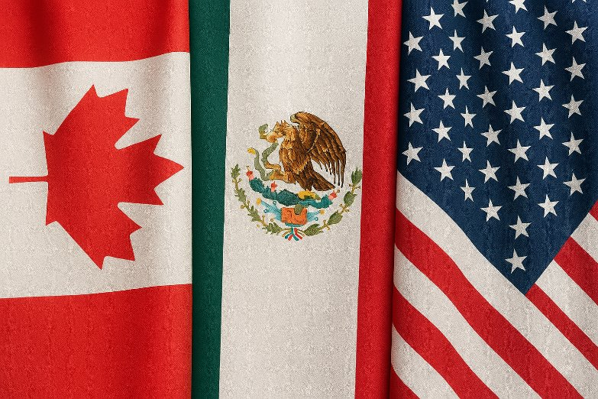
Position development
North American region
PH Quads plus
NAPPO
EPPO

Slide 6
Achievements 2017-25

Slide 7
Guides & e-Learning
Since 2017: 10 guides and 14 e-Learning courses
Guides | E-Learning course
Establishing and maintaining PFAs (2019) | PRAs (2022)
Surveillance (2021) | Phytosanitary inspection (2022)
Regulation of wood packaging material (2023) | How an NPPO functions (2025)
E-Commerce (2023) | Wood packaging material in int'l trade (2025)
Participation in CPM (2024) | Engaging with stakeholders on plant health (2025)
 | Achieving market access for plants & plant products (2025)

Slide 8
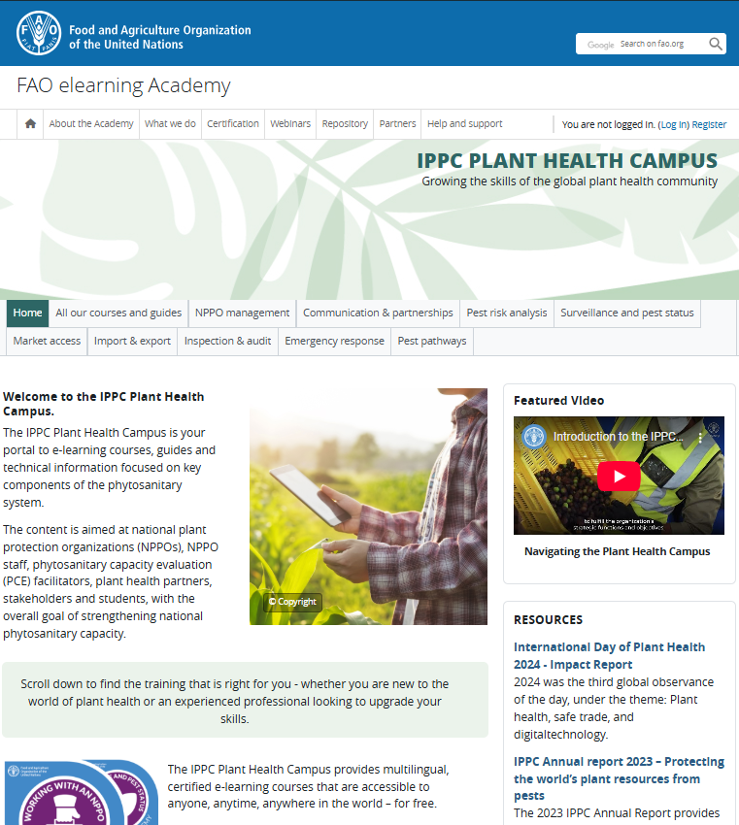
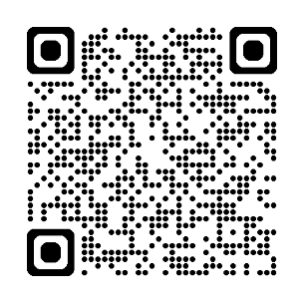

IPPC Plant Health Campus
Launched at CPM-19
Over xx courses
All courses translated to FR (June 2025)
ES courses being rolled out.
Learn by:
  Domain of interest
  Career pathway
Notes:
Developed in collaboration with the Food and Agriculture Organization of the United Nations (FAO) elearning Academy and funding from the European Union, Canada, South Korea, COLEAD
Seen as a crucial tool to help with implementation by many stakeholders, including the European's Union Working Party of Chief Plant Health Officers (CPHOs) during their September meeting in Brussels.

Slide 9
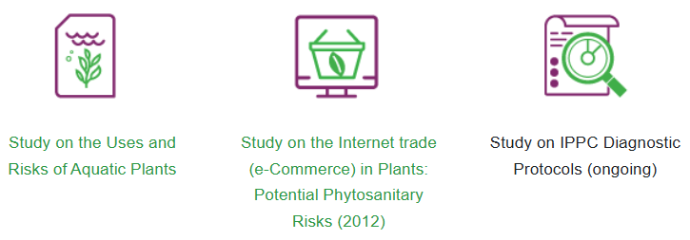



IPPC Observatory
Purpose: monitors the implementation of the IPPC, ISPMs, and CPM Recommendations.
Impact so far:
  Study on e-Commerce (launched in August 2024)
  Study on antimicrobial resistance (2023)
  IPPC General Survey (2026)
Always open for business
Notes:
Studies and surveys.
AMR: Initially launched in 2023 to understand phytosanitary risks associated with antimicrobial and antifungal products in plant health. First phase focused on antibiotic use, second phase on fungicides.
Use of third-party authorization (2020)
Global emerging issues (2016)
Equivalence in phytosanitary measures (2016)

Slide 10

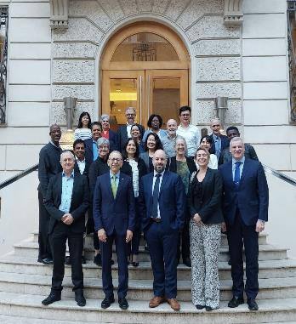
NAPPO’s contribution to the IC
All three NAPPO countries dedicated time and resources to the work of the IC.
Stephanie Bloem (NPPO rep. (2017-2023).
NAPPO workshops and documents.

Slide 11
Update 2025

Slide 12
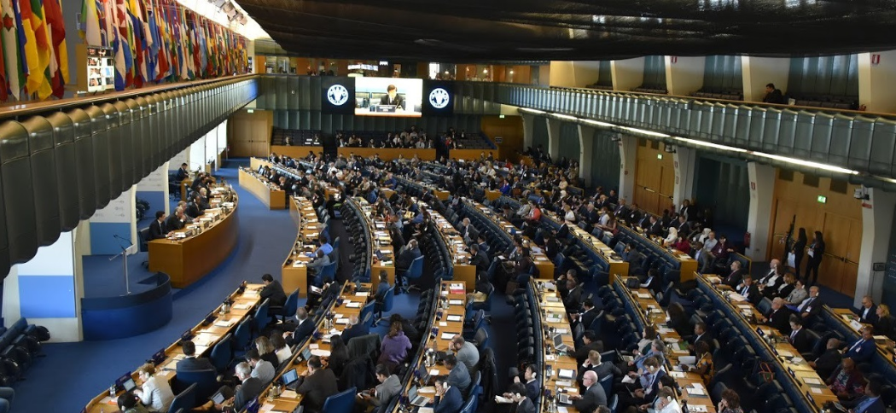
Outcomes of CPM-19
Is it time to re-think ISPMs?
Alignment of SC and IC work programs
Task Force on Topics
Specifications for:
  Audit guide
  Guide on third-party authorization
Plant Health Campus

Slide 13
Open session: Smart plant health, what does the future look like?
Monitoring pest risk with Epidemic Intelligence from Open Sources (EIOS)
Smart Surveillance and Integrated Response to Maize Lethal Necrosis (MLN) in Eastern and Southern Africa
Ultrasound beetle detection ("electronic woodpecker")
Smart FARM (Farmers Adopting Responsible Management)
Beijing’s first AI-based Smart Crop Protection System
The implementation of the IPPC ePhyto Solution in Senegal
India’s experience with utilizing the IPPC Plant Health Campus for phytosanitary capacity development

Slide 14
Success indicators for 2025-26...
The EWG for the guide on audits is formed in late 2025 and work is initiated in 2026
Call for experts is launched in 2026 for the guide on authorization of third-party entities
IPPC general survey is launched at CPM-20
All existing PH Campus courses are translated into Spanish
The first proposal for the development of guidance material will be reviewed by the IC

Slide 15

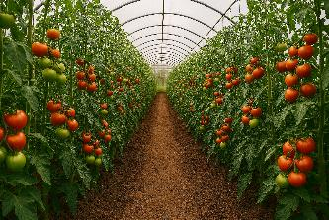

Conclusion & Perspective on the IC
A mind shift is taking place within the IPPC community
It takes time to get organized
Aligning the IC work with the SC is essential (where possible)
Project-based funding and staff rotation is hindering progress
Participation from developing countries is crucial (and is improving)
Investing in implementation and capacity development is a win-win scenario

Slide 16


