Slide 1

NAPPO Training and Other Resources
Alonso Suazo
NAPPO Technical Director

Slide 2
Objective
Provide an overview of the available training and learning materials on the NAPPO website

Slide 3
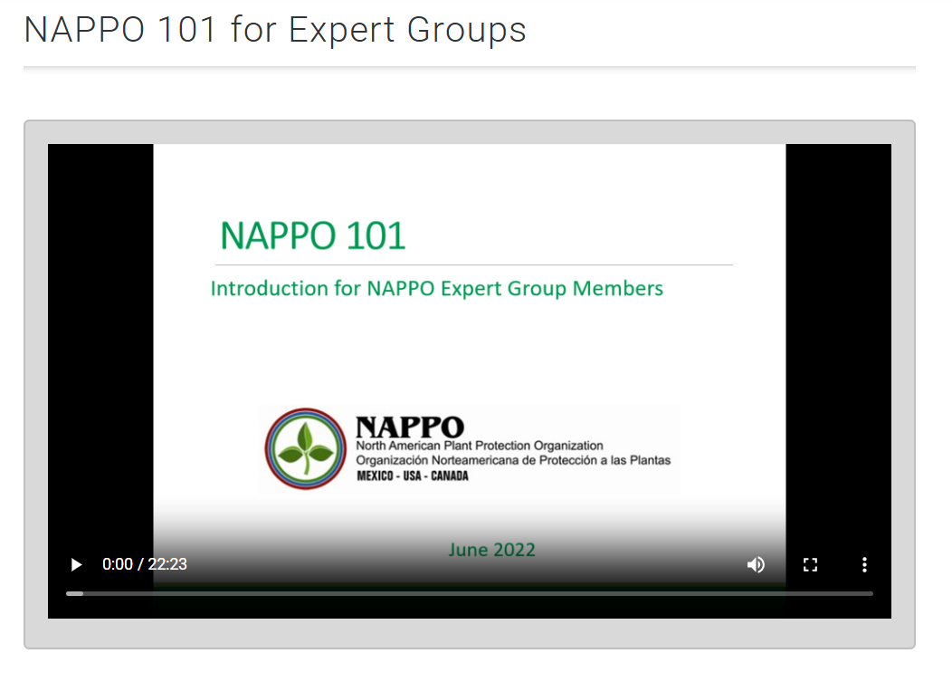
Resources for New NAPPO Expert Group Members
Resource to provide basic information about NAPPO and specific information about the expert groups’ work.
Developed by the NAPPO Advisory and Management Committee.

Slide 4
NAPPO Resources that Contribute to the Implementation of Regional (RSPMs) and International (ISPMs) Standards
Organizing workshops, seminars, and other events
Producing relevant documents
Providing summaries of RSPM to inform stakeholders about the purpose and content of each standard.

Slide 5
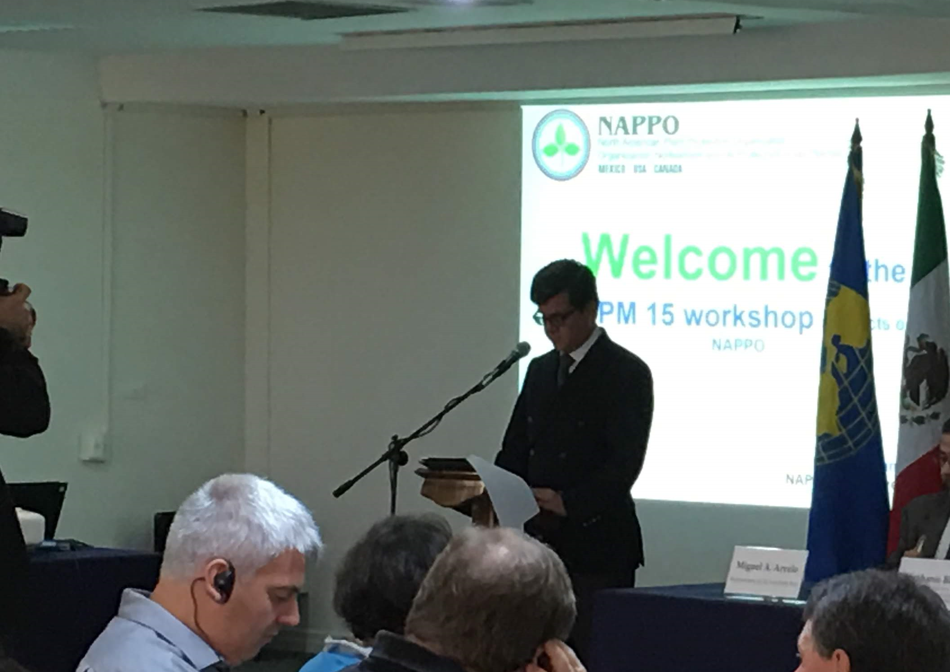
Workshops
Implementation of ISPM 15 (Regulation of wood packaging material in international trade)
Implementation of ISPM 38 (International movement of seeds)

Slide 6
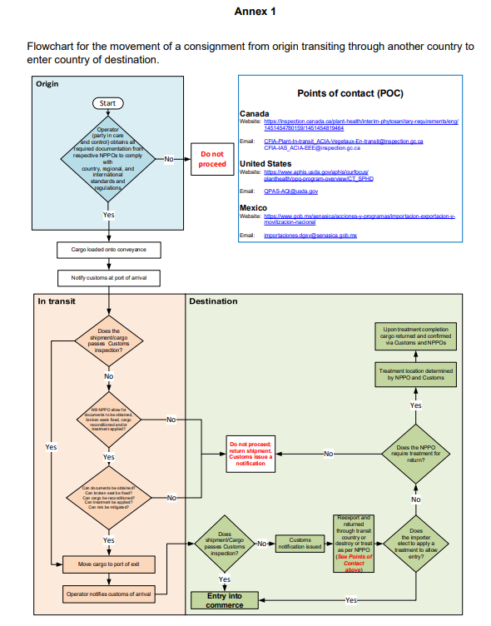
Relevant Documents: “Standardization of Responsibilities and Actions for Safeguarding Consignments that have transited one NAPPO Country to enter another NAPPO Member Country” – Implementation of ISPM 25
Points of contact in each NAPPO country for non-compliance cases:
Website
email
In-transit movement of commodities in the NAPPO region
Developed by the Implementation of ISPM 25 NAPPO expert group.

Slide 7
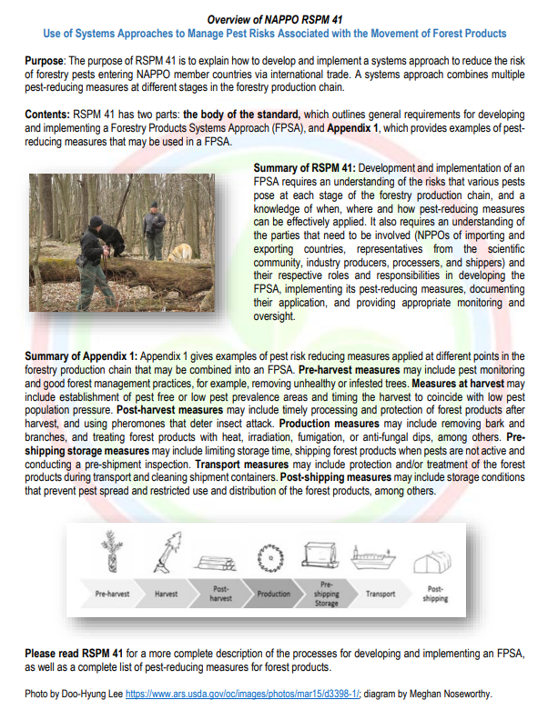
RSPM Summaries in the NAPPO Website
One-pagers that:
  Provide basic information on the purpose and content of Regional Standards
  Available in the NAPPO website (www.nappo.com) for RSPMs that are not archived.

Slide 8
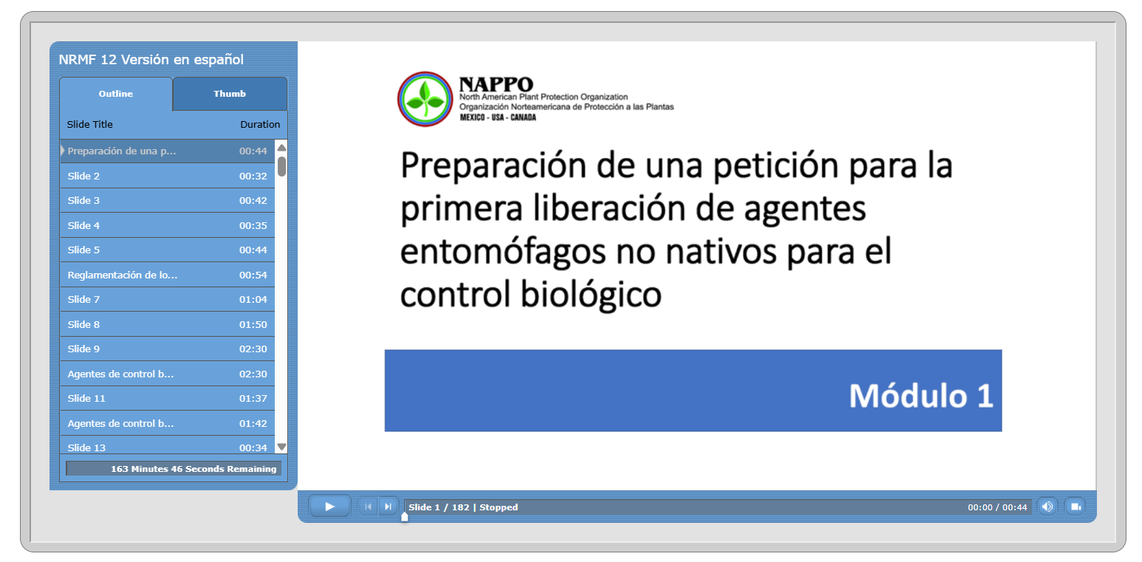
RSPM 12 (Guidelines for Petition for Release of Non-Indigenous Entomophagous Biological Control Agents) Training Module
Developed by the NAPPO Biological Control EG
Assist biological control practitioners in drafting a comprehensive, well-organized petition for the first release of non-indigenous biological control agents of insect pests.
RSPM 12:
takes the guesswork out of what information to include in a petition.
Helps reviewers quickly identify where there are gaps in our knowledge of the pest and the proposed biological control agent, as well as the risks, if any, of releasing the new agent.
www.nappo.org

Slide 9
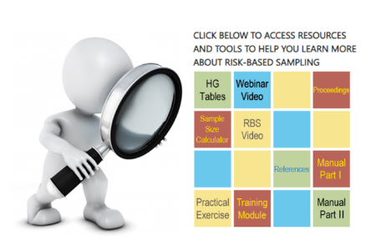
Risk-Based Sampling Resources
Resources, tools, training materials, and exercises to assist in the development and implementation of a risk-based sampling program.
Navigation Instructions
Use your mouse to place the pointer on the link of interest and click to access the information.

Slide 10
What is next for NAPPO
More training and informational material will be developed as the NAPPO Secretariat prioritizes implementing RSPMs and other NAPPO documents.
The NAPPO website will be updated with a section exclusively devoted to the implementation of RSPMs and other documents for easy access to stakeholders.

Slide 11
Thank you!

