Slide 1


Plant Health Learning Resources in the NAPPO Region
Clean Plants Industry Training Tools and Resources
2025 NAPPO Annual Meeting, Ottawa
October 22, 2025

Slide 2
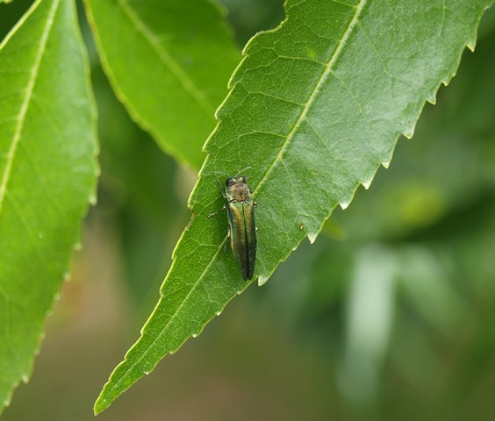
Agenda
Clean Plants Elevator Pitch
Training Tools for Industry
  Workshop Training
  Training for Internal Auditors
  External Auditor Training
Challenges with Decreasing Enrolment

Slide 3
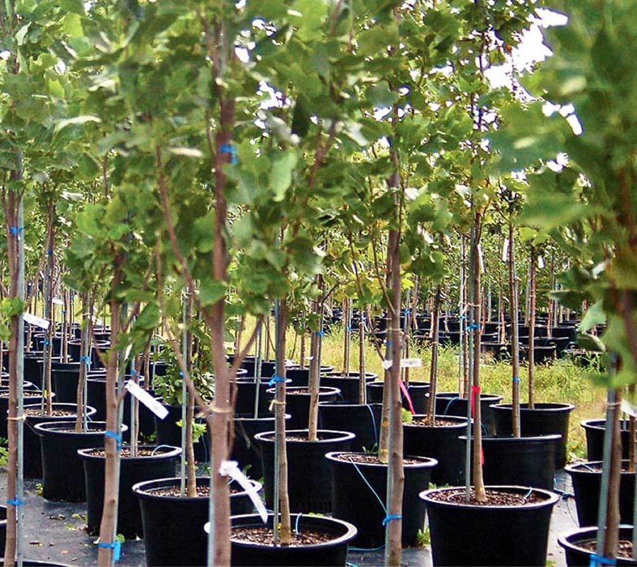
CNCI’s Clean Plants Certification
Third party audited systems approach nursery certification
Designed by nurseries for nurseries
Certification focused on two plant health pillars:
  Pest management
  Traceability
Ship plants within Canada that are completely free of all regulated pests and substantially free of all other insects and diseases

Slide 4
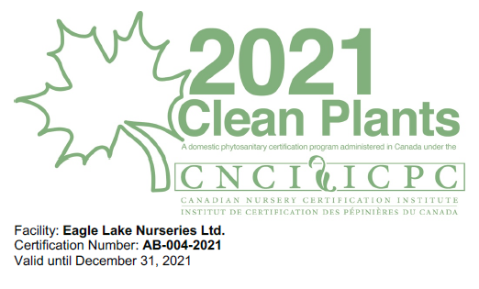
Training Tools and Resources
CNCI provides self study training options
For Nurseries
  Mandatory Workshop Training Video
  Clean Plants Standard Training Q & A’s
For Auditors
  Compulsory Basic Training for Internal Auditors
  External Auditor Training

Slide 5
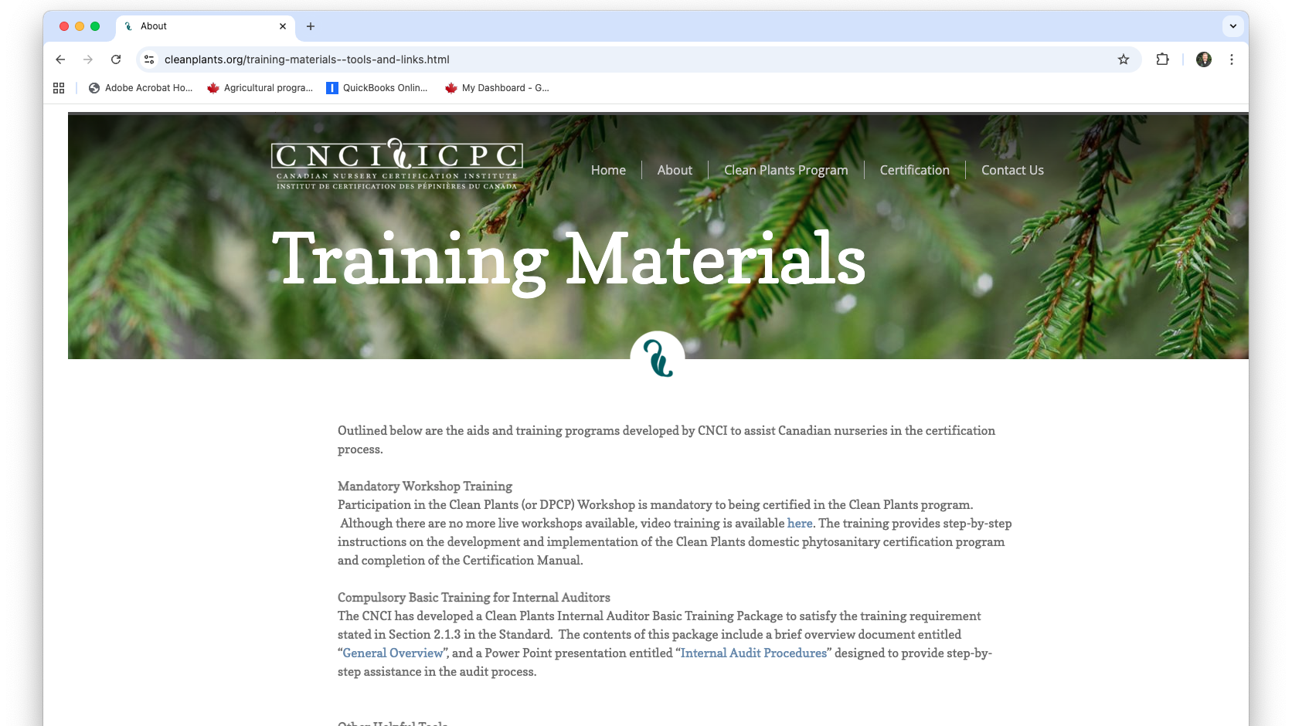

Slide 6
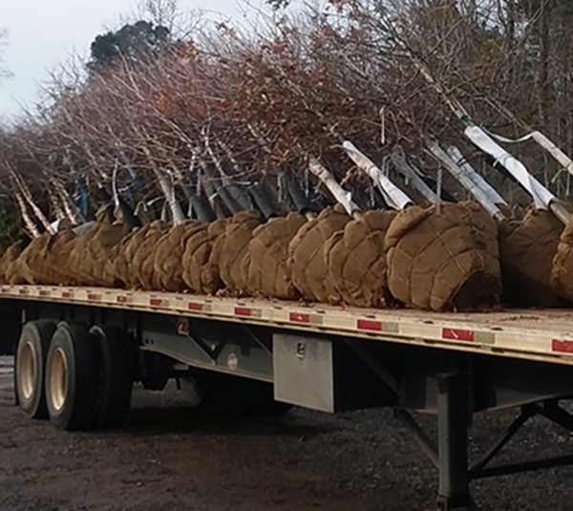
For Nurseries
Mandatory Workshop Training
YouTube video to introduce the Clean Plants Program for new entrants
  Overview of the program and the benefits to being certified
    https://www.youtube.com/watch?v=HS_VePWfETs
  Preparatory guidance for a nursery to develop their Clean Plants Manual
Clean Plants Standard Training Q & A’s
A table of common questions regarding details in the manual
  Q & A’s are aligned with the sections of the manual (General to 7.4.3)
  Supports nurseries as they complete their Clean Plants Manual

Slide 7
Questions and Answers Regarding Clean Plants Standard and Training Materials
Section | Question | Answer
General | How does being Clean Plants certified help your nursery? | Clean Plants Certified nurseries represent the cutting edge of horticulture. Like ISO and other systems-based quality assurance programs, Clean Plants provides a distinct marketing advantage. Why? Clean Plants nurseries: Offer buyers confidence that they are receiving problem-free goods Are able to fill orders that spec Clean Plants Certification Can track the source and destination of all products Have systems to protect themselves from invasive pests and plants Help the environment and our foreign trade ability by preventing movement of quarantined and regulated pests Are equipped to handle incidents of quarantine with limited loss, and are better prepared to manage CFIA requirements
General | What’s the downside to Clean Plants? | There is no doubt that you will need to invest both time and money to become Clean Plants Certified. But once the system is in place, most growers find it to be a manageable routine that signifies an increased level of professionalism at their nurseries.
General | Is Clean Plants for everyone? | Some nurseries have a clientele that is not concerned with Certification. They may not ship to other growers, or may be highly specialized and localized. Each grower must do their own assessment as to the return on their investment in this program.
General | Are there certain buyers that require Clean Plants certified stock? | Several municipalities are planning to require Clean Plants Certified stock; City of Calgary is the first municipality to demand it for 2011.
General | What does Clean Plants have to do with “CNCP”? | The Canadian Food Inspection Agency (CFIA) created CNCP for nurseries that ship product internationally on a fairly regular basis. As a rule, CNCP nurseries may not have more than 5% of their plant stock originating from non-CNCP vendors. But, Clean Plants Certified nurseries are an exception to the rule, and can supply CNCP clients.
General | Which are the CNCP nurseries? | See the CFIA’s list at http://www.inspection.gc.ca/english/plaveg/protect/dir/cncpcface.shtml
General | What happened to the “Domestic Phytosanitary Certification Program (DPCP)? | The name of the Domestic Phytosanitary Certification Program (DPCP) has been changed to “Clean Plants” as of April 16, 2010. Nursery growers have expressed that “DPCP” was a bit of a tongue twister and that the program name should be more reflective of the program’s benefits.

Slide 8
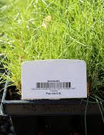
For Auditors
Compulsory Basic Training for Internal Auditors
A brief overview document and Internal Audit Procedures presentation with slides alternating between
  The requirements stated in the Clean Plants Manual
  What the auditor needs to audit to meet the standard
External Auditor Training
Cleans Plants Auditor Training Manual
  To familiarize auditors with the program and associated regulations
  Provides the basics of nursery production
  Outlines auditor responsibilities
  A one-hour virtual training session for new auditors

Slide 9

Clean Plants Internal Auditor
Basic Training
Internal Audit Procedures

Slide 10
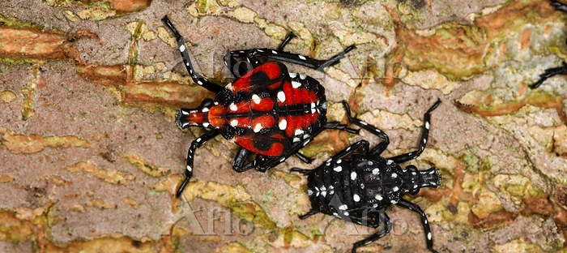
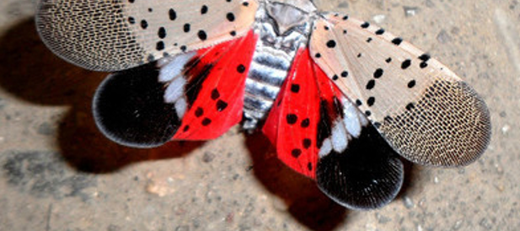
Challenges with Decreasing Enrolment
Increasingly challenging to enroll new nurseries in Cleans Plants and keep exiting ones
Reasons cited:
  they don't see the benefit to their clients
  challenges with keeping up with documentary requirements during spring shipping and
  the cost of external audits
Yet invasive pests and diseases continue to require systems approach management to meet regulations at the nursery level

Slide 11
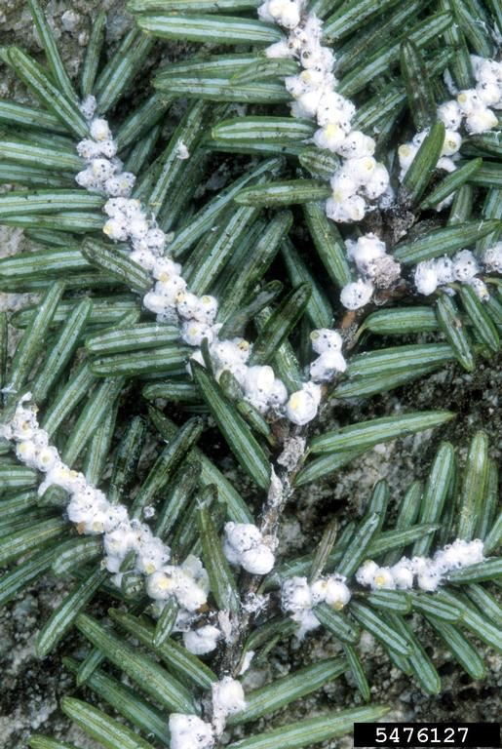
Opportunities?
Finding the value proposition for nurseries?
  Export
  Market pull
  Cost savings
Clean Plants Training tools remain a valuable industry resource
  For existing members
    staff training
    education

Slide 12

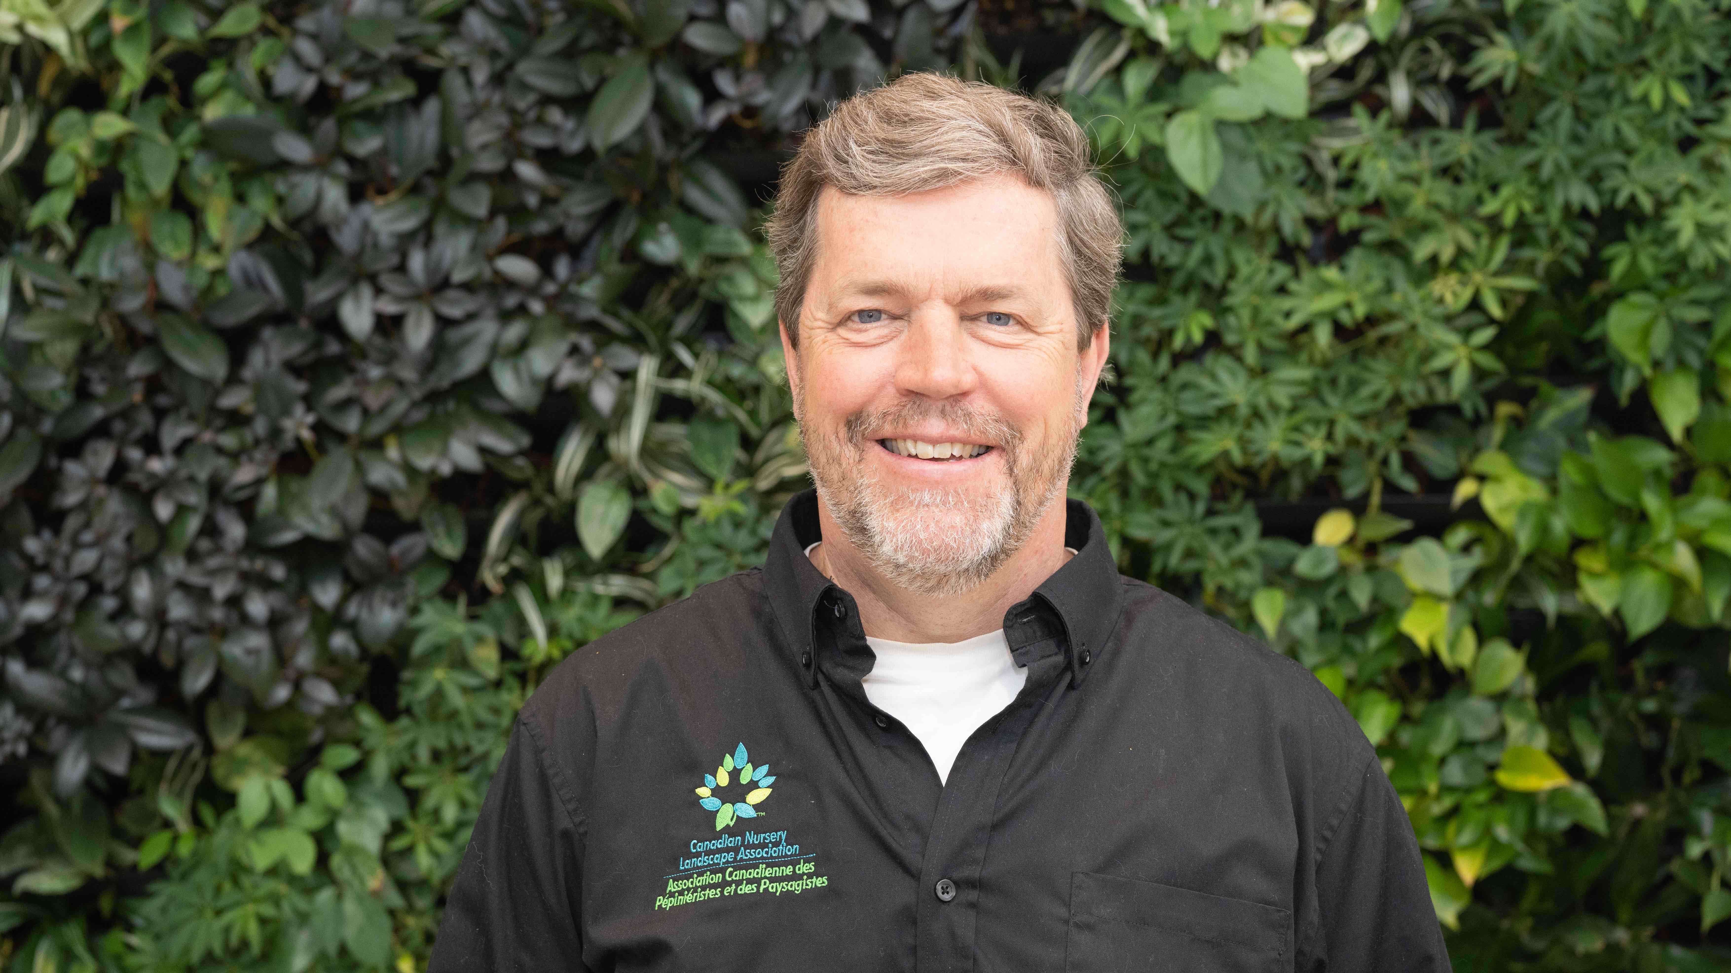
Jamie Aalbers
Growers and Research Specialist
Canadian Nursery Landscape Association www.cnla.ca jamie@canadanursery.com
Thank you!

