Slide 1
IPPC Systems Approach Tools and Resources
Dominique Pelletier, CFIA

Slide 2
Background
Project initiated in 2017
Imperial College London, with STDF funding
IC oversight
75% NPPOs use systems approach
Trained facilitators
Notes:
75% NPPOs use systems approaches after participation in the project

Slide 3
Purpose for the tools
Low-Tech on purpose
Templates with instructions
  Can save multiple iterations
Support the development of combinations for managing pest risk associated with pathways
Offer a better stance in trade negotiation
Trained facilitators can be hired to assist with the process
Available in six languages

Slide 4
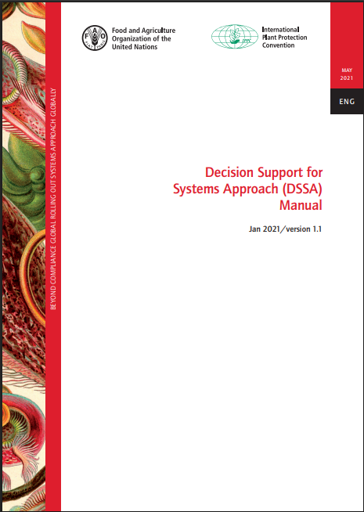




Slide 5
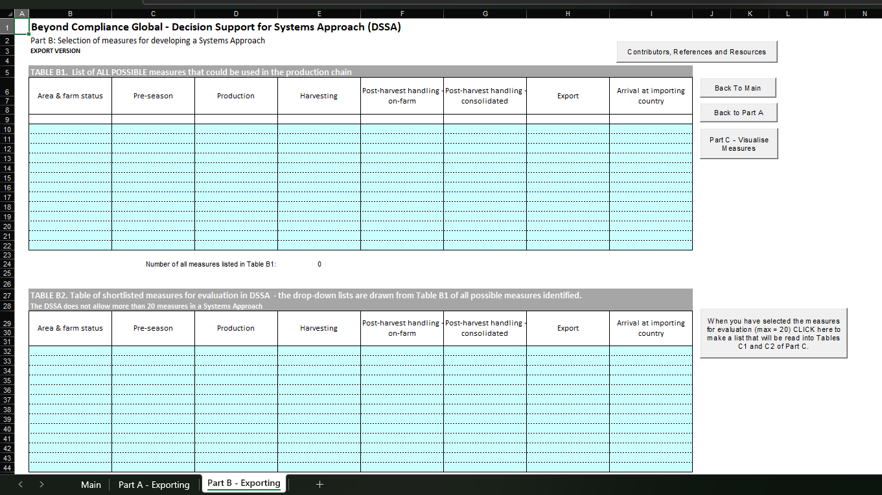

Slide 6
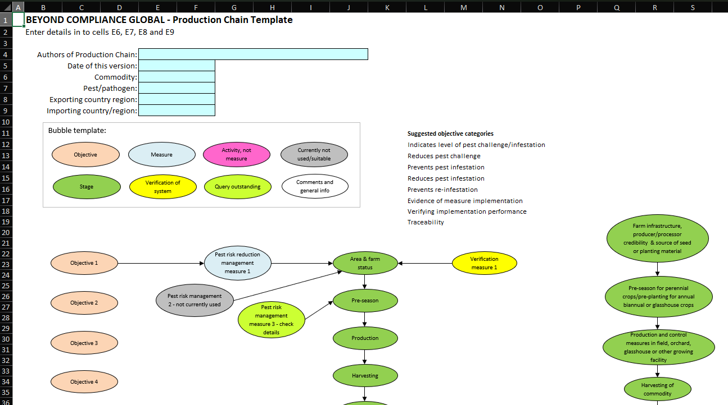

Slide 7
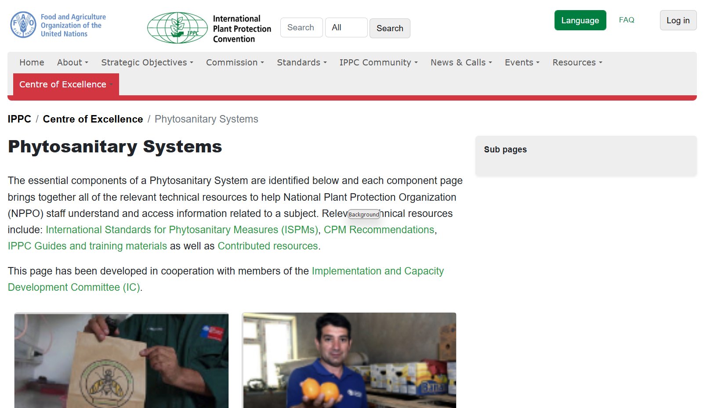

www.ippc.int > centre of excellence > phytosanitary systems­

Slide 8
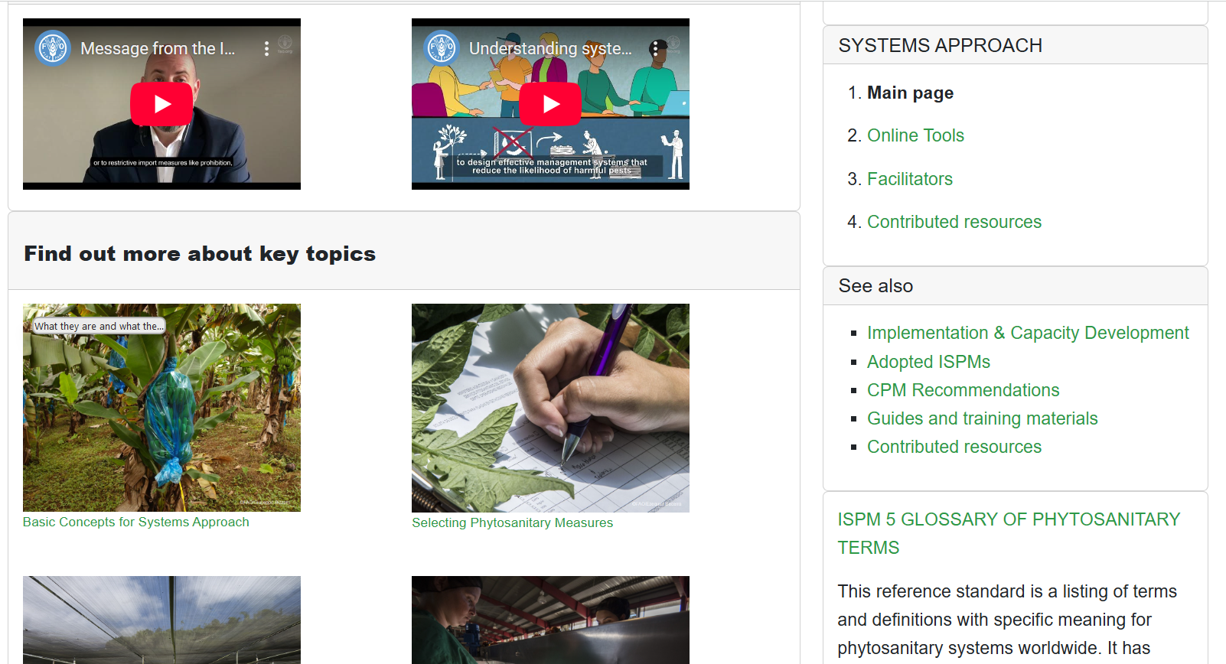

www.ippc.int > centre of excellence > phytosanitary systems > systems approaches­
Basic Concepts for Systems Approach
Selecting Phytosanitary Measures
Using Verification or a Control Point
Agreeing on the Combination of Measures

Slide 9
IPPC Global Workshop on Systems Approaches
Workshop to take place December 1-4, 2025 in Santiago, Chile
Workshop will include an optional field trip side event on Dec. 5
Registration was open until 15 October
Participants: National Plant Protection Organizations (NPPOs), Regional Plant Protection Organizations (RPPOs), invited industry experts
Workshop organized by IPPC, IICA, COSAVE, SAG-Chile in partnership with Government of Canada, USDA and DAFF-Australia

Slide 10
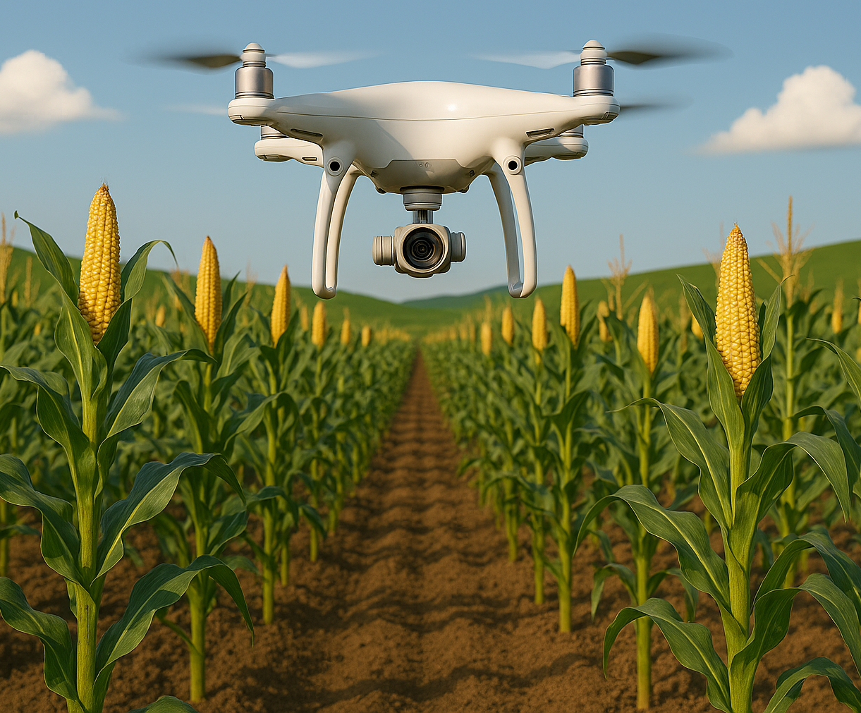
IPPC Global Workshop on Systems Approaches
Workshop will focus on:
  ISPM 15 (systems approach) concepts
  Overview of other standards connected to ISPM 14
  Case studies
  Exercises
  Discussion on challenges for implementation of ISPM 14
  Discussion on multilateral systems approach recognition
For more information, please visit the IPPC website

Slide 11


