Slide 1
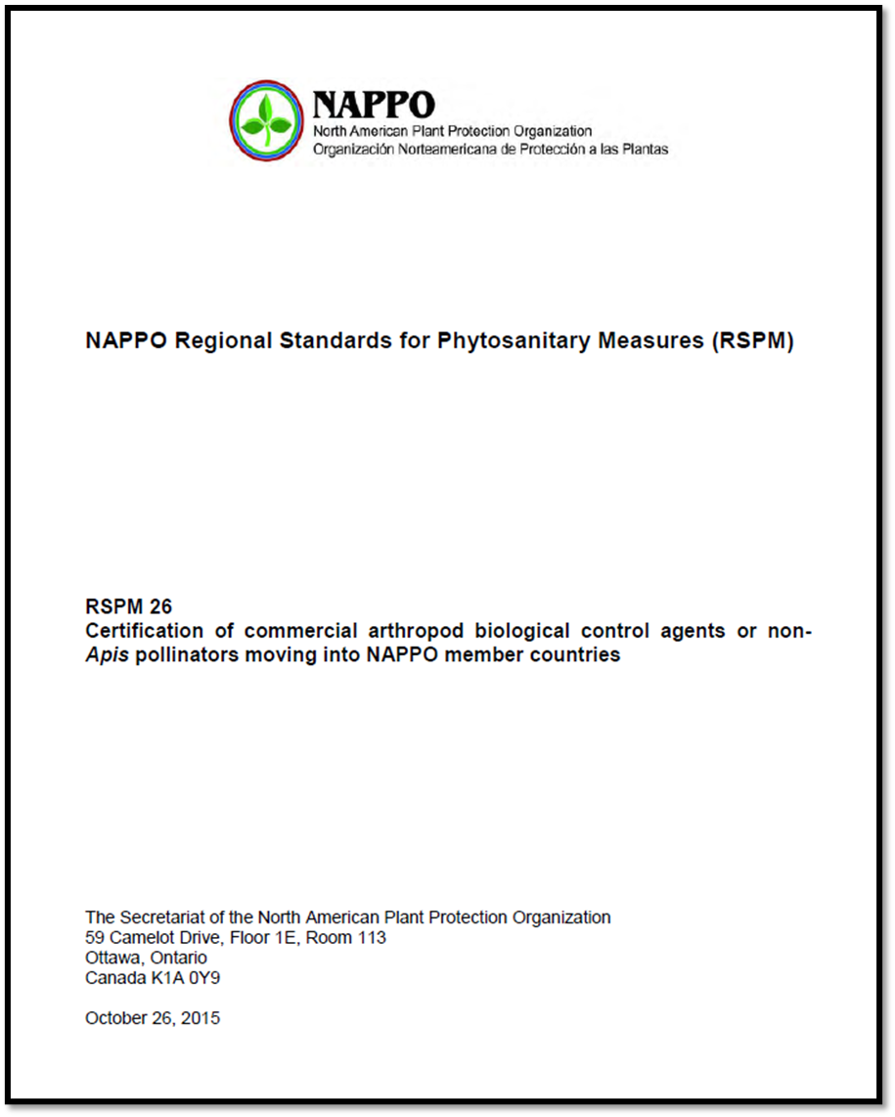


Update on the Fundamental Review of RSPM 26
NAPPO Annual Meeting 2025 (October 22, 2025)
Biocontrol Revision RSPM 26 Expert Working Group

Slide 2
Discussion paper: Key elements
  Overview of the commercial arthropod biological control agent market
  Background and trigger for RSPM 26
  Former and current trade environments and regulations
  Status and challenges in RSPM 26 implementation
  Options for RSPM 26:
    Maintain status quo
    Archive
    Replace with a guidance document
    Update

Slide 3
Decision and Key Considerations
EWG Decision: Update RSPM 26
  Remove non-Apis pollinators from scope
  Adopt less prescriptive approach focused on shared objectives
  Add appendices on import requirements and approved CABCA
Key factors considered:
  Expertise of EWG including regulatory oversight of non-Apis pollinators
  Status and challenges related to implementation
  Differences in import requirements
  Current climate and challenges

Slide 4
Next steps
  Draft the updated RSPM 26
  Submit the revision to the NAPPO Executive Committee for approval
  Circulate the approved draft for NAPPO country consultation
  Review and address comments before finalization and publication

Slide 5
Biological Control Expert Group Members
Organisation | Name | Organisation | Name
Canada – CFIA | Bruno Gallant | Mexico - SENASICA | Carlos Lázaro Castellanos
Canada – CFIA | Heather Cumming | Mexico - SENASICA | Jorge Antonio Sánchez
Canada – AAFC | Paul Abram | Applied Bionomics Ltd. | Brian Spencer
US - APHIS-PPQ | Ron Weeks | Biobest Group | Kim Riley
US - APHIS-PPQ | Ignacio Baez | Koppert | Melissa Tacolla
US - APHIS-PPQ | Kristen Dyer | Biobest Mexico S.A de C.V | Antolin Díaz
Mexico - SENASICA | Vicente Rosas Medina | Biobest Mexico S.A de C.V | Hugo Arredondo Bernal
Special thanks to former members: Bob Pfannenstiel, Kirk Martin, Ben Slager, Keith R. Hopper, Eric Rohrig and Helmut Rogg.

