Slide 1

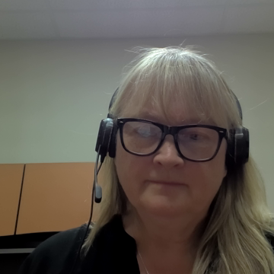
Revision of RSPM 8
The Authorization of Individuals to Issue Phytosanitary Certificates
October 2025
Notes:
Hi There, my name is Alex Graham and I am pleased to provide an overview of the work being carried out by the expert working group on revising the RSPM 8 for the authorization of individuals to issue phytosanitary certificates

Slide 2

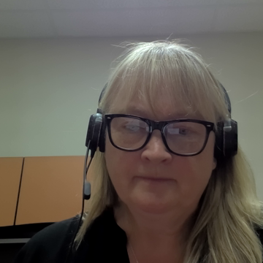

2025 NAPPO Expert Group Members
Michael Perry USDA-APHIS Senior Export Specialist
International Phytosanitary Management and Standards Program
Terrance Wells USDA-APHIS Senior Export Specialist
North America (Canada, Mexico, and US Territories) & Caribbean
SENASICA
Beatriz Alejandra Jiménez Cruz
Edgar Reyes Oregón
Anna Birmingham CFIA Senior Specialist
International Phytosanitary Standards
Alexandra Graham CFIA A/National Operations Specialist - Plant Health
Notes:
I would like to start by introducing our group members:

Slide 3

RSPM 8 The Authorization of Individuals to Issue Phytosanitary Certificates
This Standard Covers :
Responsibilities for NPPOs
Core competencies for Authorized Certification Officials (ACOs):
  Knowledge
  Skills
  Abilities
  Authorization
  Requirements for signing Phytosanitary Certificates under the IPPC
Notes:
Knowledge-training, experience and education
Authorization-Passing an exam to be authorized and maintaining that authorization to sign phytos
As members of the IPPC, the NAPPO member countries shall follow the obligations under the IPPC as they relate to authorization of public officers to issue phytosanitary certificates, including in section Article V.2(a):
“The issuance of phytosanitary certificates shall be carried out by public officers who are technically qualified and duly authorized by the official national plant protection organization to act on its behalf”.

Slide 4
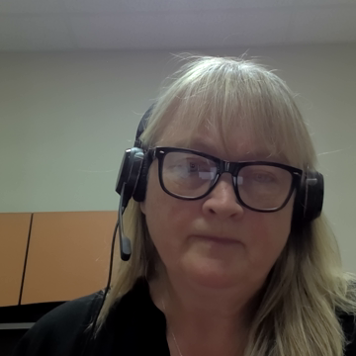
Project Proposal
Review the standard and consider if sections can be simplified or are no longer relevant.
Review ISPM 7 and ISPM 12 to consider if RSPM 8 contains redundant material.
Consider if specific amendments to RSPM 8 should be made, in respect of:
  Current program and practices in NAPPO member countries
  Terminology adopted in IPPC standards, ISPM 5 and RSPM 5 (Glossary of phytosanitary terms)
  Review will include updating RSPM 8 to reflect new technologies (ePhytos)
Notes:
Before the first sentence: A new review is proposed to keep the standard relevant, efficient, and aligned with current international practices. The standards are meant to be reviewed every 5 years and the last review took place in 2013.
After the last sentence: All three NAPPO countries have adopted a level of electronic certification for phytosanitary certificates. These new systems and processes have added to the responsibilities of ACOs regarding knowledge, skills and training that should be reflected in our standard.

Slide 5
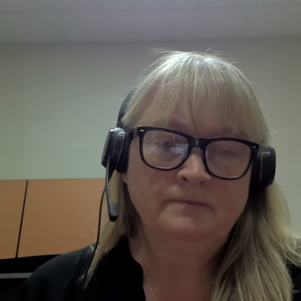
Purpose of this review
This project links to NAPPO strategic goals by:
Strategic goal 1.b.
Harmonizing phytosanitary certification knowledge and issuance for international shipments into and between NAPPO countries while facilitating trade
Strategic goal 2.a.
Updating the standard based on the latest technical and digital information
Providing a forum for the periodic review of RSPM 8 to:
  Identify new priorities related to ePhyto issuance
  Address gaps in access and data
  Develop and maintain best practices for digital certificate exchange
Notes:
Why we are doing this project
1b NAPPOs purpose-place for 3 countries to ensure harmony/consistency
Strategic goal 2.a. Facilitating safe trade on the basis of science-based regional standards and harmonized phytosanitary measures

Slide 6
Purpose of this review
Strategic goal 2.b.
Carry out routine reviews of the NAPPO region’s phytosanitary framework to pinpoint emerging priorities and gaps
Strategic goal 2.e.
Assess the successes and challenges in the implementation of regional standards to adjust them to changing global conditions
Strategic goal 2.h.
Support the global implementation of ePhyto and electronic data exchange
  Build capacity to develop and strengthen digital skills of ACOs
Notes:
As mentioned in the previous goal - Strategic goal 2.b. Conduct a regular/periodic review of the phytosanitary measures’ framework for the NAPPO region to identify new priorities and existing gaps and determine which standards and other documents, procedures, or practices should be developed, maintained, updated, or archive(periodic review).
Strategic goal 2.e. Assess the successes and challenges in the implementation of regional standards to adjust them to changing global conditions -Discuss ePhyto implementation strategies, challenges and successes to date, and where the systems may be harmonized.
Strategic goal
2.h. Support the global implementation of ePhyto and electronic data exchange Build capacity to develop and strengthen digital skills of ACOs.

Slide 7
Objectives of this project
Review the relevance and continued need for RSPM 8
Assess the impact of current practices and technologies adopted by all three NAPPO member countries, and identify necessary updates to ACO responsibilities, skills, and training requirements.
Evaluate and propose updates to key components of the standard, including:
  Maintenance of authorizations
  Record keeping and documentation
  Consistency across countries
  Examination processes
Update RSPM 8 to ensure alignment with international standards and electronic certification systems.
Strengthen collaboration and communication among national experts in export certification across Canada, the United States, and Mexico.

Slide 8
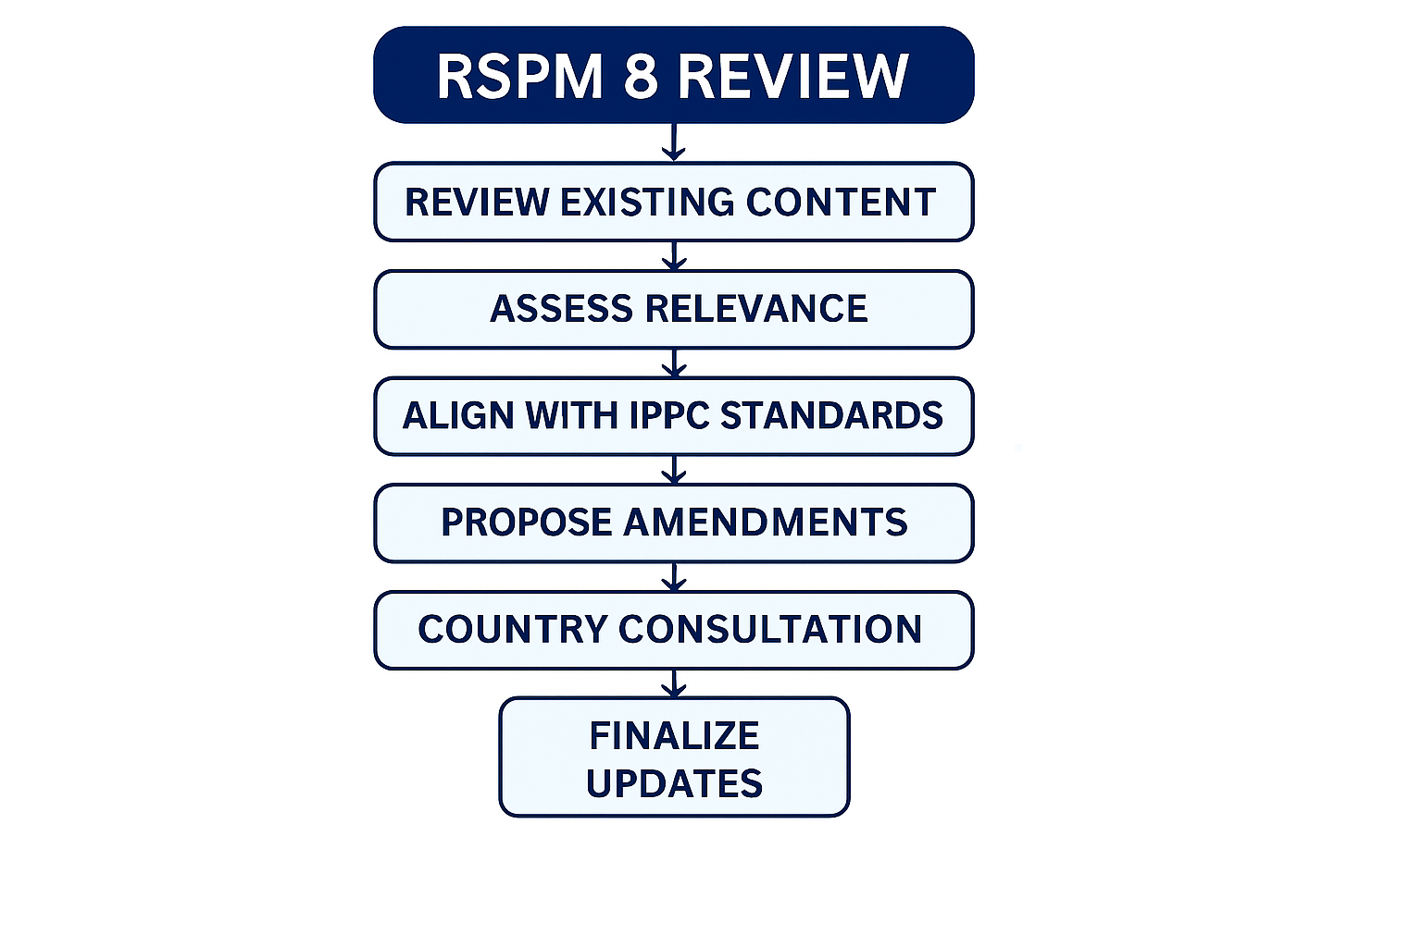
Time frame
Completion of all these elements is anticipated to take approximately 1 year.
Notes:
Completion of all these elements is anticipated to take approximately 1 year.

Slide 9
Concluding Remarks
Benefits of Reviewing the Standard:
Reconnects export certification experts across NAPPO countries
Encourages exchange of best practices
Promotes consistency in certification procedures
Strengthens alignment with international standards
Identifies emerging challenges and technology advancements
Notes:
Reviewing the standard will re-establish and maintain communication links and outreach between experts in the three NAPPO member countries that are responsible for export certification activities at the national level.
This renewed collaboration will support the exchange of best practices, promote consistency in certification procedures, and strengthen regional alignment with international standards. It also provides an opportunity to identify emerging challenges, share technological advancements, and foster a more coordinated approach to phytosanitary certification across North America.
In summary: Build capacity to develop and strengthen skills of the ACOs in each country.

Slide 10
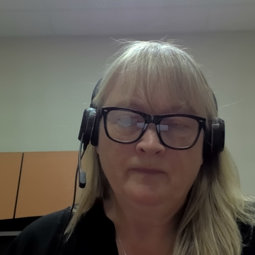
Thank you
Gracias
Merci
Notes:
And with that I have come to the end of my presentation, thank you for your time.

