Slide 1




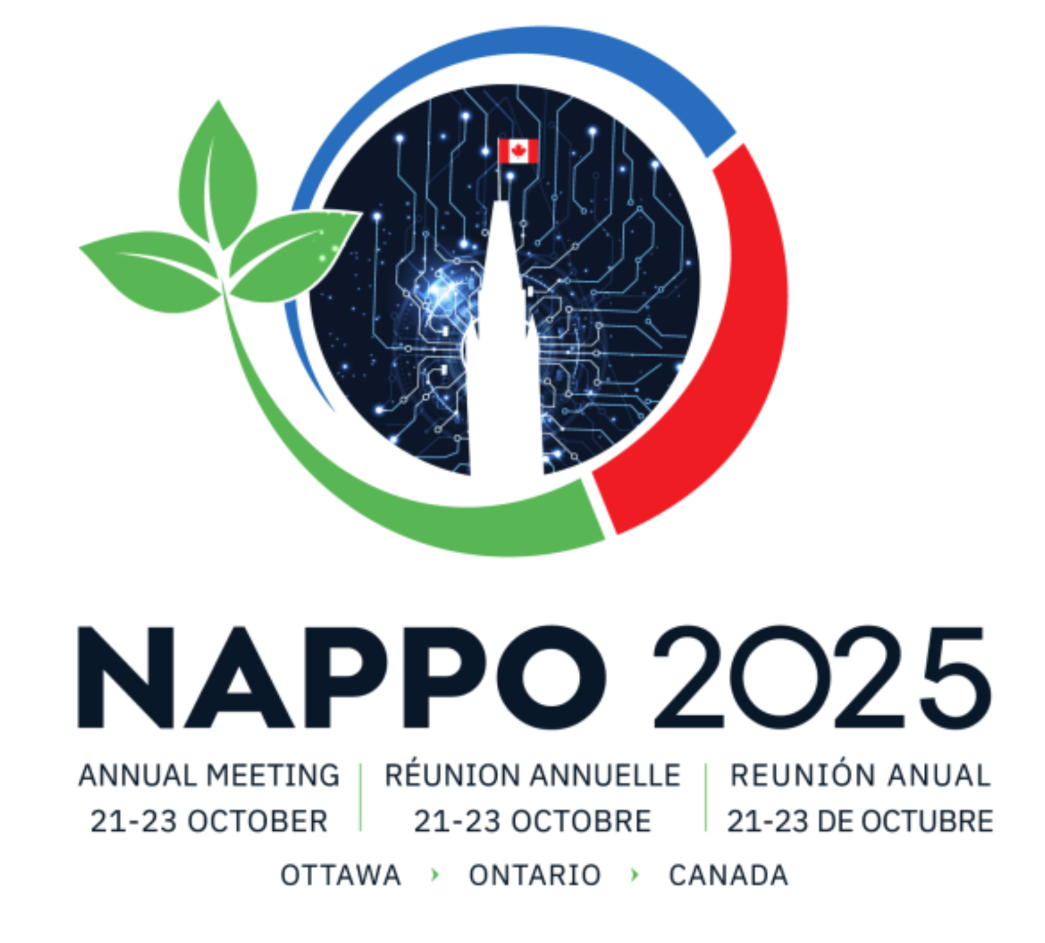
Brad Gething
National Wooden Pallet & Container Association
48^{h} NAPPO Annual Meeting
Project Report 2025
Testing the heat treatment dose for wood product pests in North America
Water bath ring study
Notes:
This project got underway in 2025 and has started to take form the last few months. I’ll give a summary of the project importance, our progess, and where we see things going in the next year.

Slide 2
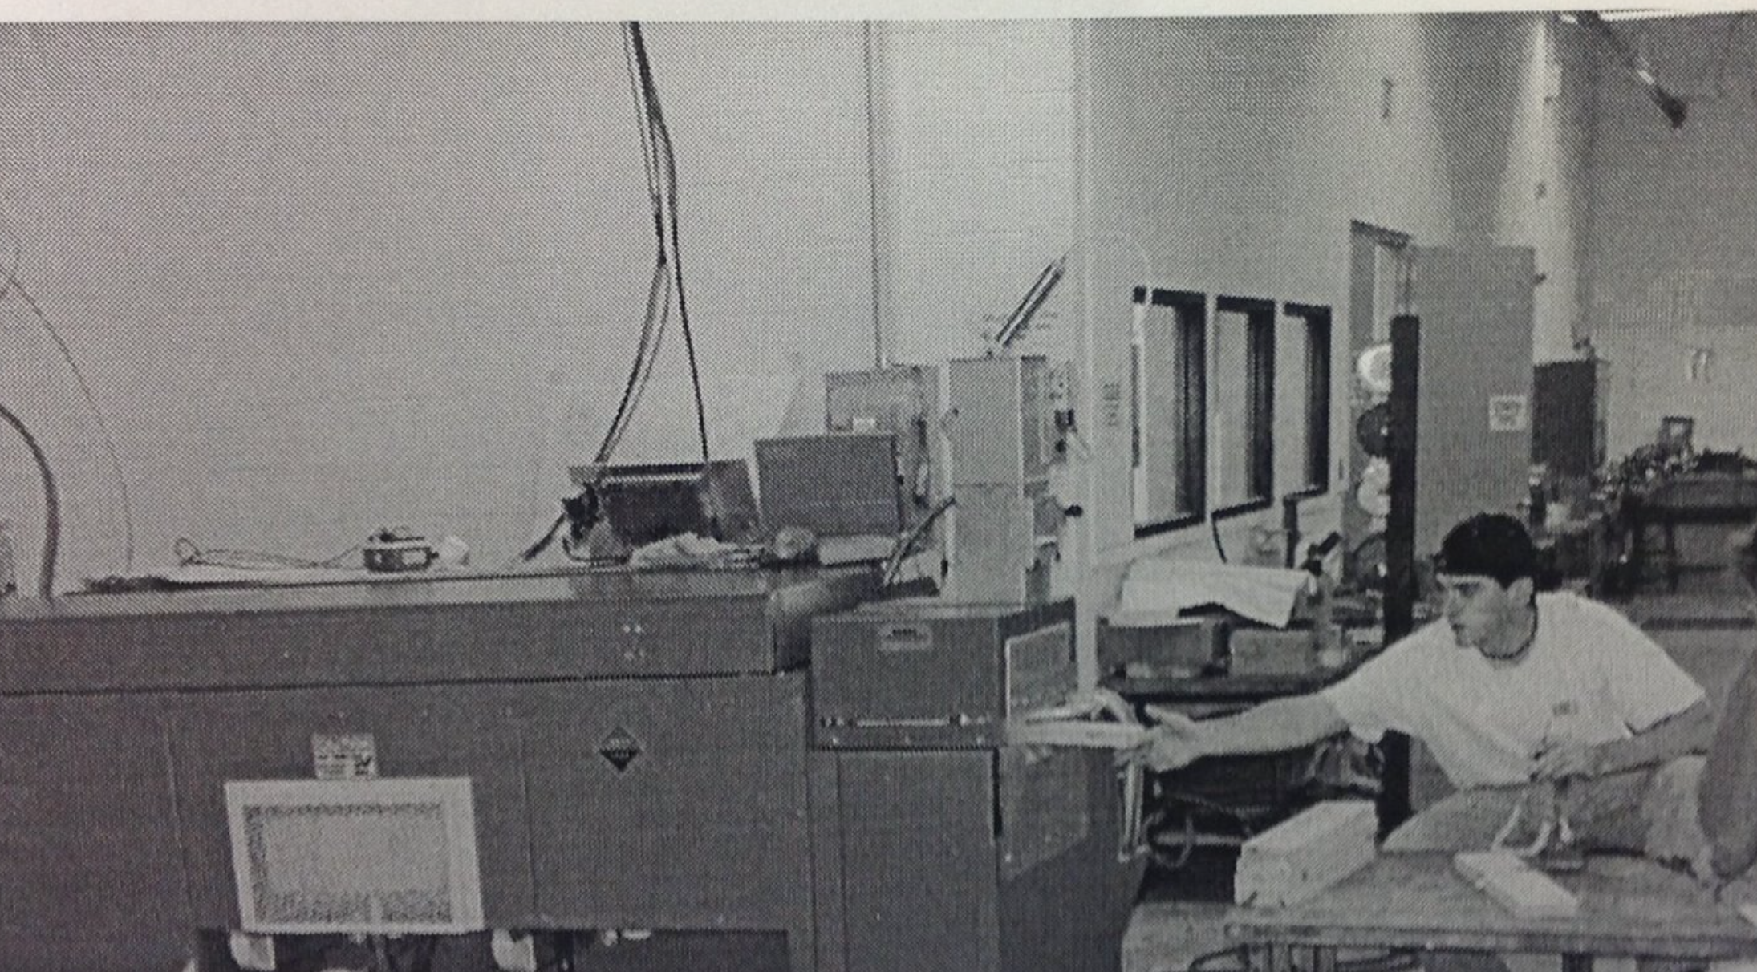
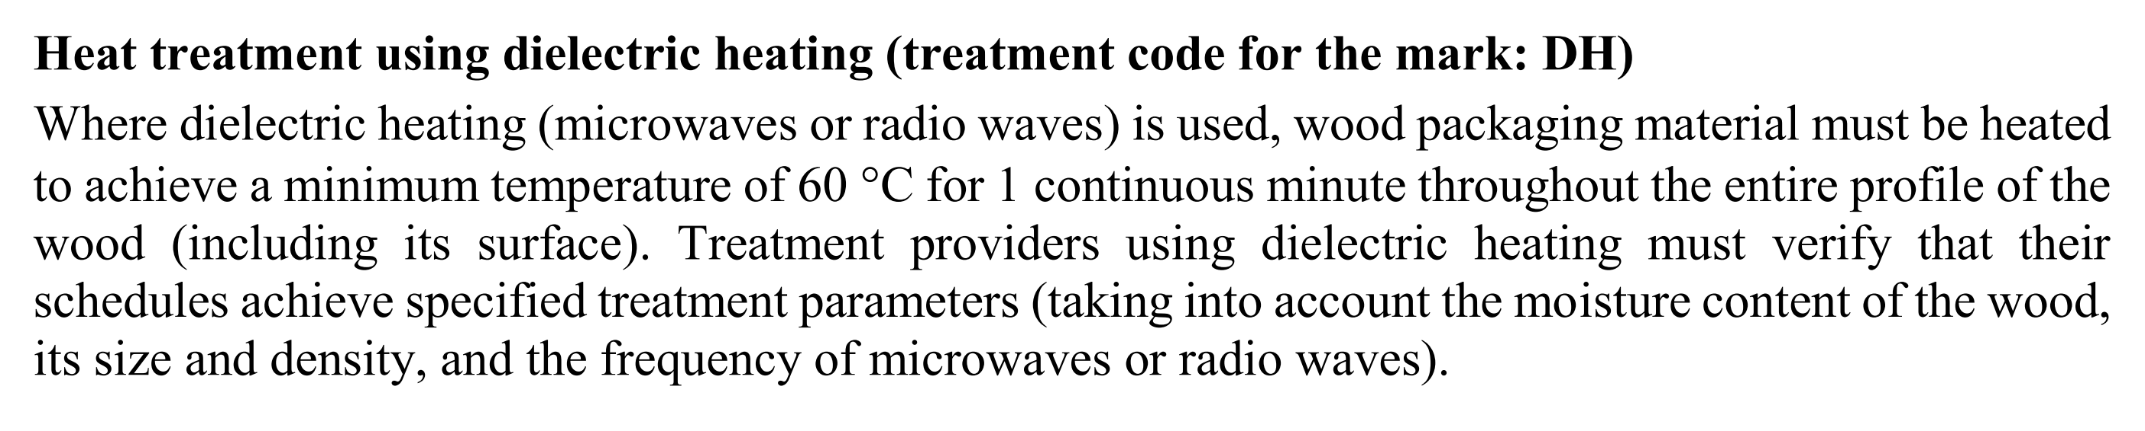
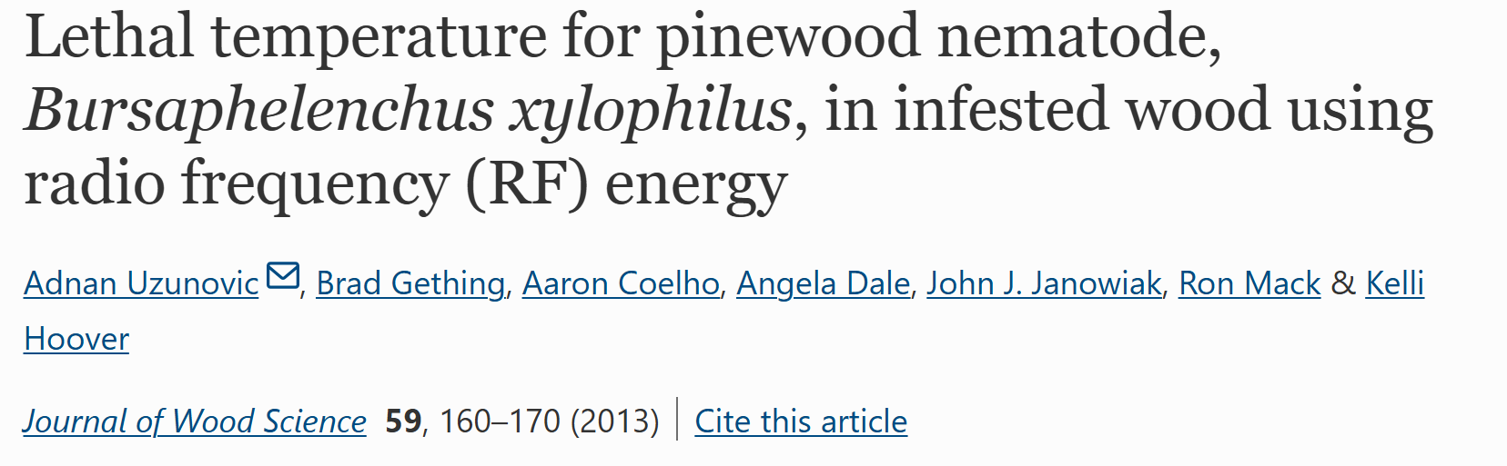
My Background
Notes:
Currently Vice President of Science & Technology for the National Wooden Pallet and Container Association
In grad school I was part of the research team whose research led to the dielectric HT schedule in ISPM 15. I’m a material scientist by training, not a biologist/etymologist, mycologist. It’s not my expertise. My specialty is in the treatment.

Slide 3
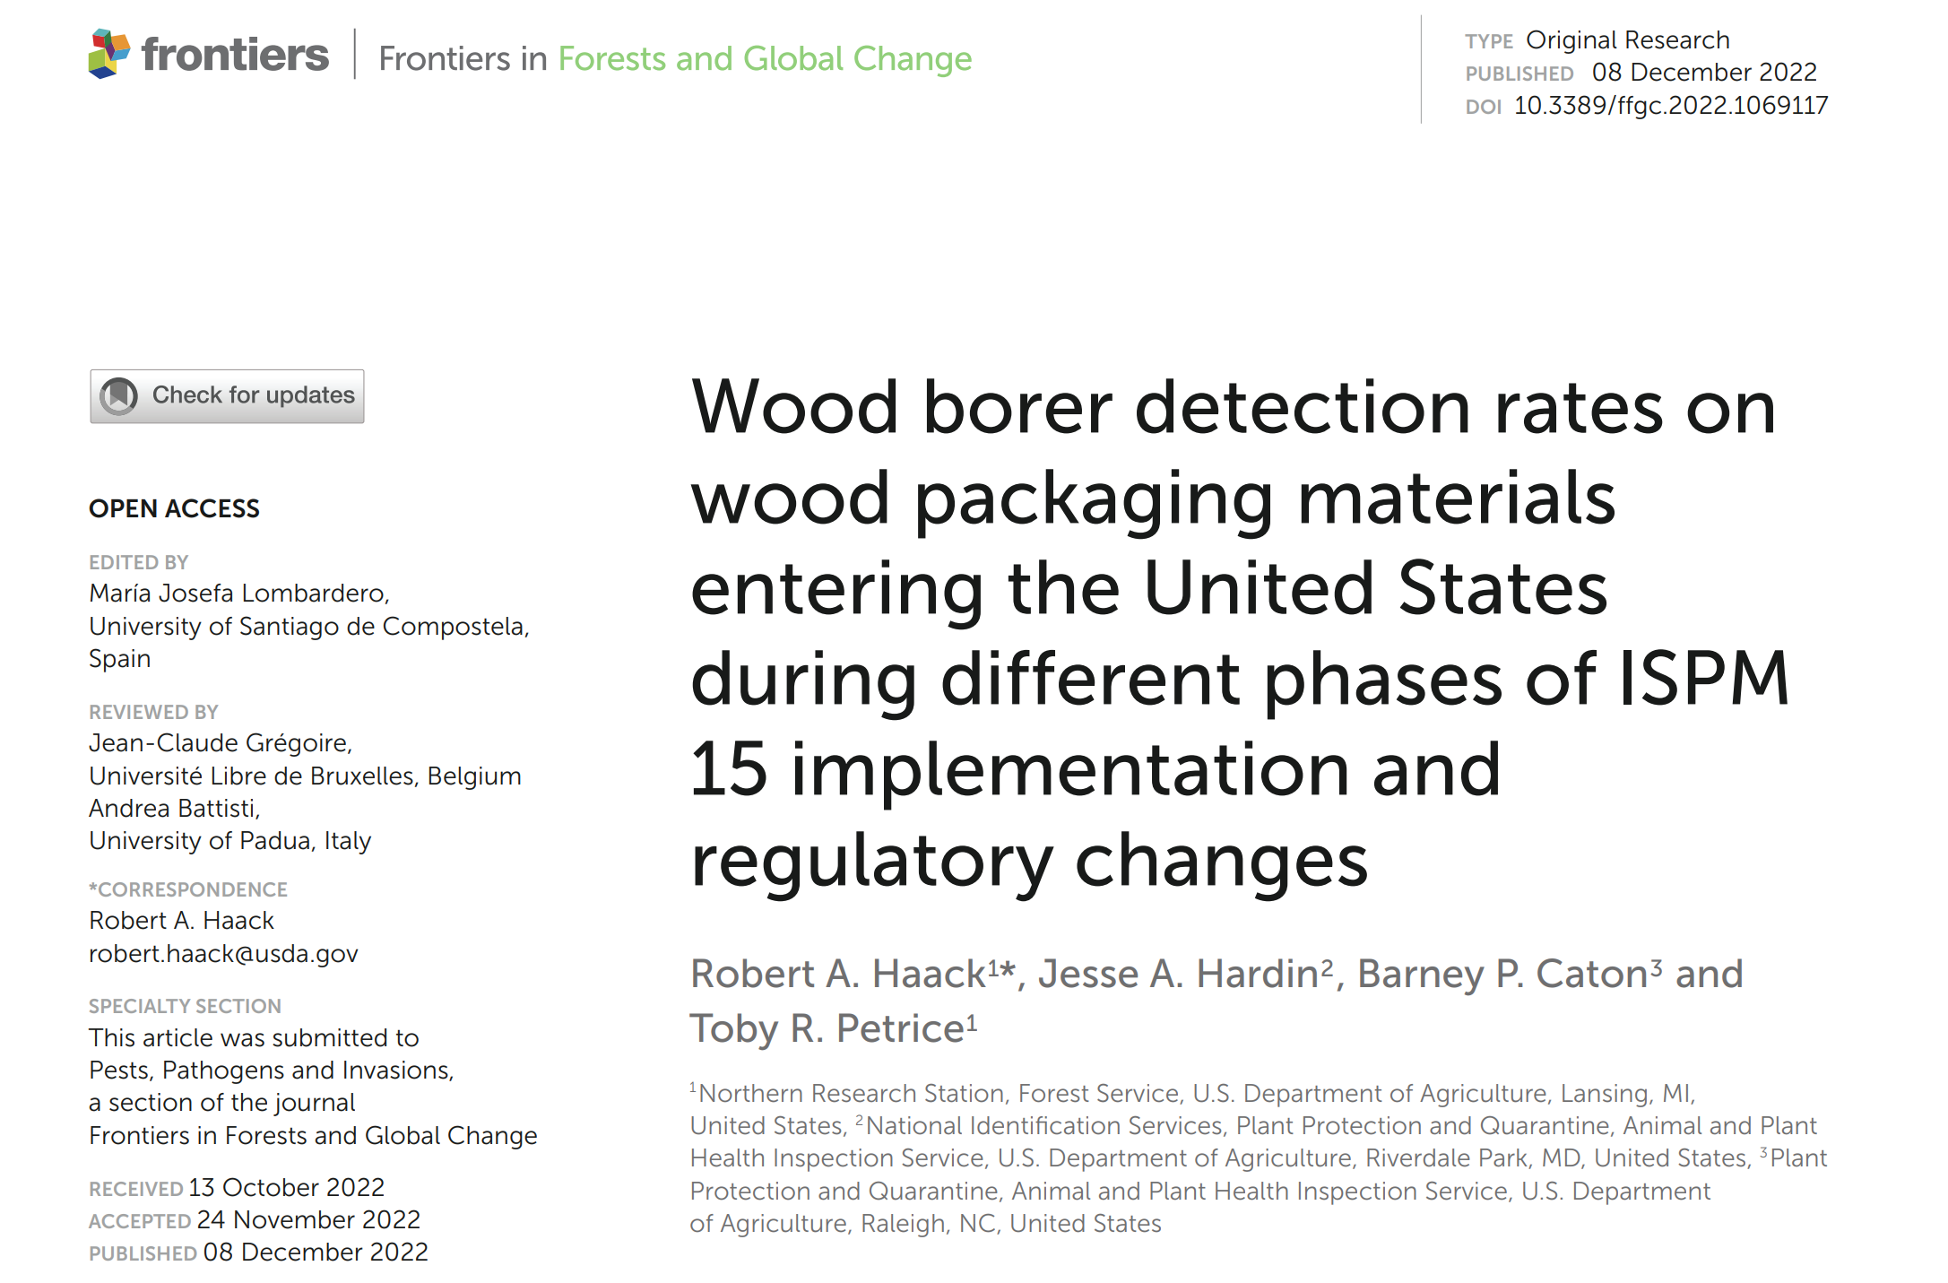
Notes:
Successful mitigation of invasive wood-boring pests from ISPM 15 implementation, but there are still some pests arriving on wood packaging. Continuous improvement will further reduce risk. The industry is proud of progress made, but more is attainable.
One area of question is the efficacy of the treatment schedule. Further confirmation would eliminate the question and allow for focus in other areas.

Slide 4

Determining Efficacy
Plant protection guidelines require scientific data
Quantification of species-specific lethal time-temperature regimes
Challenges with studies to date:
    Wood characteristics: Dimension, moisture, density
    Accuracy: Application, measurement
Notes:
When focusing on treatment schedule efficacy, there are several considerations.

Slide 5
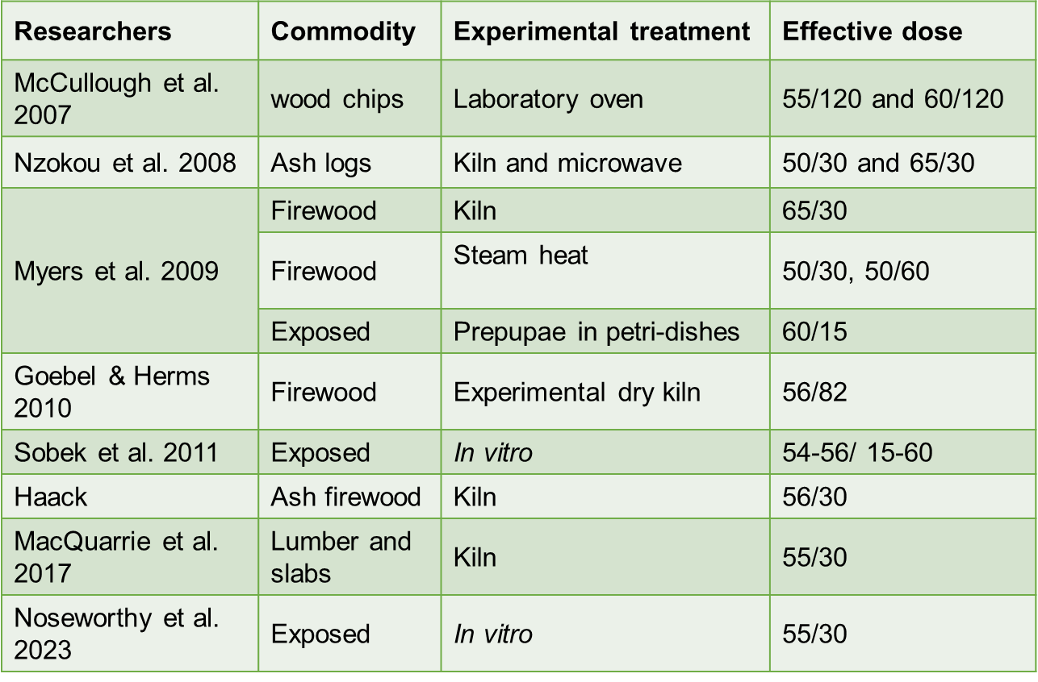
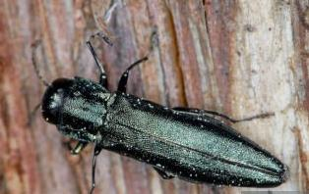

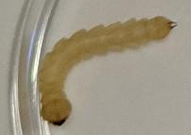
Range of results - Lack of harmony in heat treatment used globally
T. Klejdysz
Notes:
Summary of baseline studies performed on EAB.

Slide 6
T. Klejdysz

Slide 7
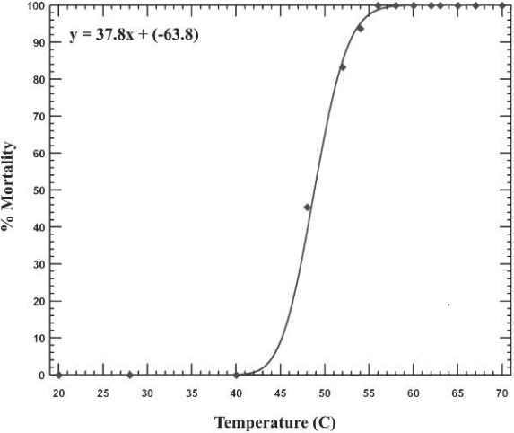

Advancement
Recommendation to use controlled in vitro experiment:
    Target minimum lethal dose
    Test wide range of pests from different climates
    Provide confidence in heat treatment
Dose delivery considerations – kiln schedules
Notes:
5 & 6. This range of parameters which are difficult to control can lead to variability in the results and thus a lack of agreement and harmony in the use of heat treatment used globally.
7. In order to remove some of these variables and still determine the parameters necessary to address pest risk in wood products an in vitro application was recommended where
8. Removing variables that are difficult to control is possible by applying heat in an in vitro setting – simply put this means applying heat to pests isolated from their usual biological surroundings so that we can apply and measure the effect of heat and determine
the minimum dose which is the minimum temperature and minimum time to kill pests.
It is possible test a wide variety of pests and specific life stages from a variety of environmental conditions
This method allows us to test a large number of pests with good replication and gives us confidence in the results
9. The information gathered from determining the specific lethal dose using in vitro testing needs to be paired with delivery specifications which simply put means showing that a kiln schedule effectively applies heat in such a way that it reaches the core and is delivered throughout the profile of a wood product
Figure: Graph on the right is the dose response of pinewood nematode to heat which formed the basis of treating wood packaging material to 56 degrees Celcius for 30 minutes and formed the basis for ISPM 15

Slide 8
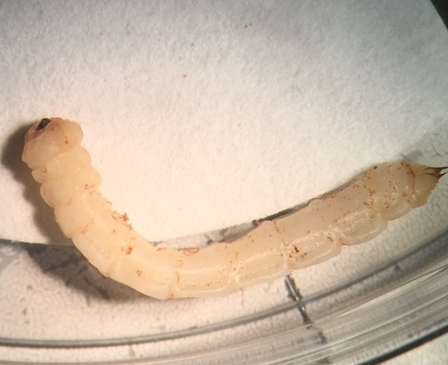
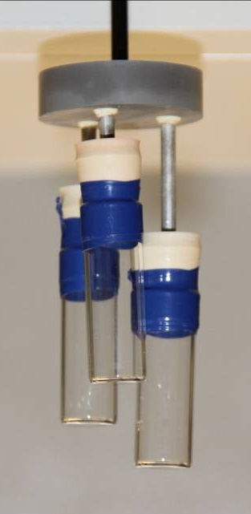
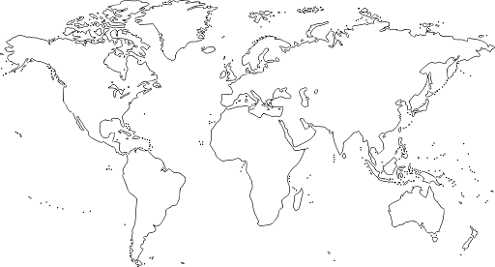




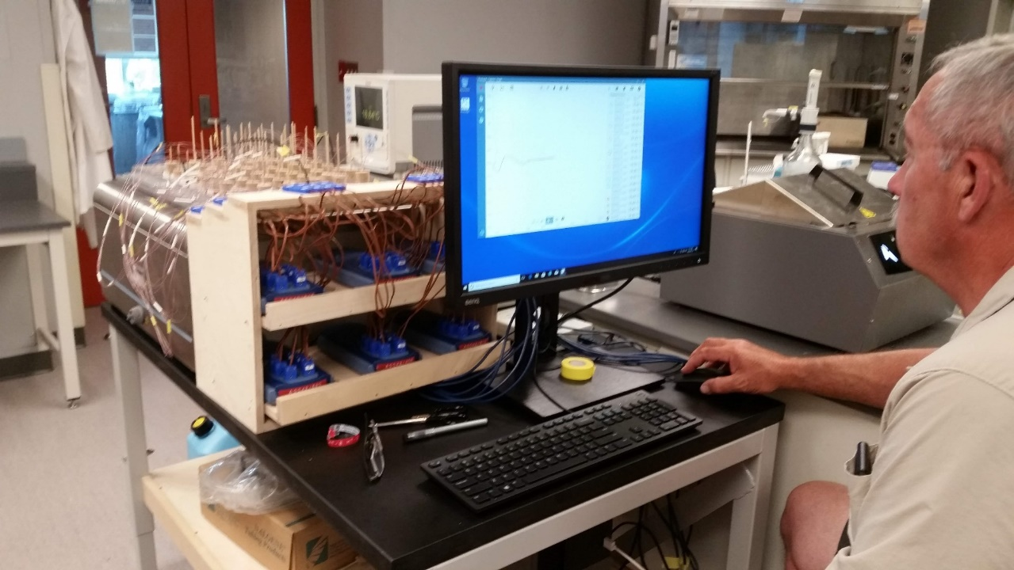
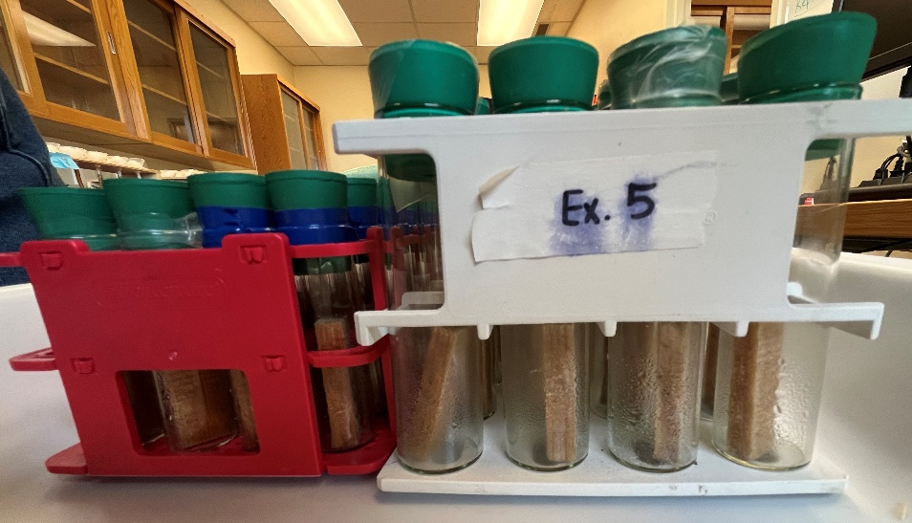
Heat treatment water bath
in vitro and in wood testing
Highly controlled heat application
High resolution and accuracy
In vitro and in vivo (in wood)
Ring study – test organisms in their native range
Notes:
This is the water bath pictured on the bottom right-hand photo with the designer of the bath, the late Lee Humble calibrating with thermocouples in every treatment position.
Using the heat treatment water bath we can
1. Control the heat application with precision
2. Measure and record the temperature applied with high resolution and accuracy at a rate in keeping with commercial kilns without exceeding the target temperature
3. In addition to testing pests in vitro we can test organisms in wood blocks such as fungi and nematodes
- Assemblies of test subjects in vials can be removed individually or in groups to look at different durations of heat application and target the lethal dose (top right is photo of test vials with varying depths to promote water and heat circulation consistency of heat application.
4. And by creating a ring study with water baths located in different areas of North America forestry pests can be tested in their native range to avoid unnecessary movement certification and quarantine laboratory conditions which reduces risk as well

Slide 9



Testing the heat treatment dose for wood product pests in North America
Water bath ring study– Expert group
Grupo de expertos
Meghan Noseworthy (NRCan)
Eric Zarrazin (CFIA/ ACIA)
Chuck Dentelbeck (CLSAB)
Adnan Uzunovic (Can Wood)
Eric Allen (retired/ jubilado)
Canada
Tyrone Jones (USDA - APHIS)
Baode Wang (USDA - APHIS)
Brad Gething (NWPCA)
USA
Ramón Martín Barrera Mendoza (SEMARNAT)
Nadia Denisse Rodríguez Velázquez(SEMARNAT)
Mexico
Notes:
This is the expert workgroup. We’re very happy to have all three countries represented because of the importance of having multiple locations and tests for the ring study.

Slide 10
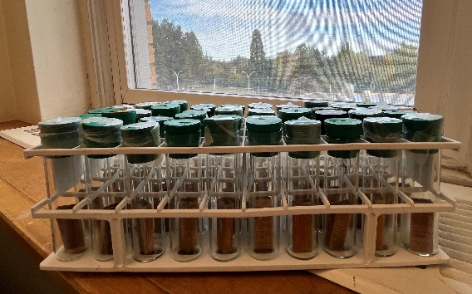

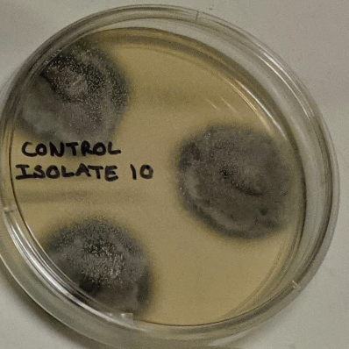
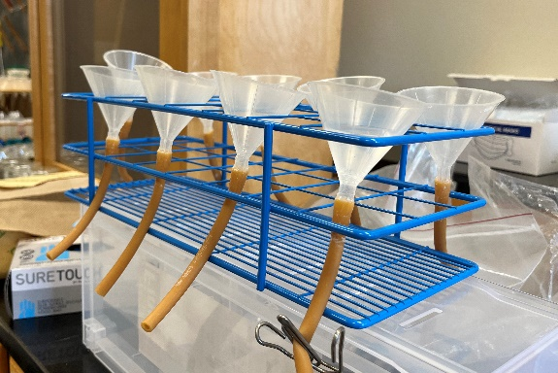
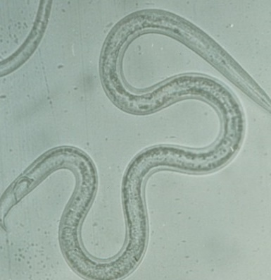
Pending Deliverables
SOP Development – organized into modules
Testing protocols and data collection – in the SOPs
Methods for analysis and reporting – development of data collection sheets
Prioritized list of organisms to test in the water bath – ongoing discussion and outreach to other NPPOs
Describe confirmatory testing - planning phase (considering fungal isolates)
Document methodology, analyses, results - NAPPO S&T Document

Slide 11
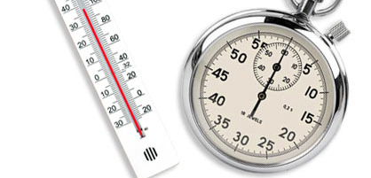
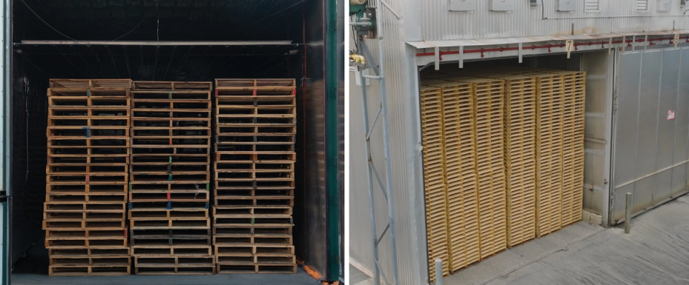
Dose vs Delivery
Notes:
Speaking from my own perspective – I anticipate the tests to confirm the efficacy of 56C for 30 minutes. If that is the case, where will go from there?
Will look to better understand treatment delivery and where failure may be occurring.

Slide 12

Leland Humble
Mina Raposo (Canadian Forest Service)
Sébastien Bélanger (Canadian Forest Service)
Christian Hébert (Canadian Forest Service)
Megan Gray (Canadian Foest Service)
David Furlonger (Canadian Forest Service)
Gwylim Blackburn (Canadian Forest Service)
Adnan Uzunovic (Canada Wood)
Natural Resources Canada
Canadian Food Inspection Agency
North American Plant Protection Organization
International Forestry Quarantine Research Group
Thanks & Acknowledgements

