Slide 1
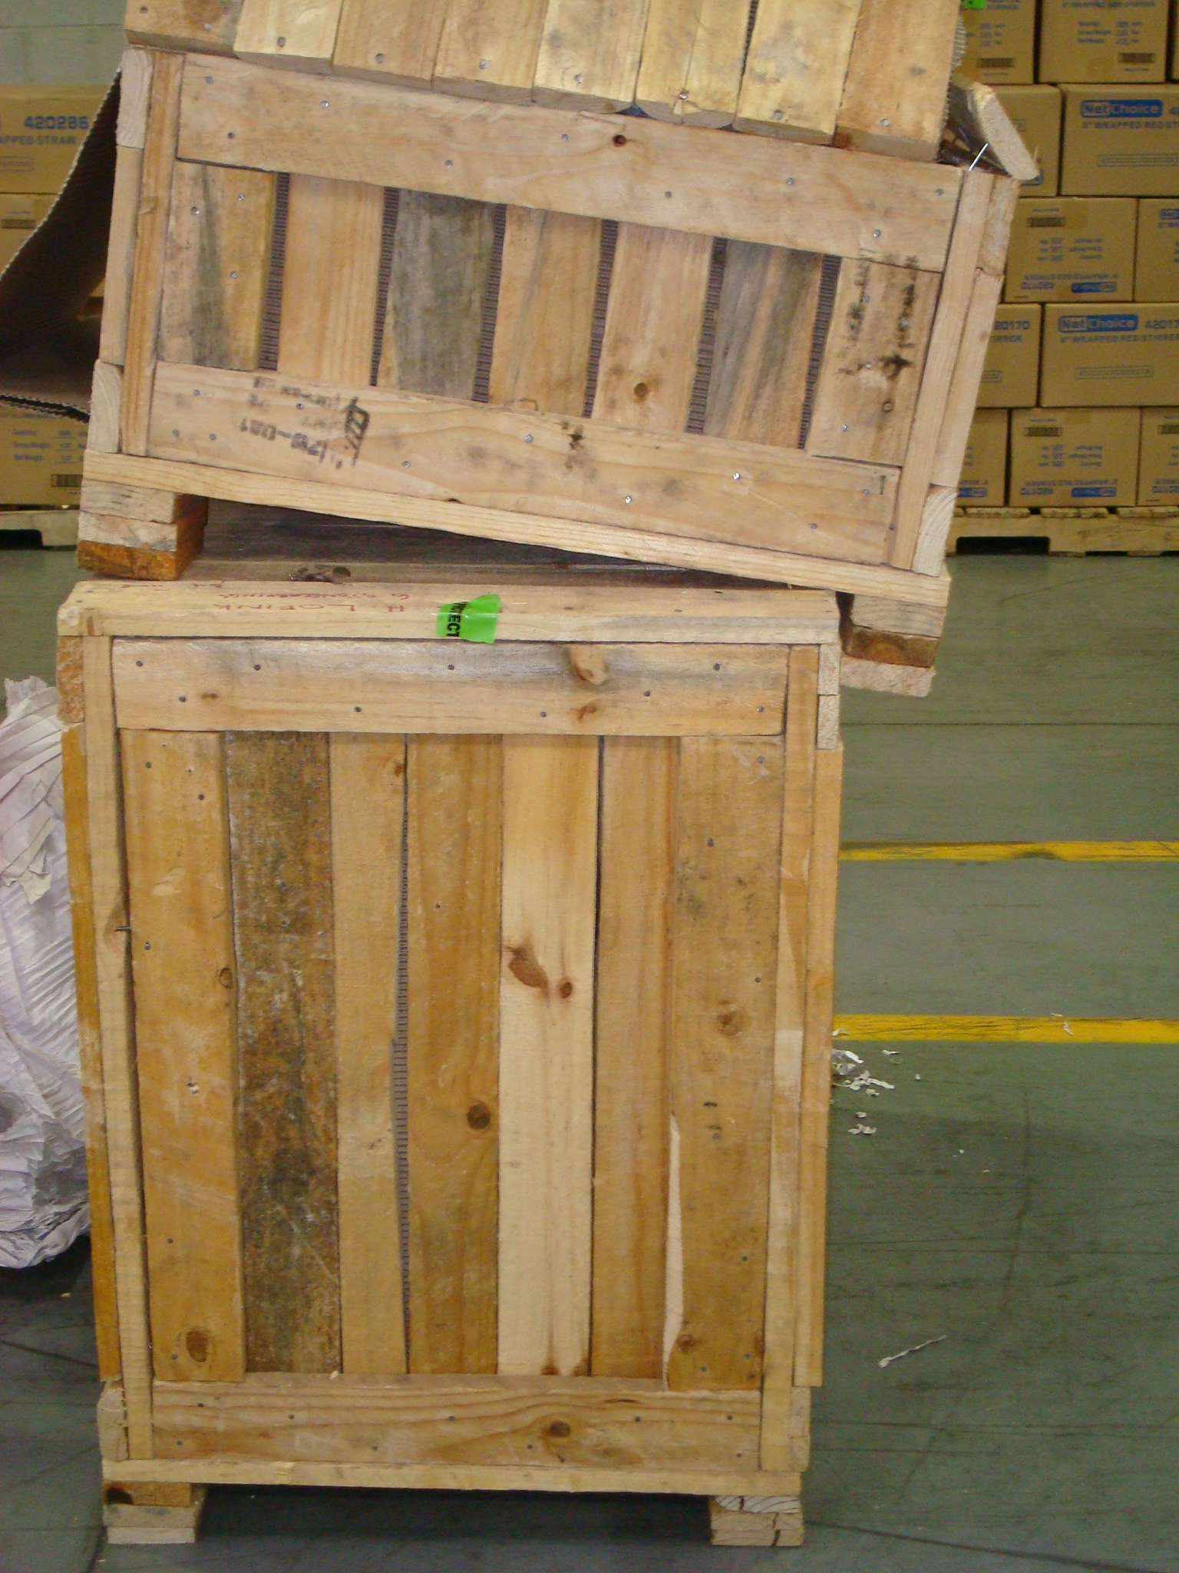
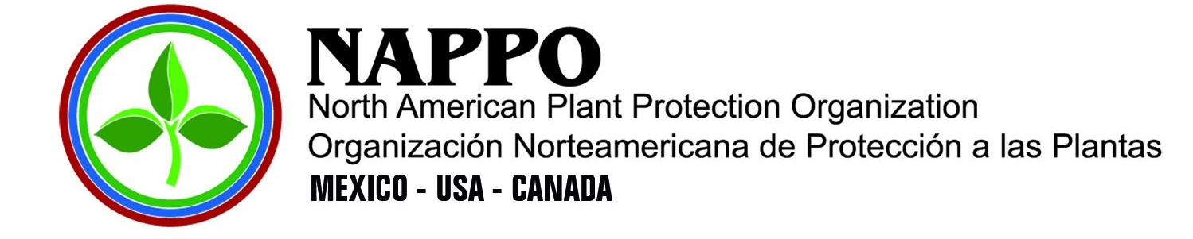
Focused ISPM 15 Compliance Improvements
Risk by Wood Packaging Material Categories
Notes:
Two possible title slides

Slide 2
f
2025 NAPPO Forestry Expert Group Members
Meghan Noseworthy (NR CA)
Arvind Vasudevan (CFIA)
Chuck Dentelbeck(Industry)
Eric Allen (CFS retired)
Canada
Tyrone Jones (APHIS)
Jon Daniels (APHIS)
Brad Gething (Industry)
Leigh Greenwood (Industry)
USA
Maria Jose Martinez (Industry)
Samuel Podlipsky (Industry)
Mexico

Slide 3
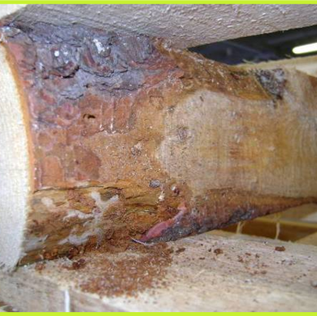
Evaluation Significance
Identify specific problematic WPM categories in which resources can be focused to maximize ISPM 15 compliance.
Notes:
Try to determine if specific types of WPM are causing the greatest risk concern. Dunnage , spools, etc

Slide 4
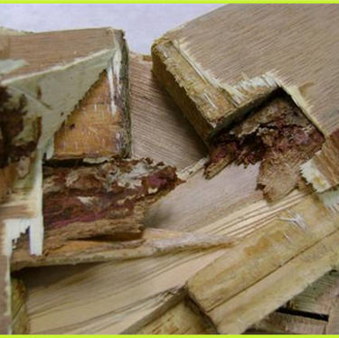
Purpose:
Evaluate the challenges associated with different categories of WPM

Slide 5
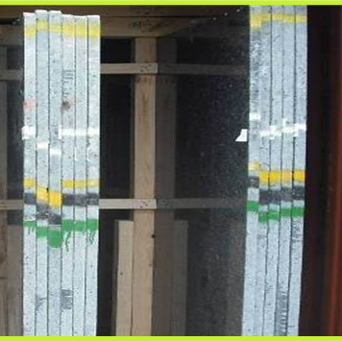
Procedure
REVIEW
Literature
Data
WPM categories
Production process
Extrapolate attributes that increase risk

Slide 6
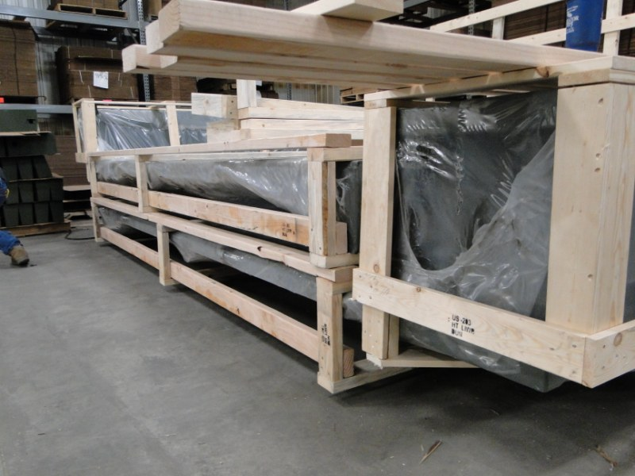
Wood Packaging Production in North America
Harmonization of WPM categories within NAPPO
Develop a description of production processes for each type of WPM in North America.
Describe the production processes point-by-point, in the three countries, for summary into an information table.
Consider comparison inclusion of other countries.
Notes:
WPM is not always as simple as we think. The US and Canada have harmonized the WPM names and descriptions. Currently Mexico is harmonizing the terminology and reviewing whether the current terms translate properly.
For example, the steps for pallets may include obtaining certified materials, building pallets, applying the IPPC HT mark, and ensuring documentation is in place. This was a best-case scenario example, and the group acknowledged that it would be more challenging to include lesser-known processes for other types of WPM.
Production process – sizing, treatment,

Slide 7
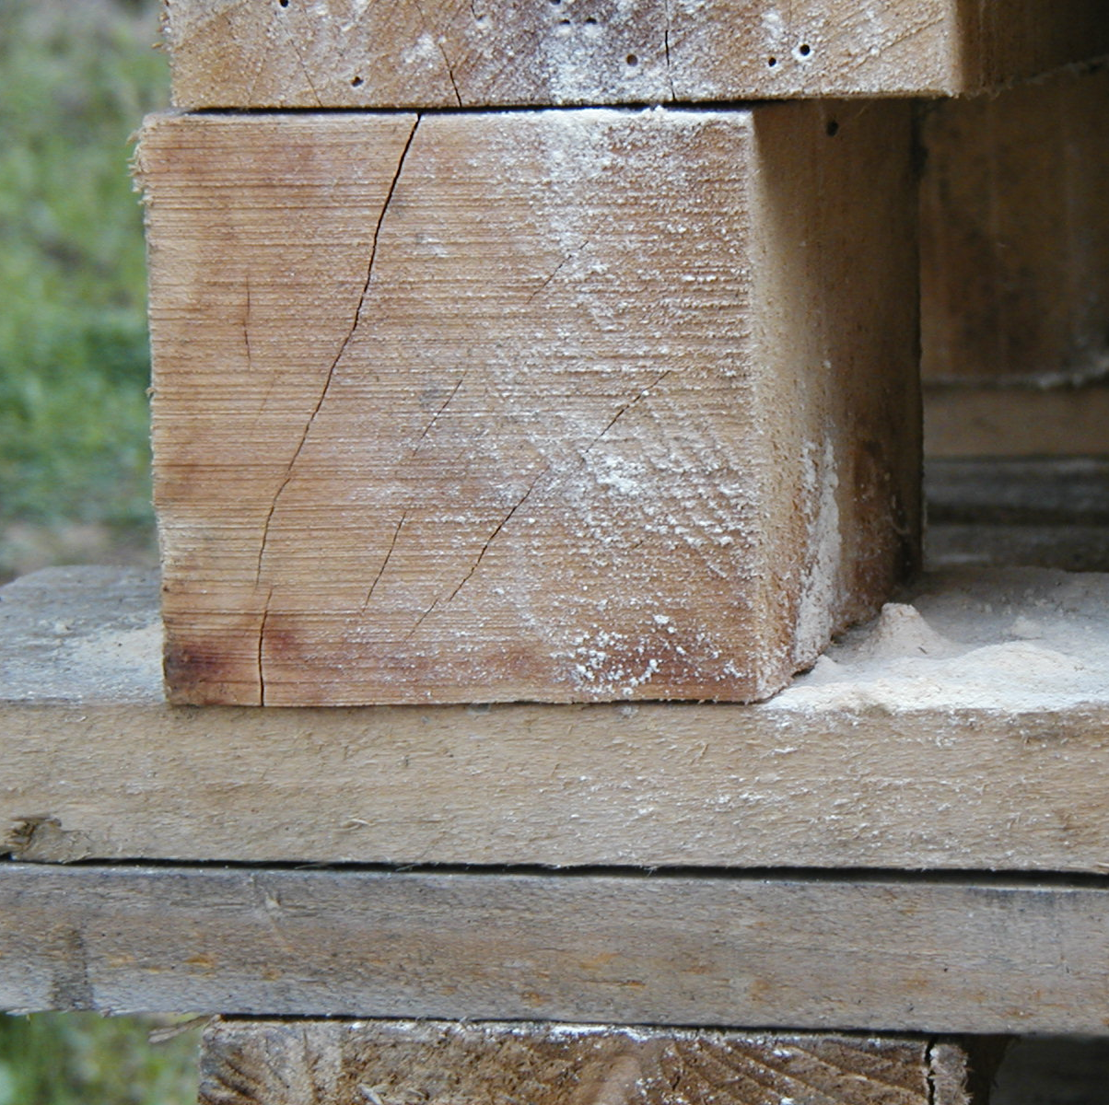
Biological Risk
Preparing a logical and scientific risk assessment of various types of WPM
Notes:
Literature and data are being used here.

Slide 8
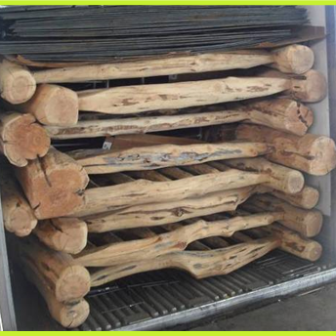
Conclusions
RECOMMENDATIONS:
NPPO harmonization of WPM categories.
Treatment and process improvements based on the type of WPM
Need for data collection improvements to benefit future reporting.
Notes:
We are striving toward … possible inclusion in ISPM 5 the ability to have all regulators discussing the same product when communicating. Examples boxes vs crates and bulk dunnage vs break bulk dunnage vs bulk (some areas it means containers and bulk shipments)
Based on size, density, moisture, etc. some products may need more time adequate treatment.
More data points would greatly increase the ability to evaluate the WPM. Category of WPM, size, etc.

Slide 9
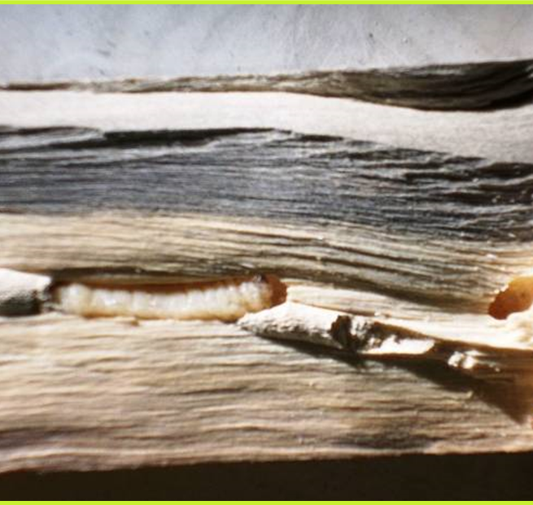
Next Steps
Finalize the names for the various types of WPM in terms that translate
Provide production specifications for WPM produced
Provide a risk-based document referencing each catagory of WPM

Slide 10
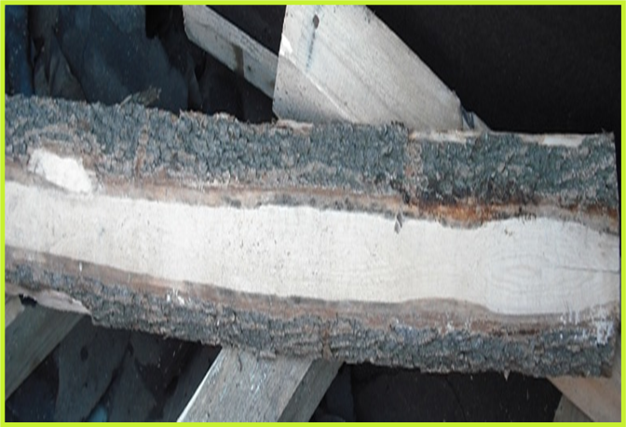
Thanks and Acknowledgements
The expert working group
NAPPO Secretariat
Nedelka Marin-Martinez
Alonso Suazo

