Slide 1
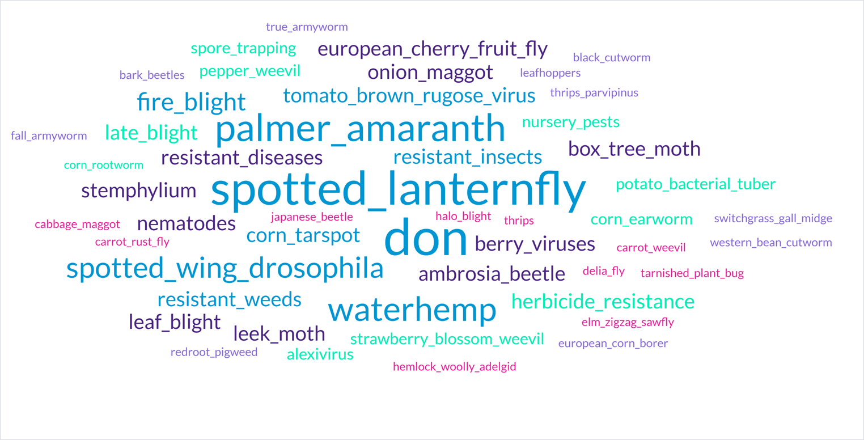
Agricultural Plant Health in Ontario
Ontario Ministry of Agriculture, Food & Agribusiness
Hannah Fraser
Agriculture Development Branch
48th NAPPO Annual Meeting
Ottawa, Ontario, Canada
October 21, 2025

Slide 2
Today’s presentation
Overview of plant agriculture in Ontario
  economics at a glance
  unique aspects
Plant health risk factors to the sector
  crop diversity, geography, climate, trade
OMAFA’s role in plant protection
  monitoring and best practices
  preparedness and emergency management
  collaboration in practice and across borders
Notes:
Plant health is a broad term. To provide some context and scope for this presentation, when discussing plant health risks to the sector, the focus involves primarily dealing with invasive pest species.
Background for reviewers: NAPPO plays a critical role in coordinating the efforts among Canada, the United States, and Mexico to protect their plant resources from the introduction and spread of regulated pests, while facilitating safe intra- and inter-regional trade. For this reason, I will not be detailed examples / discussion on topics such as resistance; climate change / extreme weather conditions impact on crops and pests, and how it could impact pest management (though it is relevant for changing geographic ranges and impact on establishment); management of endemic pests.

Slide 3

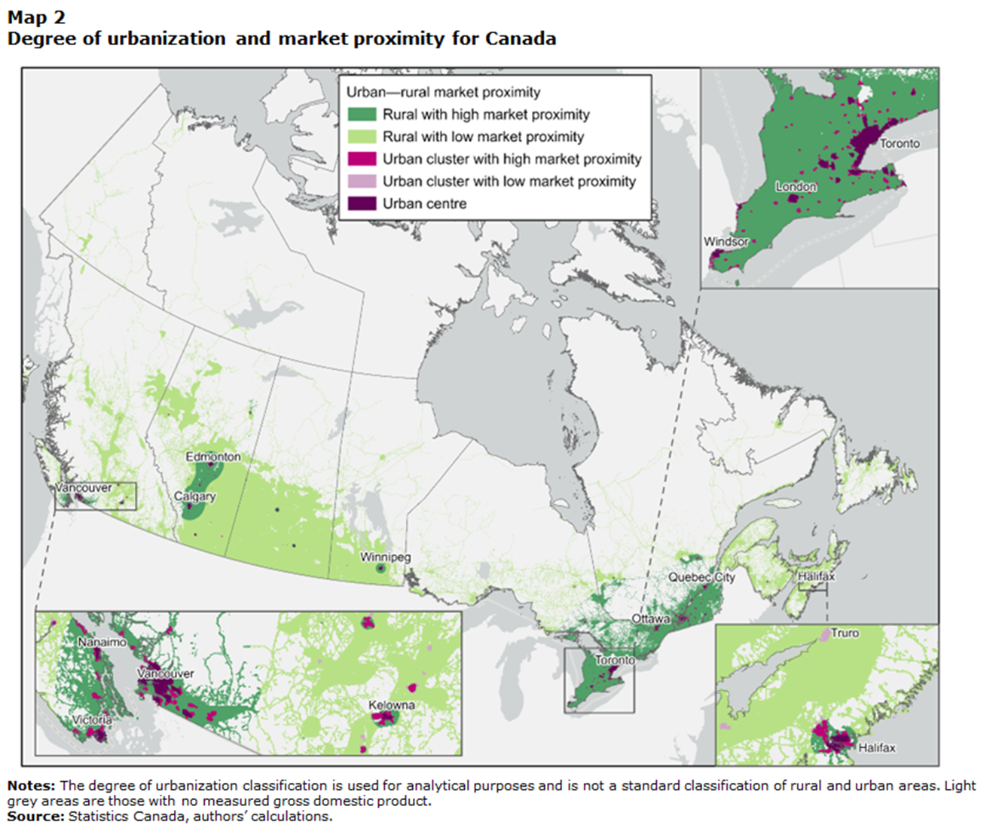
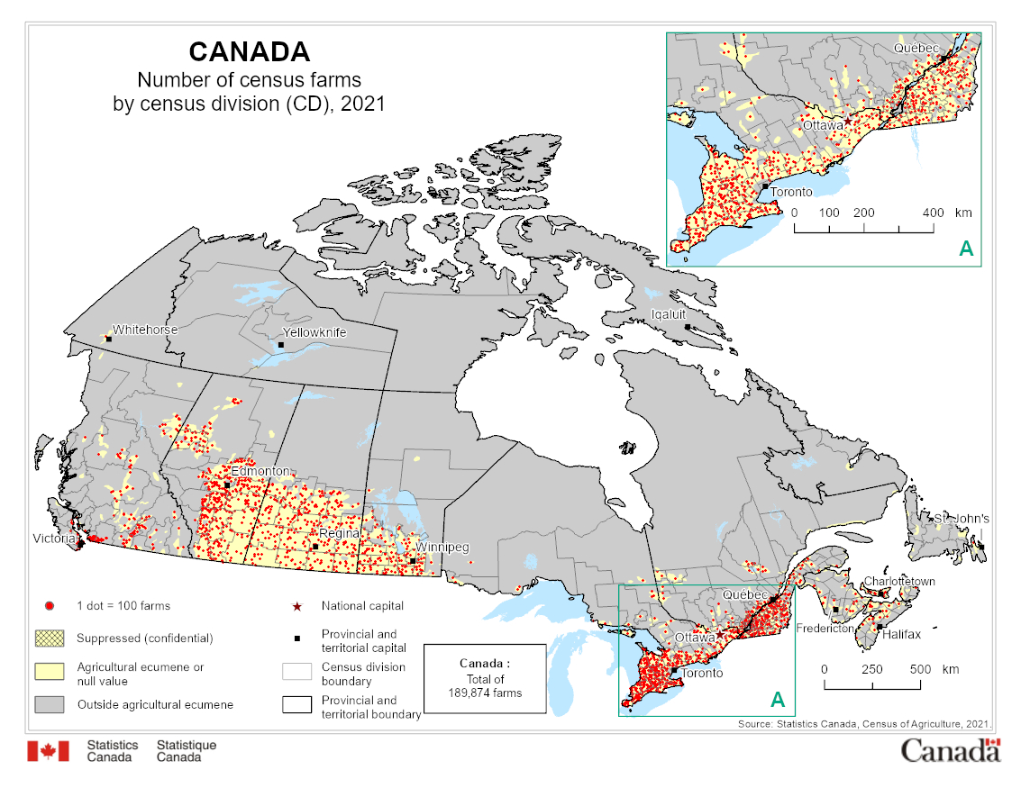

Canada: Where we live, Where we grow
Notes:
Canada covers a large geographic area and has several climatic regions defined by distinct weather patterns and with different opportunities for plant agriculture. Major agricultural areas include the Prairies, Southern Ontario and parts of Quebec, and Southern British Columbia. The majority of people live in more southerly regions close to the Canada-US border in large urban centers, evident on the map on the left by areas marked in purple.
Southern Ontario not only has a high potential for plant agriculture, but is home to most of our larger urban centres and connected rural communities. Over twenty-five percent of Canada’s population live in the Golden Horseshoe in Ontario, which includes the Greater Toronto Area (GTA) and extends to cities clustered along the western side of Lake Ontario.
Horticulture production – which is my area of focus as provincial entomologist - around these centers is a vital part of Ontario’s agri-food economy, especially with increasing demand for local fresh produce in cities, and ready access to transportation servicing both domestic and export markets.

Slide 4
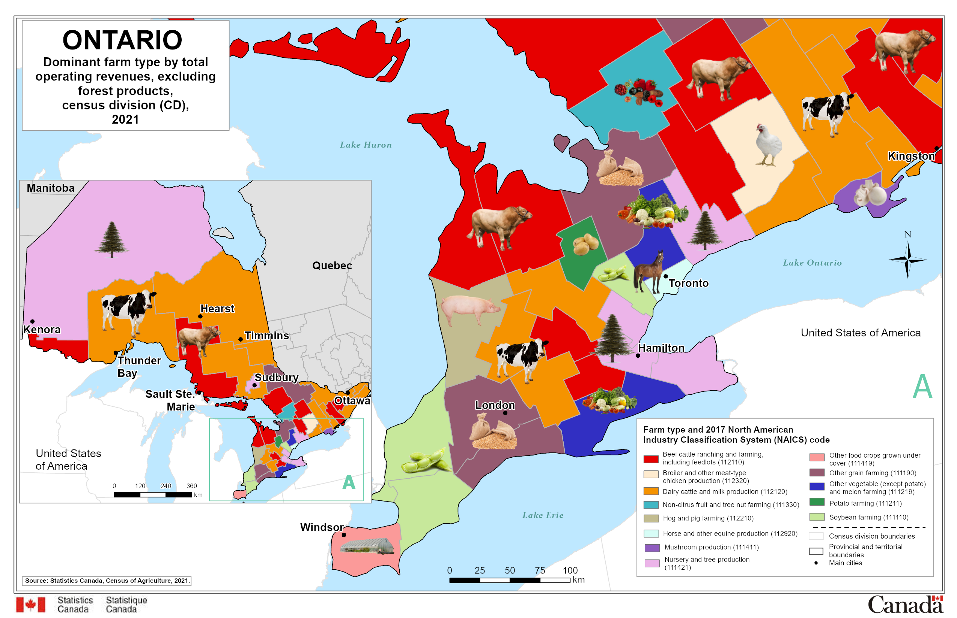
Ontario’s agriculture is rooted in diversity
Notes:
The agri-food sector in Ontario is comprised of primary agriculture, processing / manufacturing, wholesale, and retail & food services, which contribute to the provincial economy. Total GDP is estimated at over $50.7 billion, or about 5.9%. We have approximately $26.2 billion in exports
Agriculture production in Ontario can be characterized by its diversity. We produce about 200 crops and have a significant livestock industry. Sixty percent of farm are small, family operations. About 1 in 9 Ontario jobs are linked to the sector.
From a plant agriculture standpoint, some notable industries include the greenhouse vegetable sector in southwest Ontario (vegetables), the GH floriculture and nursery sectors in Niagara, vegetable production in Norfolk County and the Holland Marsh, known for its rich muck soils. This area in southwestern Ontario (point to it) is home to the largest concentration of GH in North America. Most grains and oilseeds are also located in SW Ontario.

Slide 5
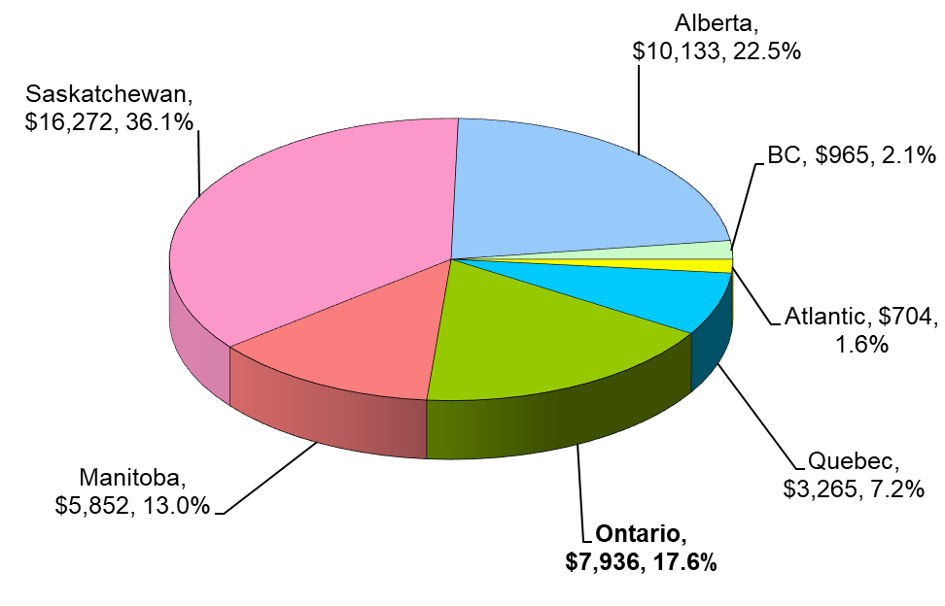
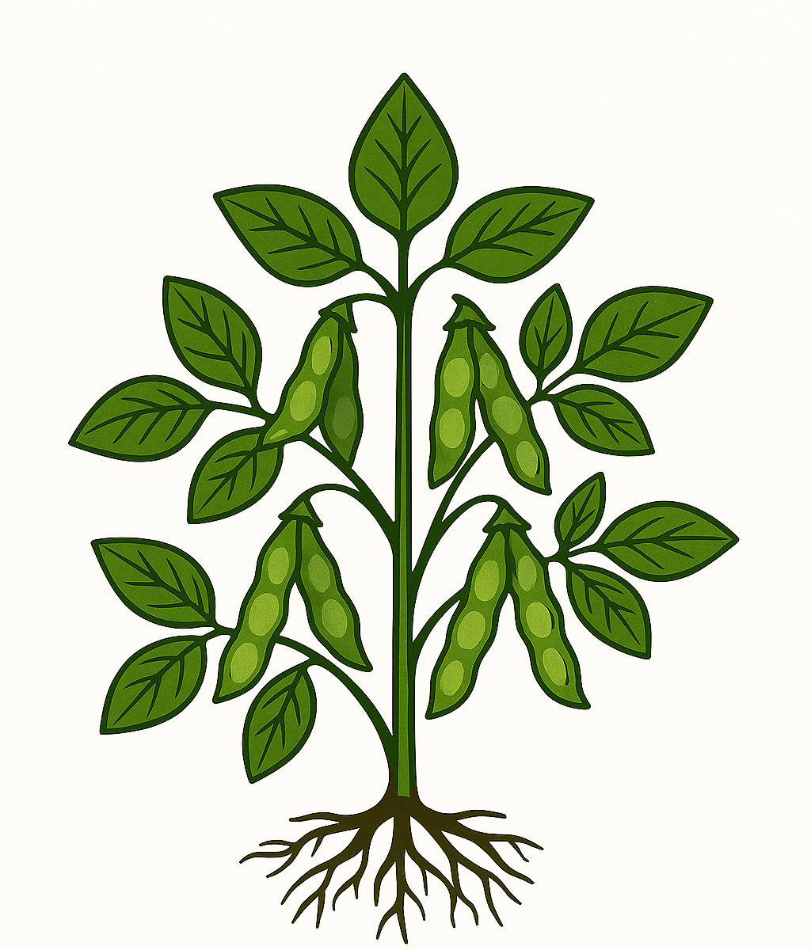
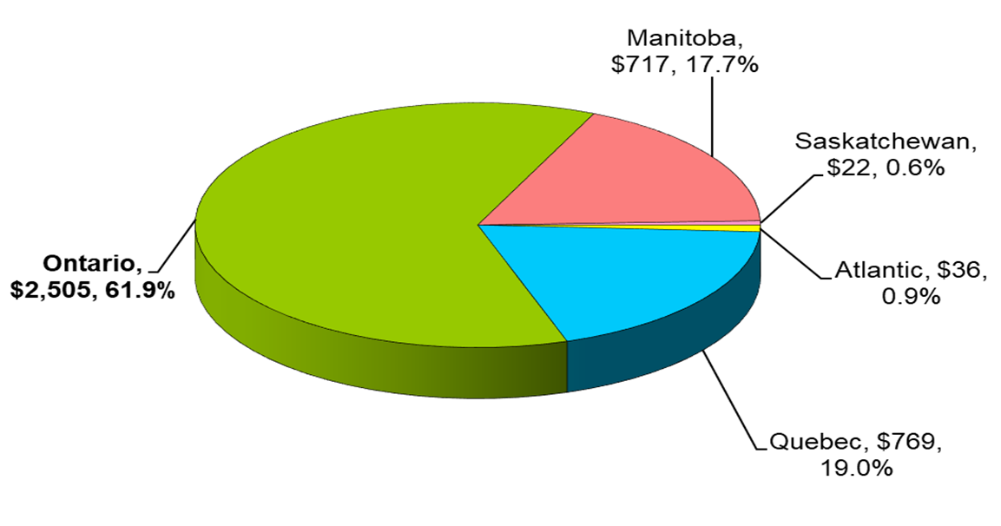
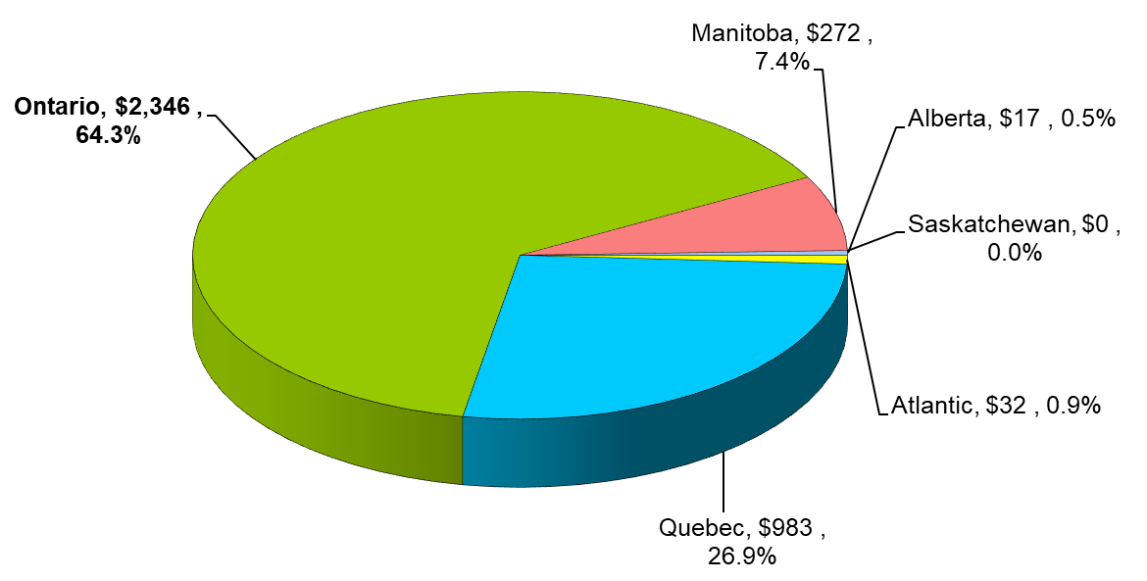
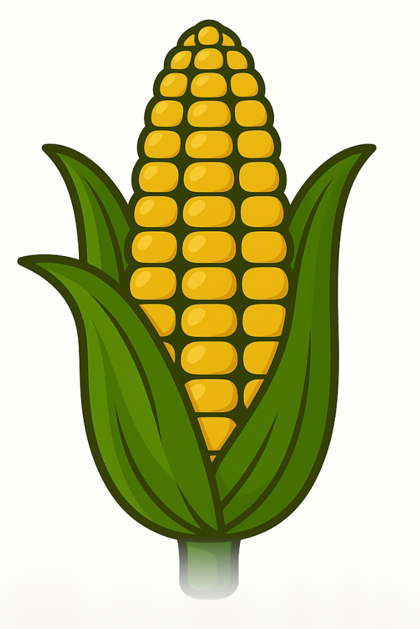
Ontario Field Crop Sector
3rd largest producer of field crops with 17% of total national field crop farm cash receipts (2024)
  $7.2 billion FCR
  32% of Ontario’s total agricultural FCR
63% of Canada’s soybeans and 64% of its grain corn (2024)
  $5.15 billion
  84% of total grain / oilseed FCR in Canada
Net exporter of soybeans and wheat
Most production occurs in southwestern Ontario, bordered by Great Lakes region
Significant efforts for cross-border monitoring networks of key pest species
Notes:
In Canada, agricultural crops are generally categorized as major or minor based on their economic value, acreage, and production volume. If we look at some of the major crops, such as cereals like wheat and oilseeds like canola and pulses like lentils, production is highest in the Prairie provinces (AB, SK, MN).
However, Ontario is Canada’s 3rd largest producer of FC, with over $7B in farm cash receipts, representing about 1/3 of our total FCR. Much of this is from grains and oilseeds, especially soybeans and corn, where Ontario dominates nationally. It is estimated that almost $13 B in direct gross domestic product (GDP) can be attributed to the grains and oilseed industry value chain (farm, processing and retail) in 2024.
Soybeans have become the largest row crop by acreage in the province. The demand for specialty soybeans with identity preservation (e.g., food grade, non-GMO, organic, etc.) has created marketing opportunities for Ontario beyond the traditional end-use of soybeans for oil production and livestock feed. Soybeans are Ontario’s largest agricultural export commodity, though exports of wheat are significant. Most production occurs in SW ON, north of Lakes Ontario and Erie. There are significant efforts for cross—border monitoring of key pest species.

Slide 6
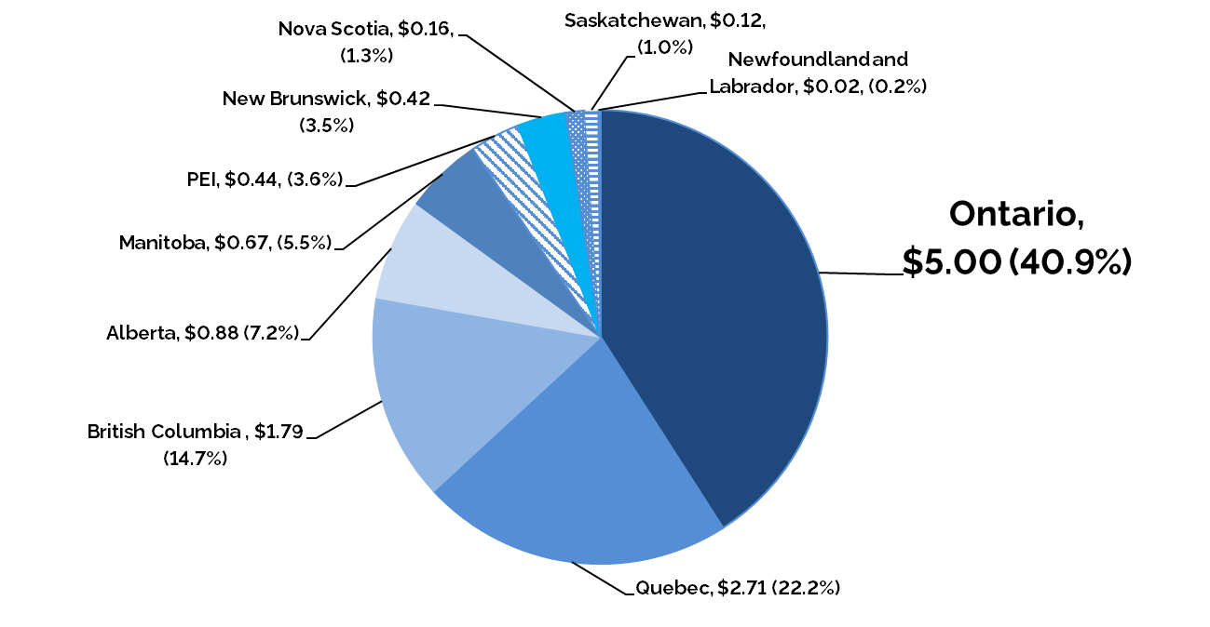
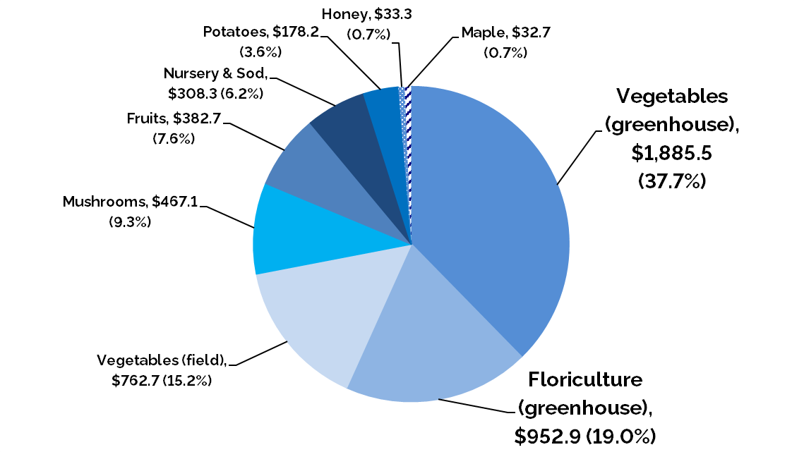
Ontario horticulture sector
Characterized by diversity:
  Up to 200 different crops
Largest in Canada (total FCR $12.2 billion)
  Ontario’s share $5 billion (2024)
Greenhouse industry accounts more than half of the total (vegetable, floriculture)
Canada’s top field vegetable crop producer, second largest fruit producer
Largest wine grape producer in Canada
  internationally recognized viticulture region
  $5.5 billion total economic impact (Wine Growers Ontario, 2019)
Largest producer of cultivated American ginseng in North America
Notes:
ON horticulture is rooted in diversity, with about 200 different crops being produced, and it represents the largest share from a Canadian perspective. Over $5billion in 2024.
Greenhouse vegetables and floriculture represent the largest share, but Ontario is also Canada’s top vegetable producer and second largest fruit producer.
With invasive species such as the spotted lanternfly – a significant plant health risk to grapevines – it’s worth mentioning that Ontario is the largest wine grape producer in Canada, with internationally recognized viticulture regions in the SW, Niagara, and Prince Edward County. Direct farm sales, wineries, tourism, employment, etc. mean the sector contributes over $5B to Ontario’s economy.
Ontario is also the largest producer of cultivate ginseng in North America.

Slide 7
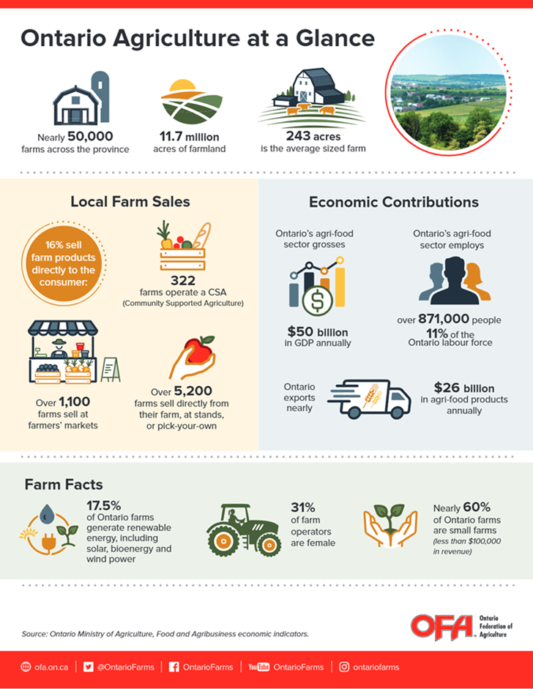
Importance of plant protection in Ontario
Economic stability and growth
  horticulture and field crops generate > $12 B in FCR (2024)
  significant spin-off values to local economies, jobs, processing, taxes, tourism, other
Safeguard food safety and security
Sustainable agro-ecosystems
  maintain healthy ecosystems, landscapes
  support sustainable integrated pest management programs and production systems
Maintain & expand markets
  domestic - export
One Health focus
Notes:
Agricultural plant protection in Ontario is tied to protecting what sustains us. Production is key to economic stability, in terms of both direct FCR and spin-off to local economies.
Plants form the base of the food chain. Threats to plant health, such as those from pests and diseases, can lead to significant crop losses, jeopardizing food availability. They can directly impact farm profitability and food prices.
Healthy plants support healthy ecosystems. Invasive pests, pathogens, and weeds can disrupt ecological balance, reduce biodiversity, and threaten food security. Invasives often disrupt established integrated pest management programs and production systems.
Efforts to prevent pest spread while ensuring fair and predictable trade systems support robust domestic and export markets. Effective plant protection ensures these crops meet quality and safety standards for export, preserving market reputation and competitiveness.
Plant health, plant biosecurity is seen as a pillar of One Health

Slide 8
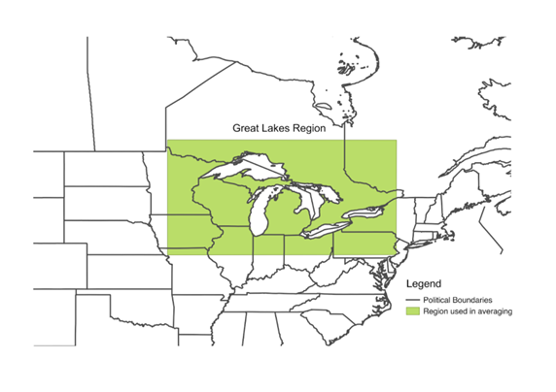
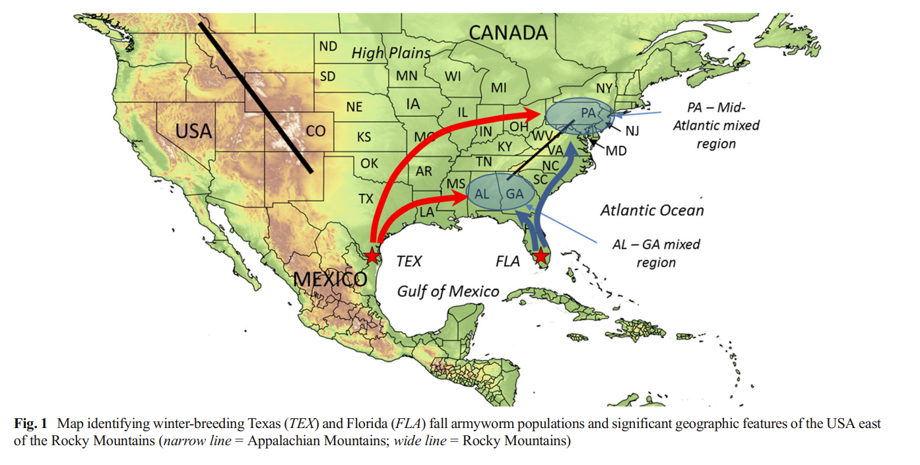
Risk Factors
Geography
  shared contiguous landmass with US (cross-border species movement), without physical barriers
  “land bridge” into / out of Ontario
Climate / Climate Change
  long growing season & frost-free period
  humid continental climate (hot summers), moderated in the Great Lakes region (milder winters)
  pest movement linked to extreme weather events
Diverse crops and ecosystems
  increased opportunity for establishment
Human activity
  international trade hub; transportation corridors; tourism
Fall Armyworm Migration
Westbrook et al., 2016: DOI 10.1007/s00484-015-1022-x
Notes:
Geography is a key risk factor for movement of key pests across borders, such as the interconnectedness of Ontario with the Great Lakes region. Ontario has been a land bridge for incoming / outgoing pests. In some cases, first North American detections have been in Ontario, in other cases we have received new pests form adjacent areas.
Ontario has a long growing season and frost free period, with hot summers and milder winters, moderated by the Great Lakes region. Pest movement from more southernly regions, especially those linked to extreme weather events, is a common occurrence. With Climate Change, it is anticipated that movement through migratory pathways and establishment success of introduced species will increase.
Diversity of agroecosystems and landscapes present in Ontario provide increased opportunity for establishment.
Ontario is also an international trade hub, with transportation corridors and tourism.

Slide 9

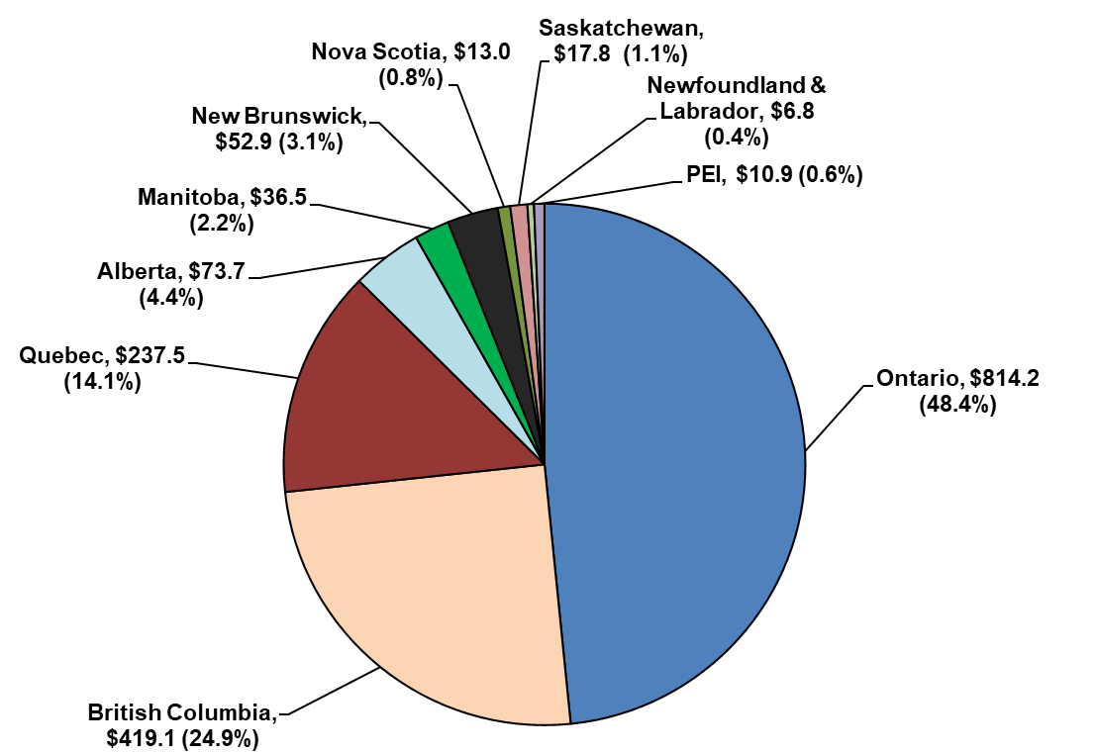
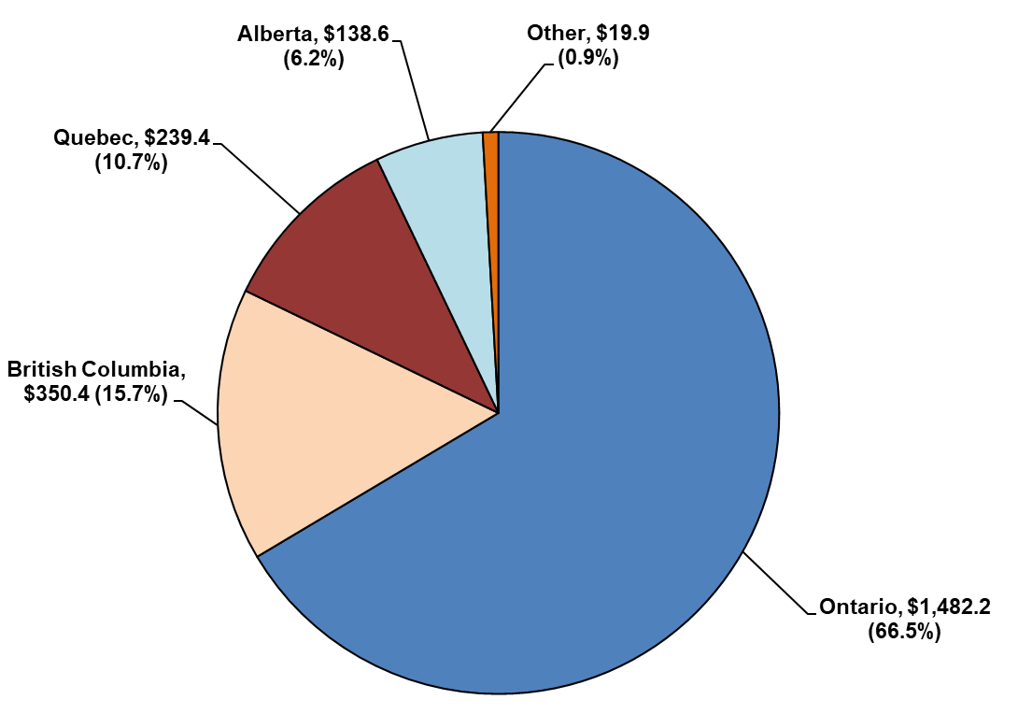



Case study: Ontario Greenhouse Sector
Farm Sales:
GH veg $1.7 B
GH flori $1.0 B
Well-established, regionally concentrated, and highly advanced operations:
  production is clustered near the U.S. border (export market)
  proximity to large consumer markets, transportation networks, and favourable growing conditions
Growth in GH strawberry; increasing interest in lettuce, micro-greens, other crops
Specialized operations:
GH veg / fruit 382
GH flori 515
Employed:
GH veg > 8000
GH flori > 6000
Farm Cash Receipts $millions (2022)
Notes:
PURPOSE OF SLIDE: Illustrate the importance of the GH sector in terms of plant agriculture, to set the stage for why plant health risks are economic threats> The GH sector is a good example to illustrate plant health risks
I mentioned previously that Ontario is home to the largest concentration of GH production in North America. The Leamington area “Greenhouse Capital of Canada” (READ including stats).
Characterized by high-tech, year-round production, diversification, and proximity to major markets (help it remain competitive). For floriculture, the strength is in potted plants, bedding plants, and propagation material, much of Canada’s grown in southern Ontario). There has been significant growth in production of new GH crops, including strawberries, lettuce, micro-greens and other crops.

Slide 10

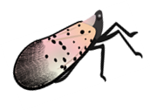


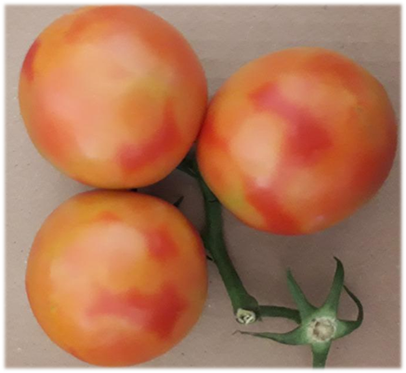
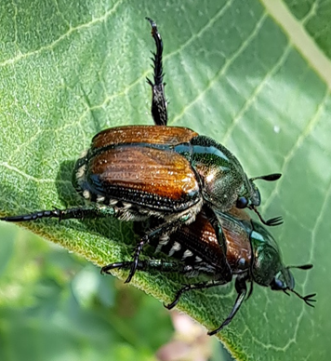
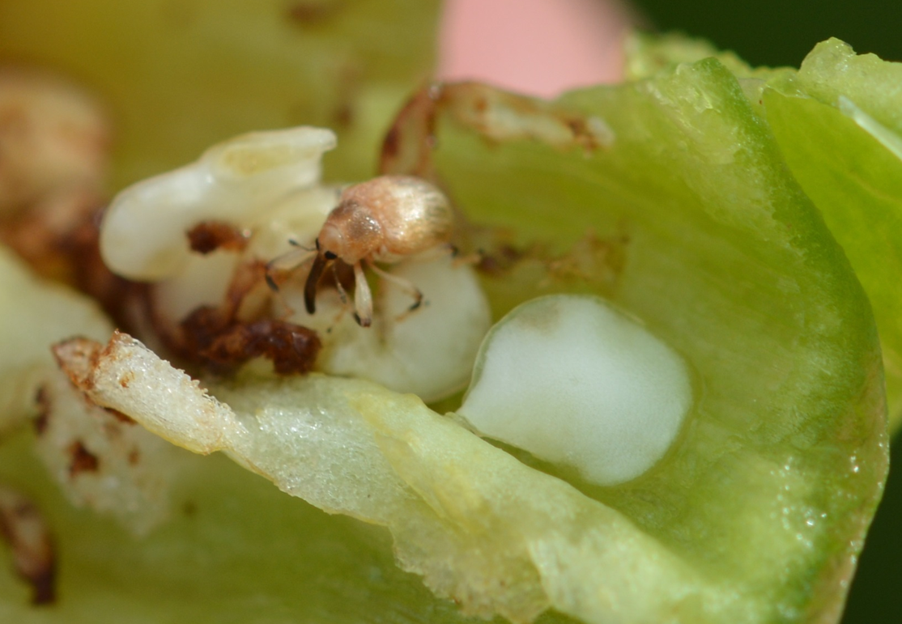
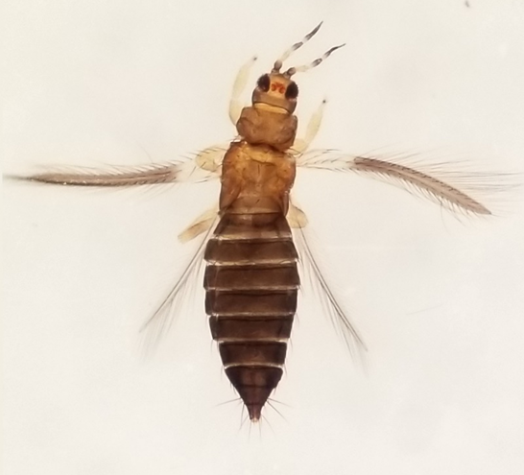
Challenges for the Greenhouse Sector
Maintaining Trade
and Biosecurity
Global supply chains
  propagative material, pesticide resistance
Stable environments / ideal growing conditions
High plant density / monocultures
Community pests
  regional concentration, urban neighbours
Access to chemical pesticides
Economic impact and sensitivity to market and trade disruption (regulated pests)
Many of these challenges occur across the plant agriculture sector
Notes:
Plant Health risks – both regulated and non-regulated pests - have affected both the GH and nursery sectors over the last 20 years or so. Biosecurity and maintaining trade are top of mind for the sector.
Global supply chains for propagative material bring potential plant health risks, including invasive species or biotypes and introduction of populations resistant to pesticides.
GH growing conditions are stable, crops are grown at high densities and monocultures, all of which provide ideal growing conditions or opportunities for survival of pests. Due to the regional concentration of GH, a pest situation in one GH can quickly become a community problem.
Although Ontario GH producers have embraced innovative crop protection strategies, including biological control as a foundation for pest management, Canadian producers often lack access to chemical pesticides found in other jurisdictions.
The sector is at high risk from market and trade disruption from regulated pests.

Slide 11
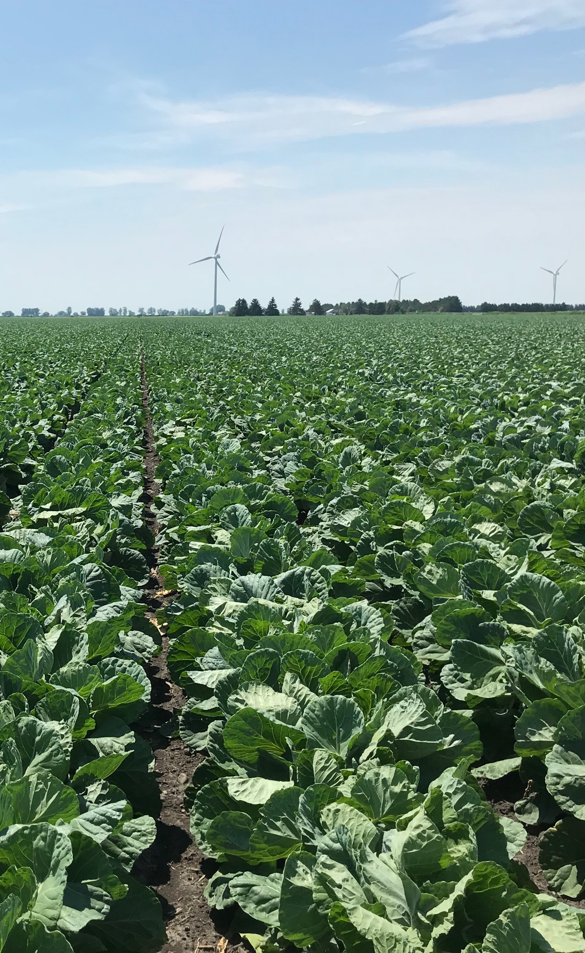
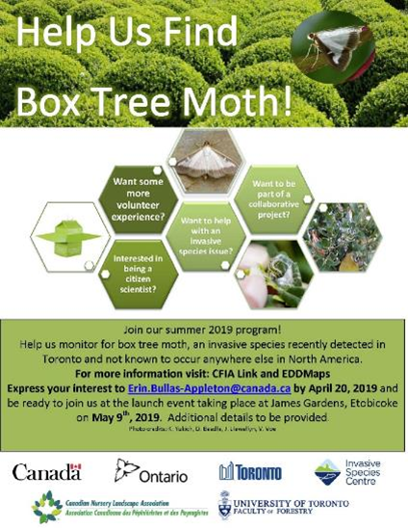

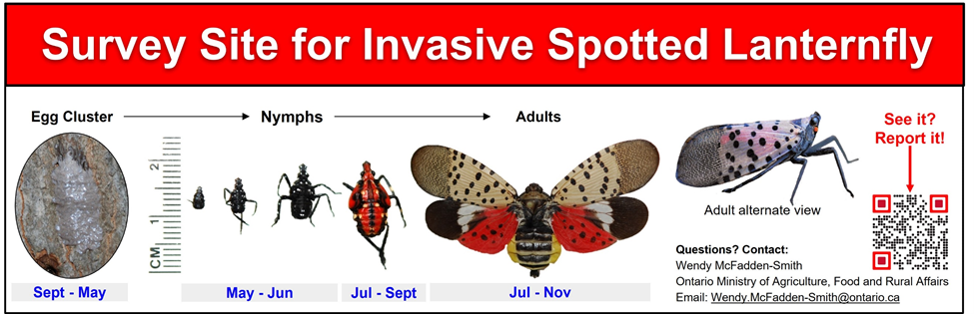
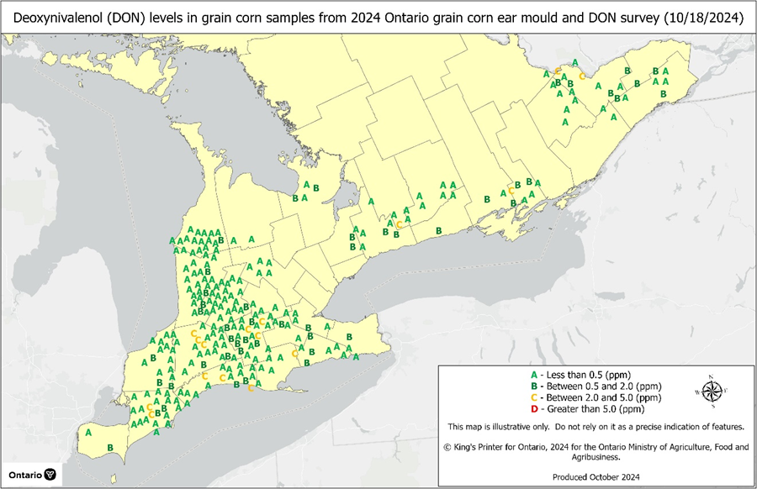
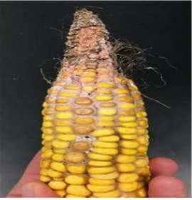
OMAFA Plant Health – What We Do
Policy and Program Development
Monitoring and Applied Research
Knowledge Translation and Transfer
  for Plant Health - Best Management Practices
Digital Services and Data Management
Support Minor Use program
External Programs and Partnerships
  Provincial, national and international working groups
  Ontario Agri-Food Innovation Alliance
  Great Lakes pest monitoring networks
  Canadian Plant Health Council – communities of practice
Notes:
Plant Health is a key priority for OMAFA and for the work done within the Agriculture Development Branch. Some of our efforts include:
POLICY and program development, including strategic initiatives through the sustainable canadian agriculture partnership’s Protection, Assurance and Risk Resilience AND providing expertise to policy initiatives at the provincial and federal level (eg. SCAP, Invasive Species, Species at Risk, environmental monitoring, PMRA transformation, Emergency Response, Biodiversity Strategy, MRLs)
MONITORING and applied research such as developing surveillance and monitoring projects for early detection; and identification of risk gaps.
KTT – a branch stregth
DIGITAL modernizing risk intelligence through digitization, as well as improving data to serve as the foundation for developing BMPs, KTT, decisions etc
SUPPORT for the Minor Use program to access risk mitigation tools
WE also work to:
build partnerships to create a shared responsibility among governments and stakeholders related to emergency management (preparedness, response and recovery)
Provide expertise to provincial, national and international working groups that work collaboratively on pest and pesticide issues relevant to Ontario agriculture (CPHIS, CPHC)
OMAFA-University of Guelph partnership, Ontario Agri-Food Innovation Alliance, OMAFA supports many IPM research projects; $ for research on how to detect pests, factors that impact populations or presence of pests, action thresholds and control strategies.

Slide 12
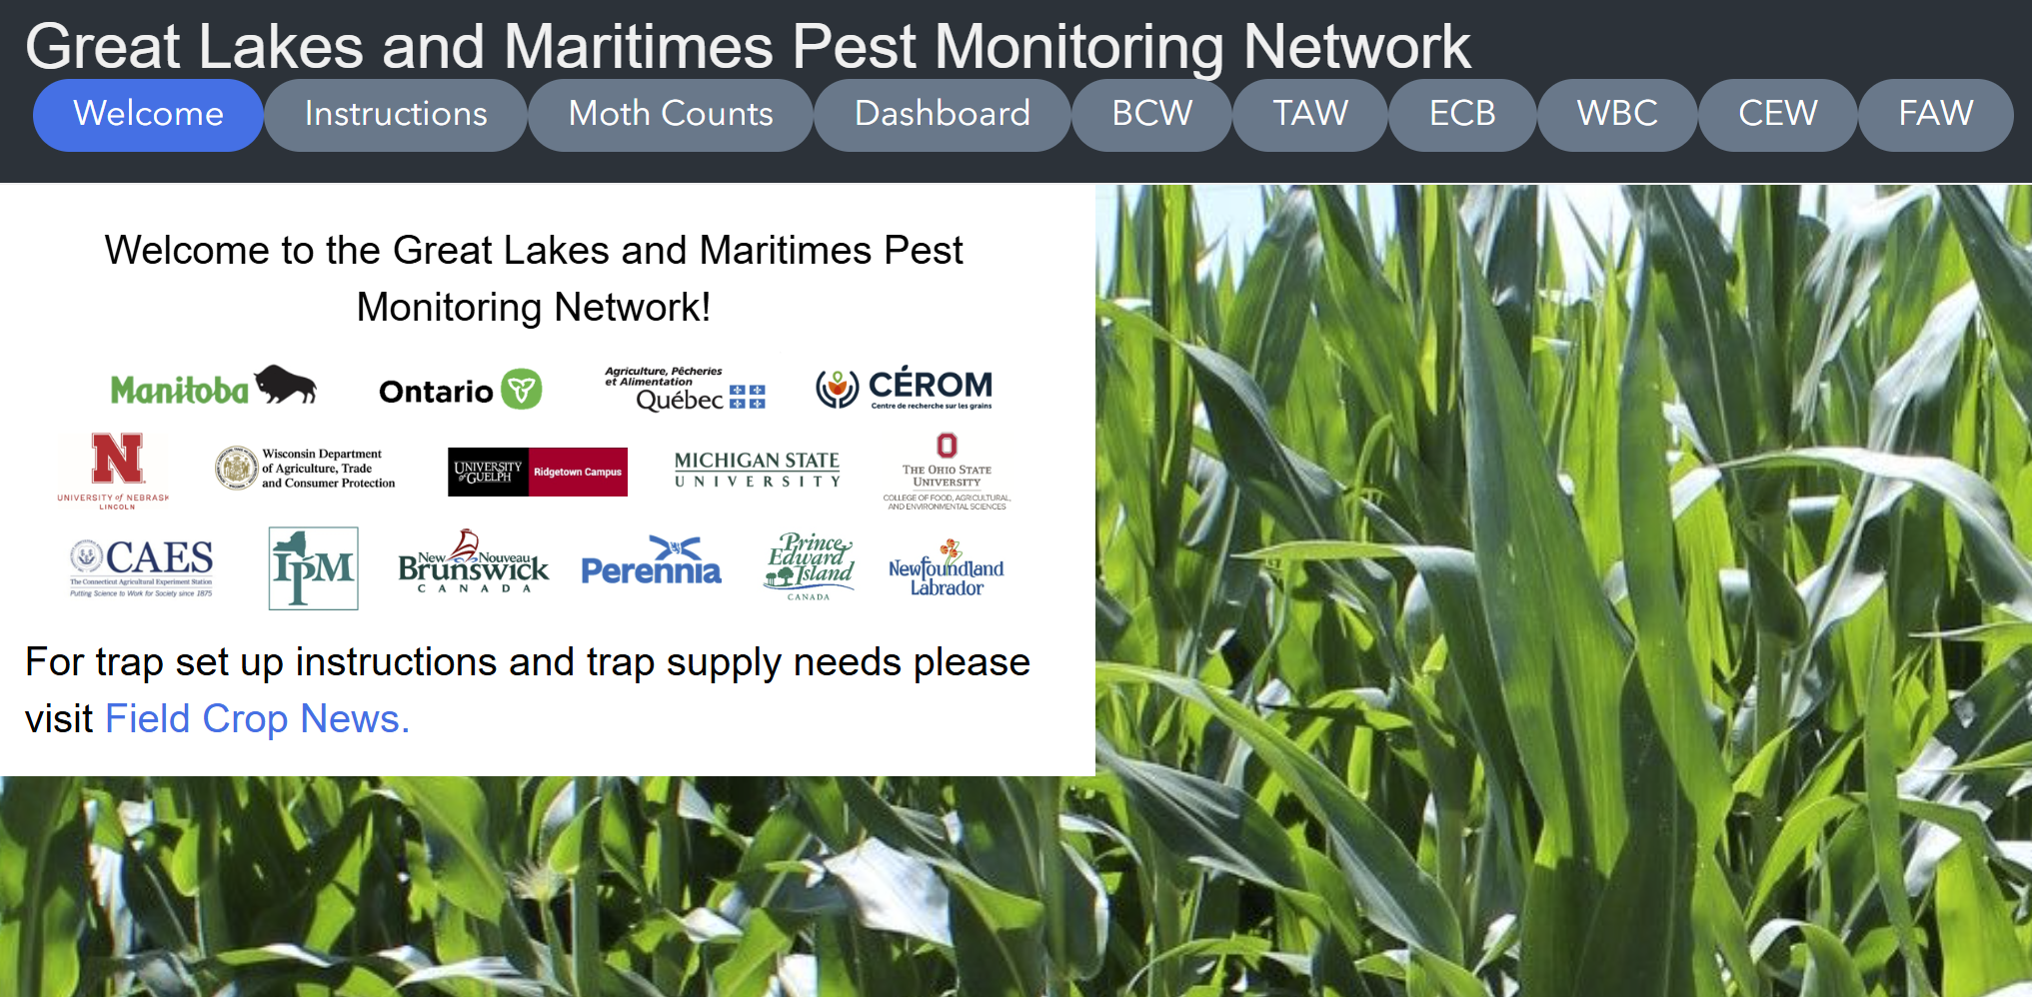
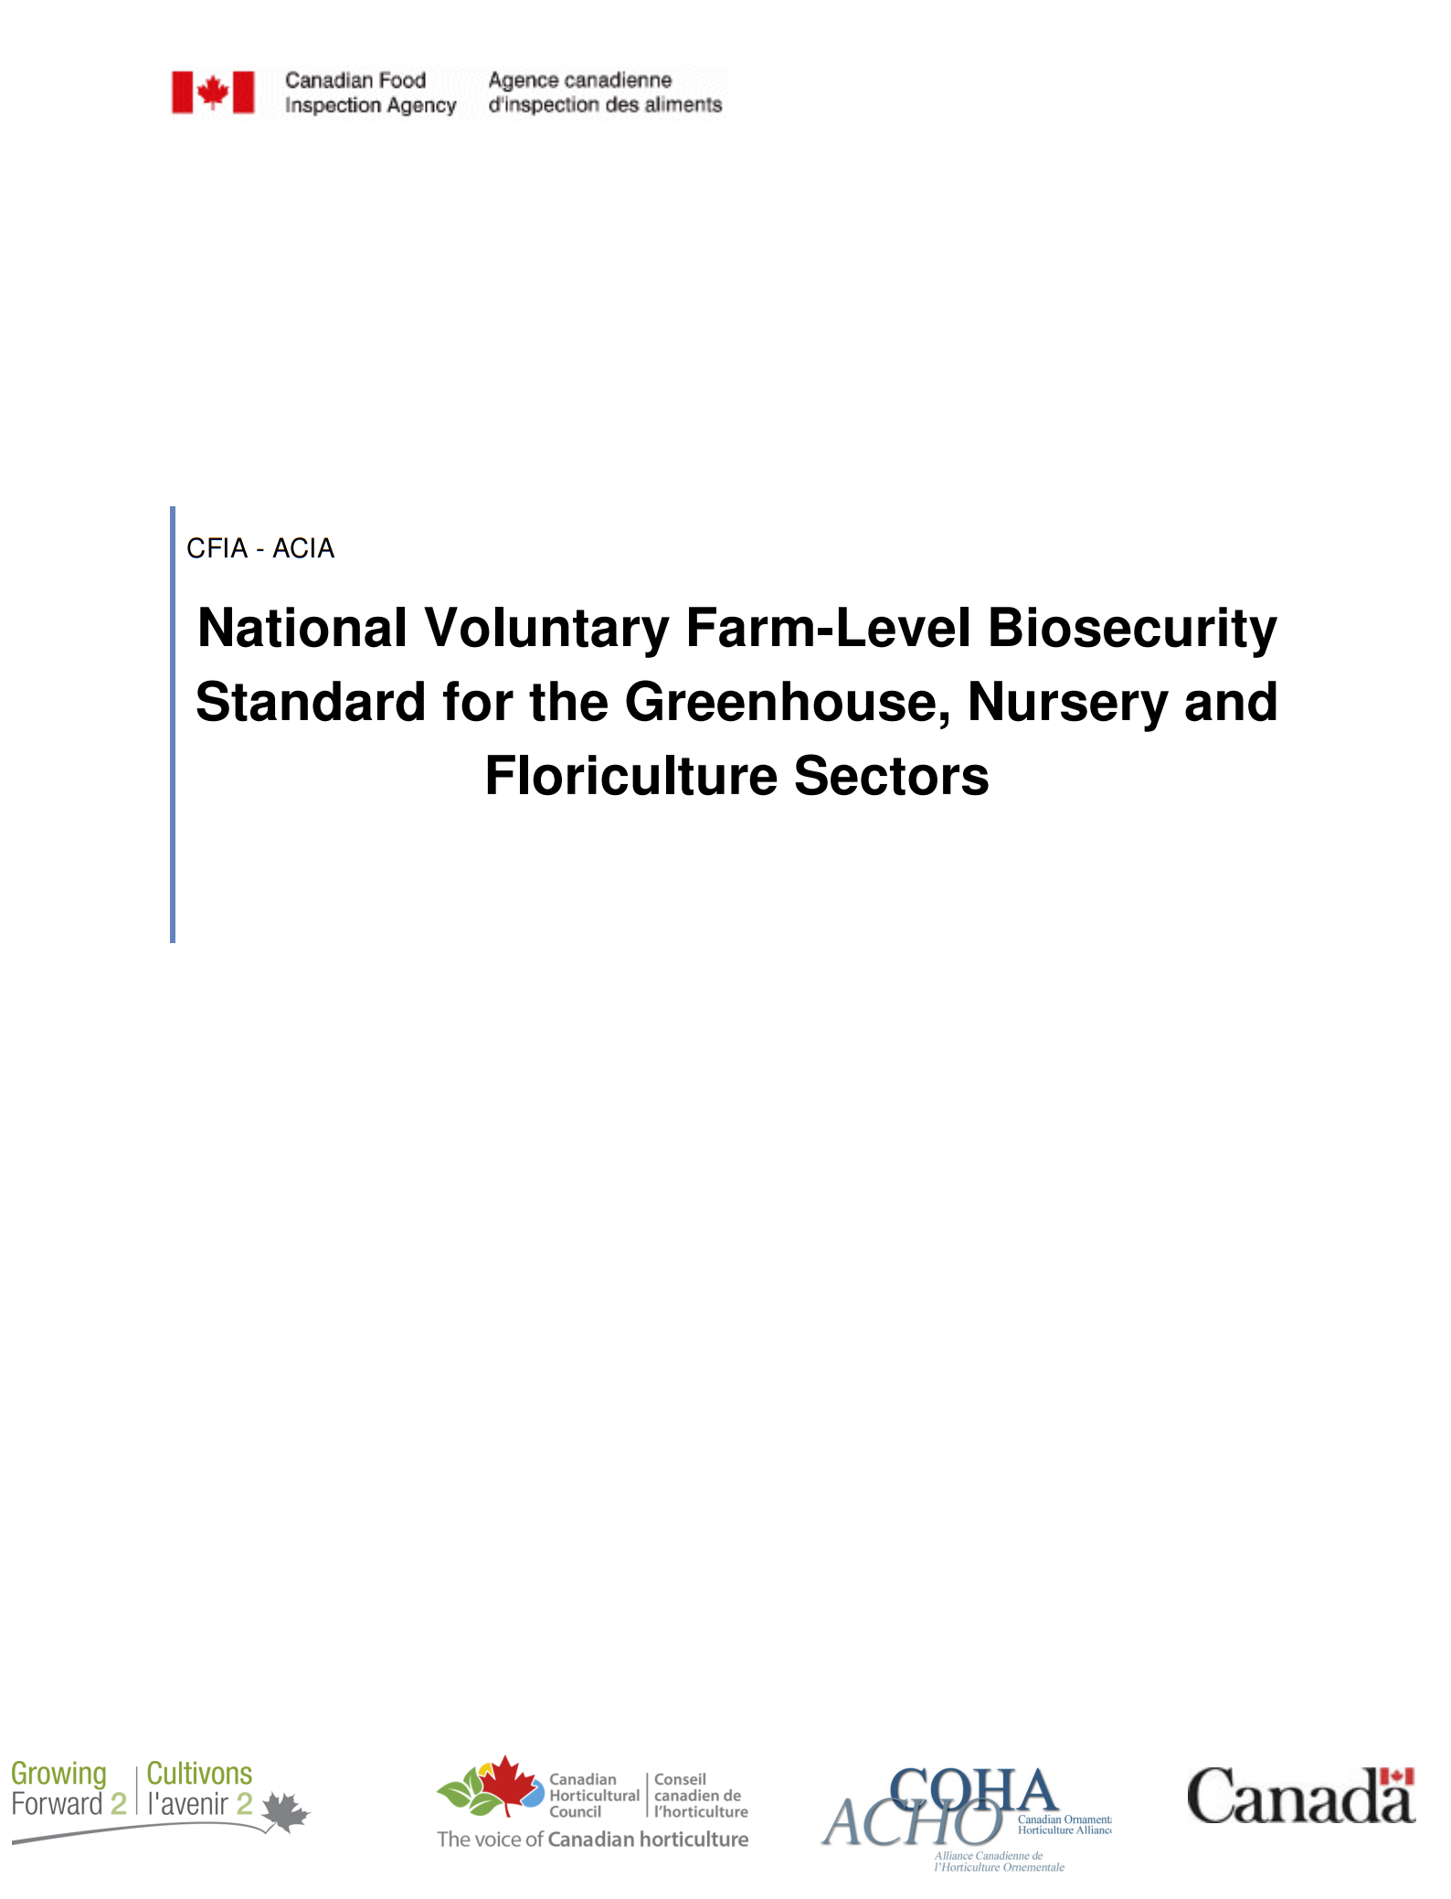
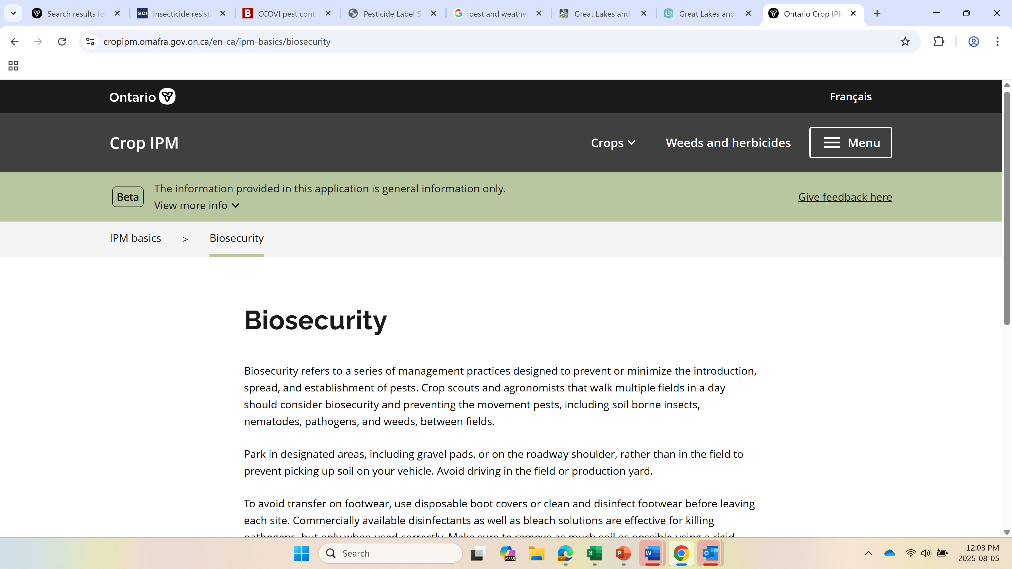
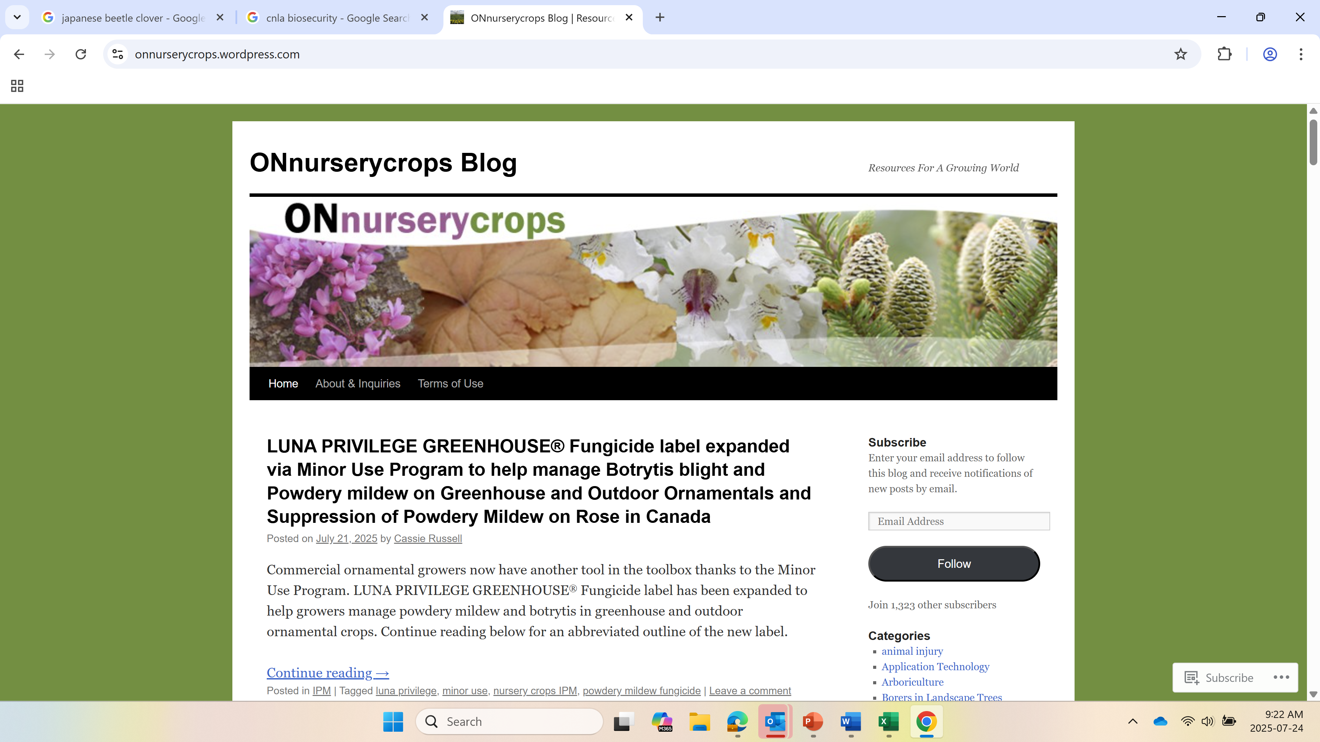
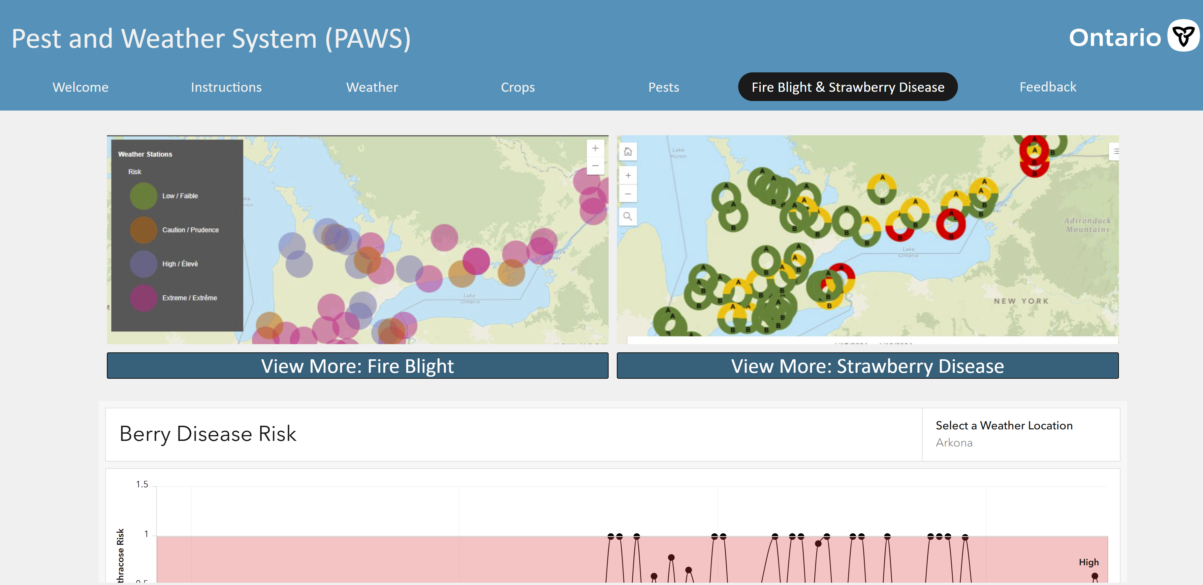
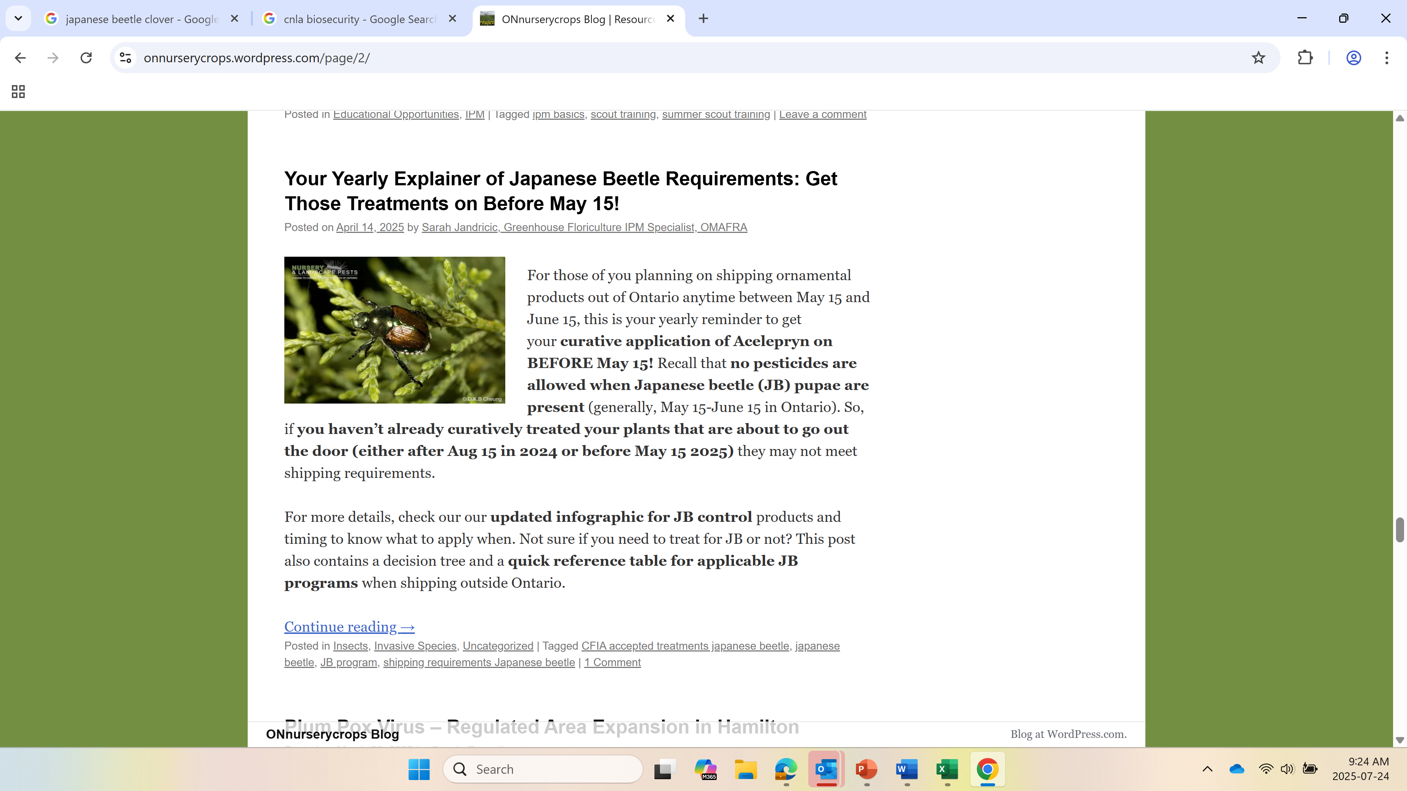
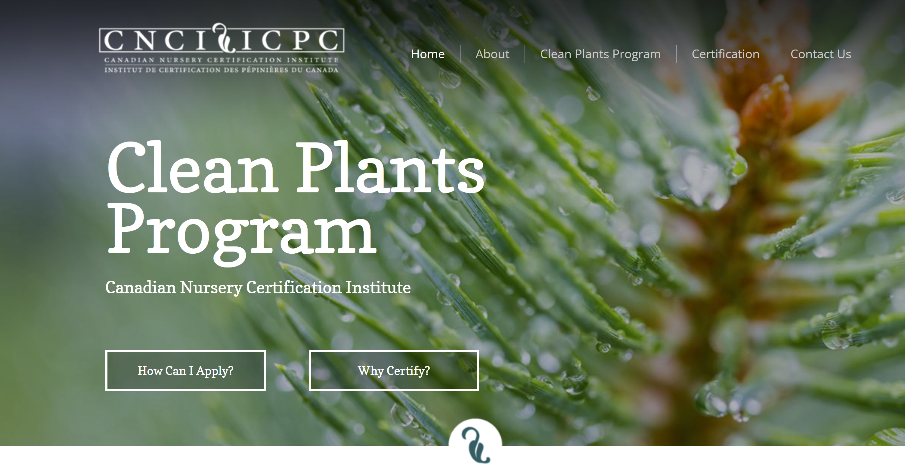
Biosecurity Guidance
& Programming
Notes:
PURPOSE OF SLIDE: Illustrate some of the ways the sectors are responding to plant health threats.
From an OMAFA standpoint, we assist with the development of pest modules for the Clean Plants Program; are involved with discussions with CFIA, industry and sometimes international trading partners on important plant health trade issues (e.g., ToBRFV); we have on occasion provided input on other countries' consultations (US' Ralstonia consultation).

Slide 13
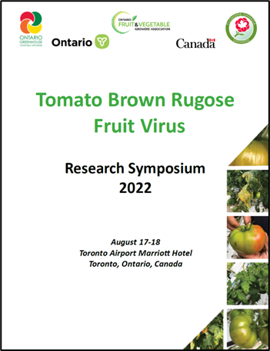
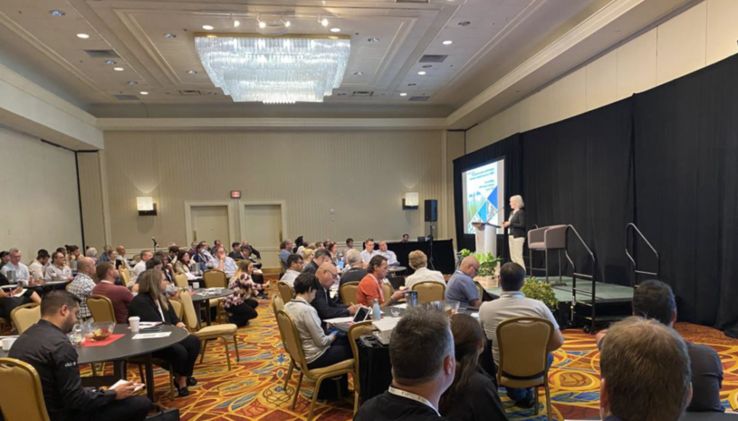
Collaboration Across Borders
Tomato Brown Rugose Fruit Virus
OMAFA Agriculture Development Branch:
  coordinate discussions with CFIA on risks & impacts
  member of National ToBRFV Task Force
  provide education & outreach on management, biosecurity
  investigate diagnostics, pathways, solutions
Research Symposium (August 16-18, 2022):
  share experiences, information and research results
  encourage partnerships and collaborations
  125 participants from Jordan, Israel, Germany, the UK, the Netherlands, Belgium, USA and Canada
  Participant and sponsor affiliations included propagators, seed suppliers, greenhouse suppliers, disinfectant/crop protection companies, laboratories, research institutions, provincial and federal government, grower organizations, producers, media
Notes:
I’d like to highlight Rugose as a testament to plant health success that can only be achieved through global communication and the combined efforts of global allies.
Rugose is an aggressive tobamovirus that can leave wrinkled spots on fruits of tomatoes and peppers, and can cause 100% loss of marketable fruit. Strict biosecurity measures in greenhouses are crucial to limit its introduction and spread, including hygiene and disinfection protocols for tools and equipment.
The disease was first recognized in Isreal and Jordan in 2014, but rapidly became a global issue, including for producers in Ontario by 2019. The development of best practices required a coordinated effort with international experts. To facilitate this, OMAFA partnered with industry and AAF were able to host a symposium where difficult questions, knowledge gaps, and partnerships could be discussed. Though Rugose remains a production challenge, resulting outcomes of the symposium mean the industry is better positioned with monitoring, BMPs, and resistant cultivars. These partnerships will be helpful for future plant health emergencies.
OMAFA was lead for organizing this symposium, along with industry reps and AAFC. Held to facilitate information sharing to collaboratively address the challenges of this pest.

Slide 14
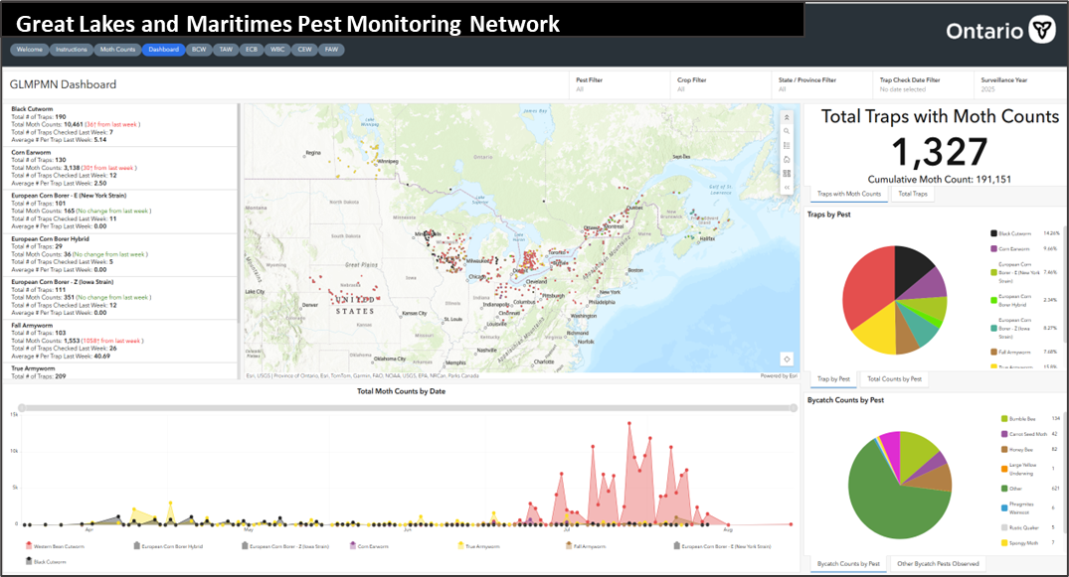
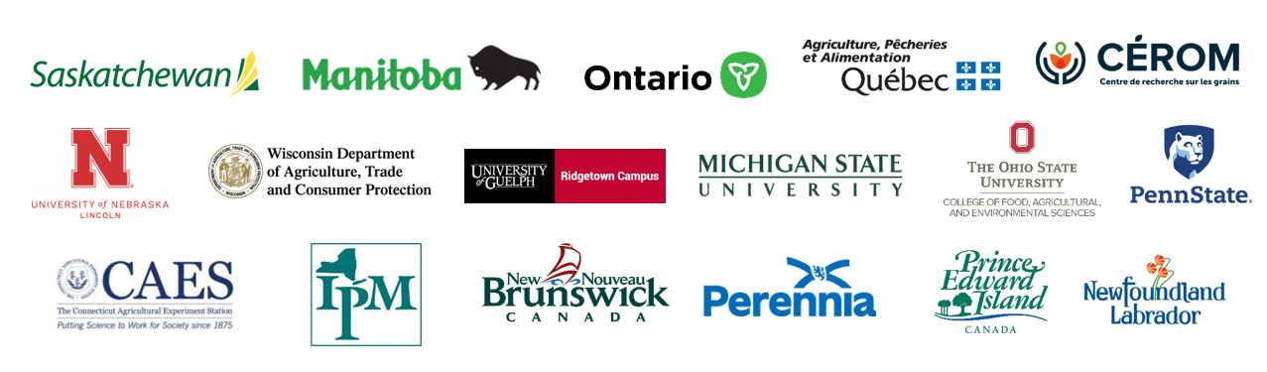

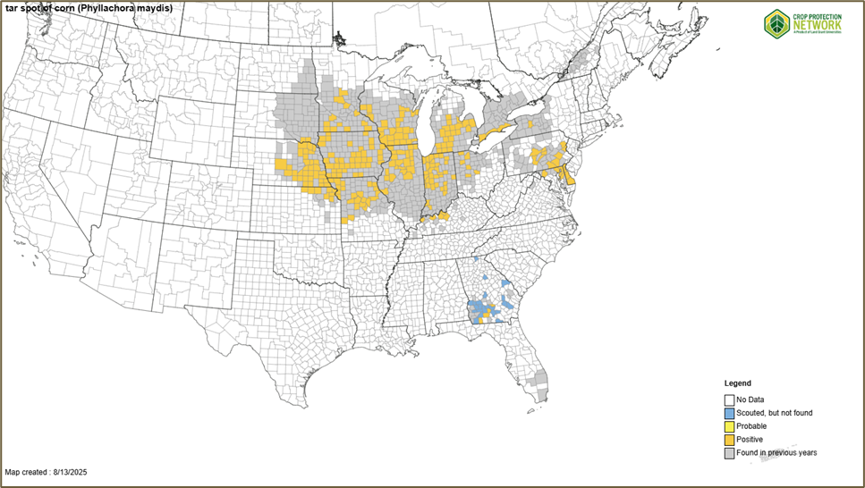

Collaboration Across Borders
Networks supporting early detection
Great Lakes Region
  Similar crops, pests
Dependent on maintaining networks between jurisdictions
  Fruit / Vegetable Workers, Great Lakes and Maritimes Pest Monitoring Network, Corn Rootworm Trap Network, Cucurbit Downy Mildew ipmPIPE, Crop Protection Network, others
  Recently discovered species support the importance of monitoring
Links and collaborations with scientific communities
  direct ties to University of Guelph - global lead in resistance management of corn insect pests, IPM of field crop insects
Notes:
Monitoring networks support early warning systems for existing and emerging pests, especially those in the Great Lakes region.
For example, the GLMPMN has been valuable in keeping each other informed of new detections. It was the expansion of western bean cutworm that started the trap network that eventually evolved into monitoring all shared moth pests.
The Crop Protection Network international partnership of university and provincial Extension specialists, and public and private professionals. It plays a strong role for monitoring on the disease side. They utilize that collaboration to monitor for diseases like tar spot but more recently are monitoring for corn leafhopper (which vectors corn stunt disease), a pest found in the US but not detected in Canada. OMAFA has representation as one of the execs on that network.
Links with U of G and international IPM specaialists.

Slide 15
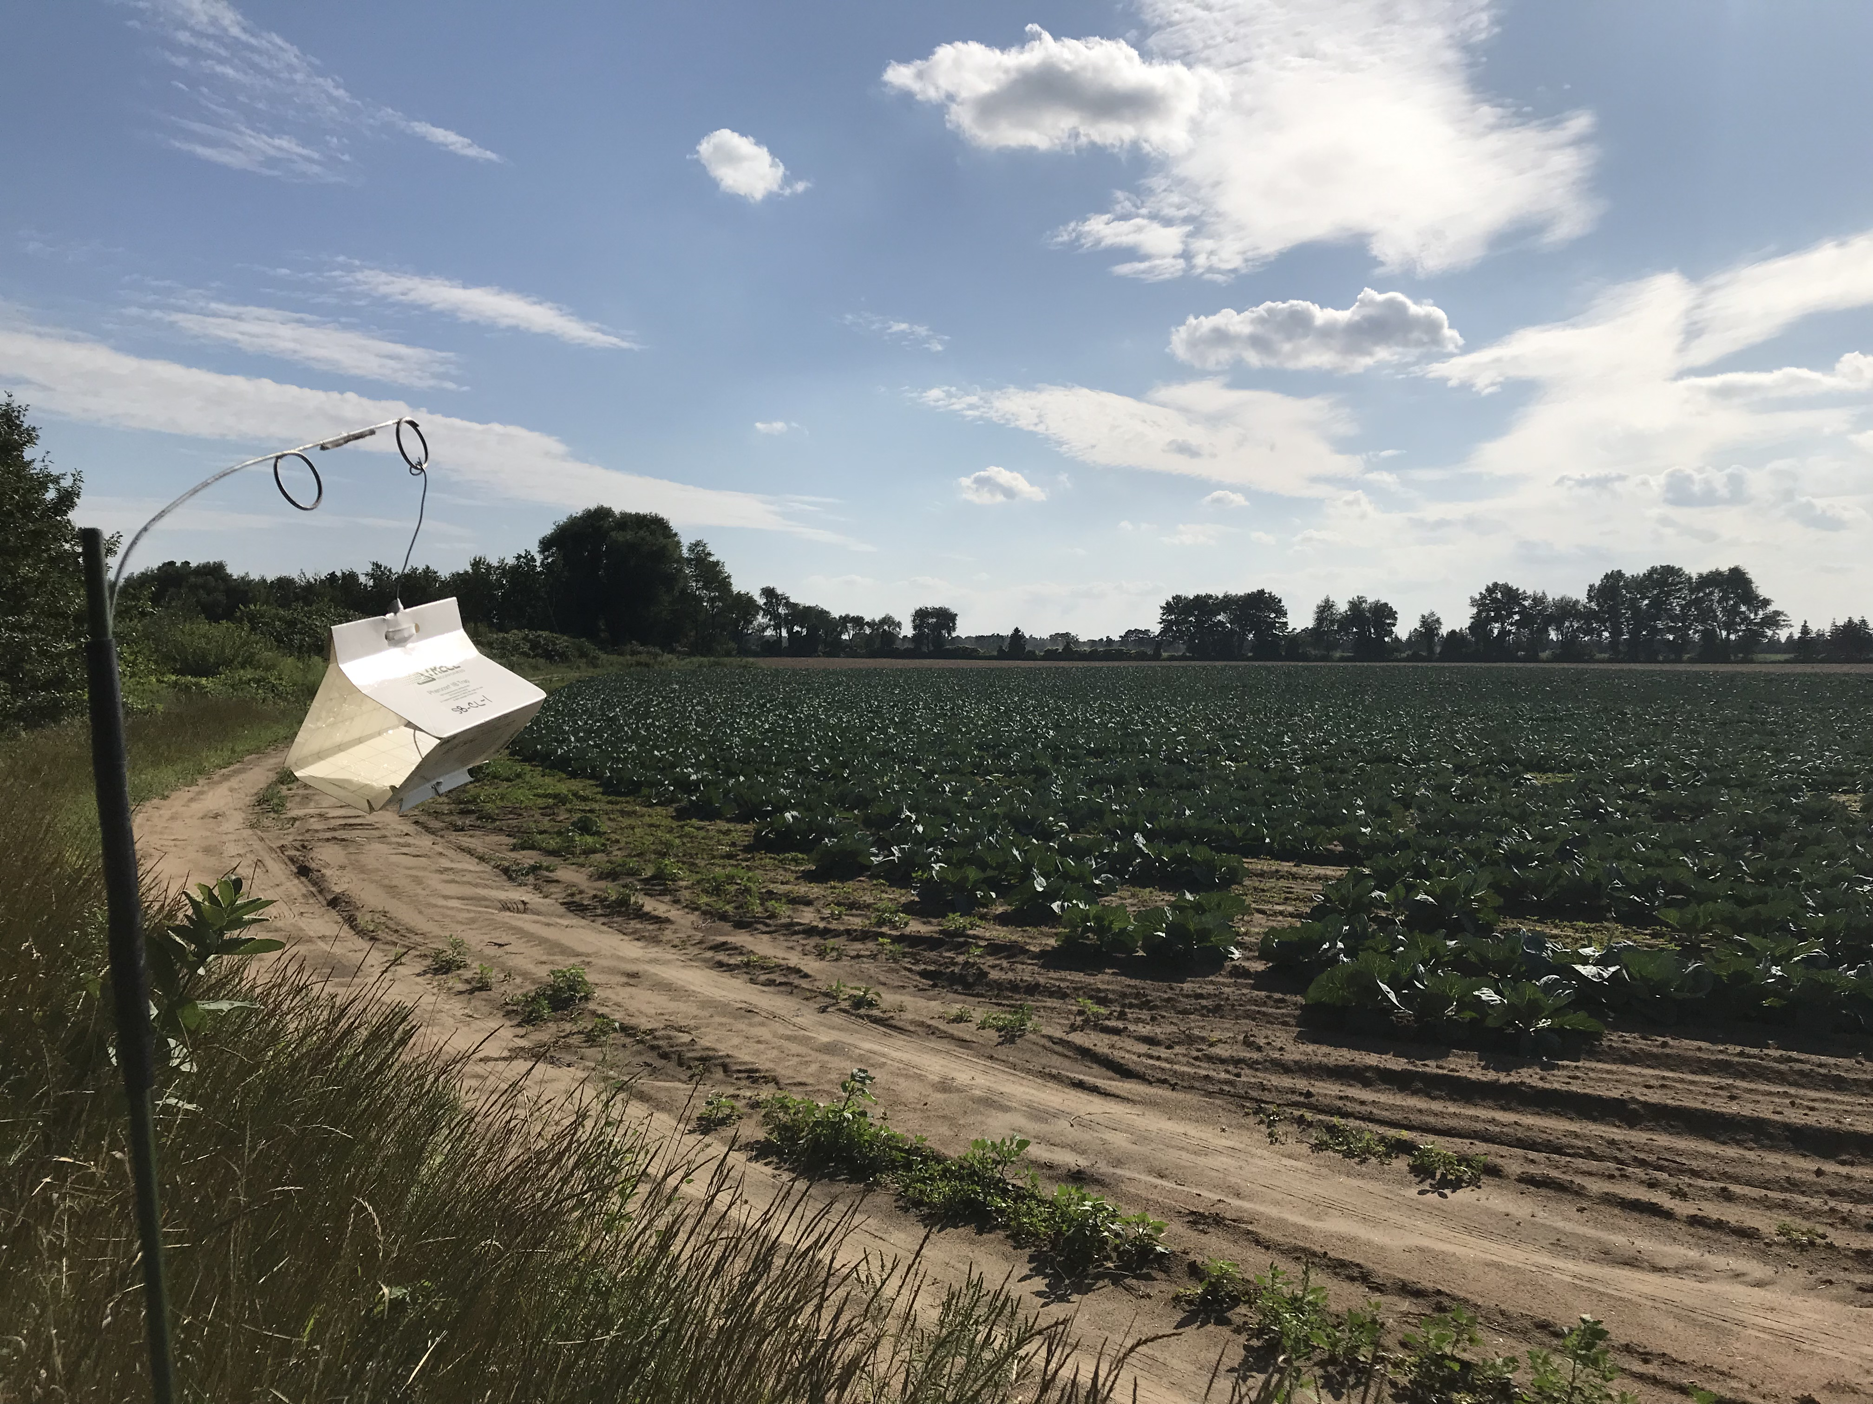
Thank you!
Hannah Fraser
Entomologist – Horticulture
Agriculture Development Branch
hannah.fraser@ontario.ca

