Slide 1

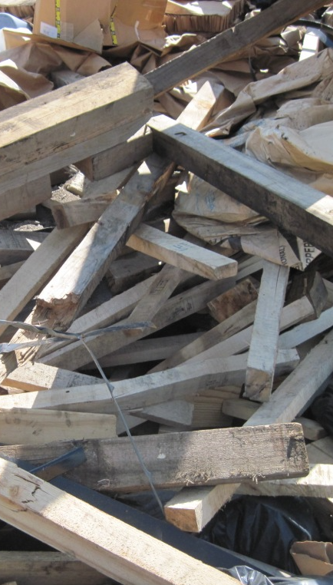

USDA APHIS: Empowering Trade Through Data Transparency and Accountability
Presented by:
Jon Daniels, PhD
USDA APHIS
Assistant Director

Slide 2
Select the correct answer: Yes, there is a correct answer
Bug:
An insect
An error/mistake in computer code
I hidden device used for surveillance
Cookie:
A small data file used to track a user
A sweet baked treat
Other
Cloud:
Visible mass of water droplets in the atmosphere
A term for something vague
A network of remote servers for storing and processing data

Slide 3
Select the correct answer: Yes, there is a correct answer
Bug:
An insect
An error/mistake in computer code
I hidden device used for surveillance
Band:
A musical group
A range of frequencies used in communications
A ring often wore on the finger
Cookie:
A small data file used to track a user
A sweet baked treat
Other
Kernal:
A single seed or grain of a plant
The core of an operating system
A function used in machine learning
Cloud:
Visible mass of water droplets in the atmosphere
A term for something vague
A network of remote servers for storing and processing data
Port:
A place where ships doc to load/unload
A type of wine
A connection point for data transfer

Slide 4
CORRECT ANSWERS: Green
Bug:
An insect
An error/mistake in computer code
I hidden device used for surveillance
Band:
A musical group
A range of frequencies used in communications
A ring often wore on the finger
Cookie:
A small data file used to track a user
A sweet baked treat
Other
Kernal:
A single seed or grain of a plant
The core of an operating system
A function used in machine learning
Cloud:
Visible mass of water droplets in the atmosphere
A term for something vague
A network of remote servers for storing and processing data
Port:
A place where ships doc to load/unload
A type of wine
A connection point for data transfer

Slide 5
Terminology matters: If data cannot be clearly defined, does it retain any meaningful value for regulatory decision-making?
Notes:
When you seek wisdom, you also receive buy-in

Slide 6


Terminology matters: If data cannot be clearly defined, does it retain any meaningful value for regulatory decision-making?
Do not make decisions in a bubble
Seek input from those in the know
Notes:
When you seek wisdom, you also receive buy-in

Slide 7
Empowering Industry Partners
Tools for Smarter Trade
Better data definitions by listening:
The Nature Conservancy, NWPCA, Clipper Americas, UTC Overseas
Standardized our terminology
Update our data collection metrics for non-compliant WPM
WPM Definition Updates
Wood Packaging Material
Dunnage
Container Dunnage
Breakbulk Dunnage
Crate, Case (box)
Pallet
Bracing, packing
Spool (reel), drum

Slide 8

Empowering Industry Partners
Tools for Smarter Trade
Better data definitions by listening:
The Nature Conservancy, NWPCA, Clipper Americas, UTC Overseas
Standardized our terminology
Update our data collection metrics (customs officials) for non-compliant WPM
Future work:
Work with NAPPO (regional plant protection organizations) to adopt
Proof of concept for global adoption
WPM Definition Updates
Wood Packaging Material
Dunnage
Container Dunnage
Breakbulk Dunnage
Crate, Case (box)
Pallet
Bracing, packing
Spool (reel), drum
WPM Data Categories
Pallet/Skid
Container Dunnage
Breakbulk Dunnage
Spool/Drum/Reel
Crate/Box/Case
Crate, Case (box)
Other Regulated WPM

Slide 9
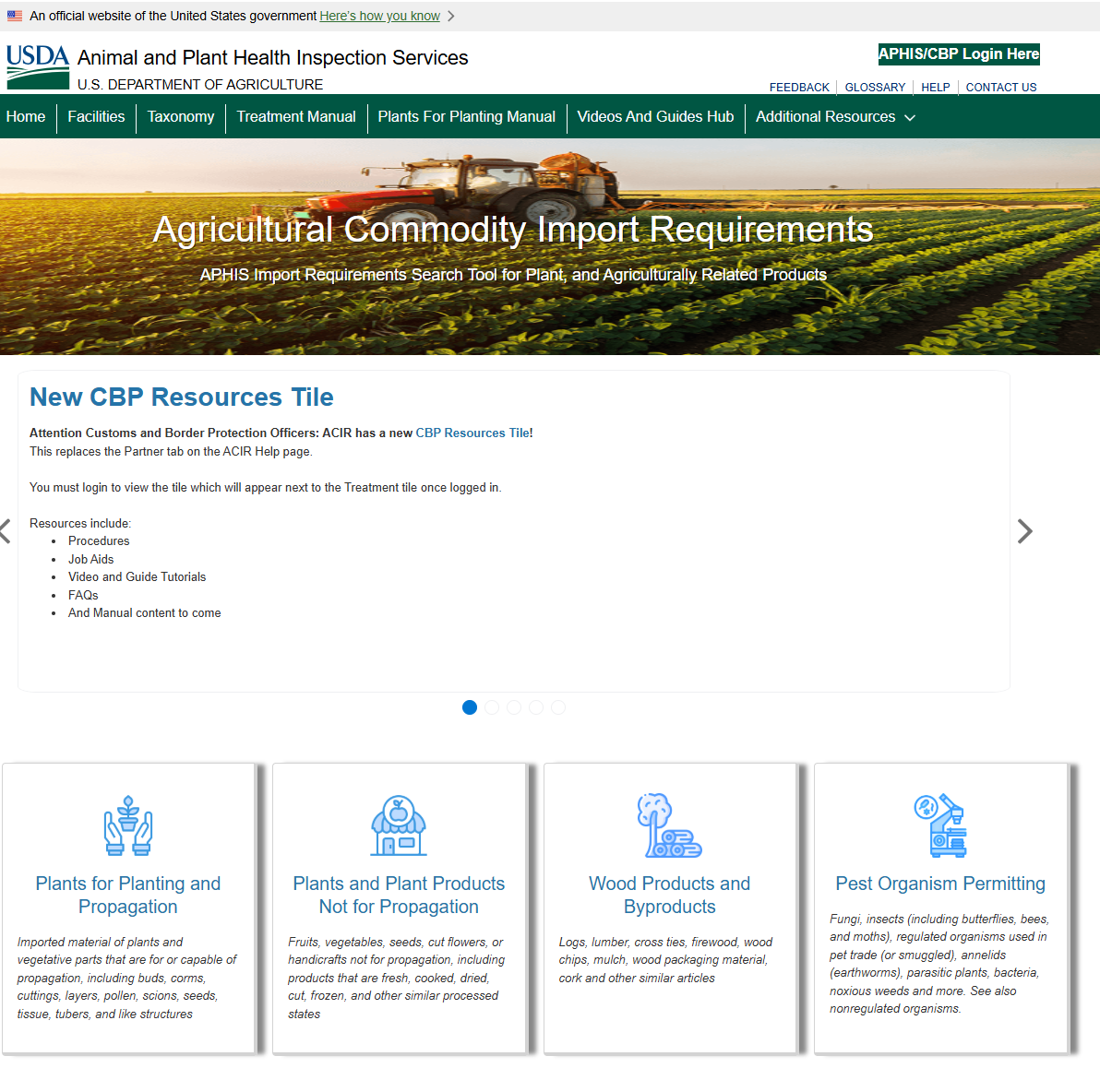
ACIR: Info instantly, digitally delivered
Agricultural Commodity Import Requirements (ACIR)
What ACIR (system of record) Offers:
System of record (accountability)
Centralized Database for import requirements across plant and agricultural commodities
Definitions & Regulatory Guidance by commodity type, country of origin, and process type
Real-Time Updates on approved facilities and treatment protocols
Integrated Search Tool for streamlined access to admissibility criteria

Slide 10
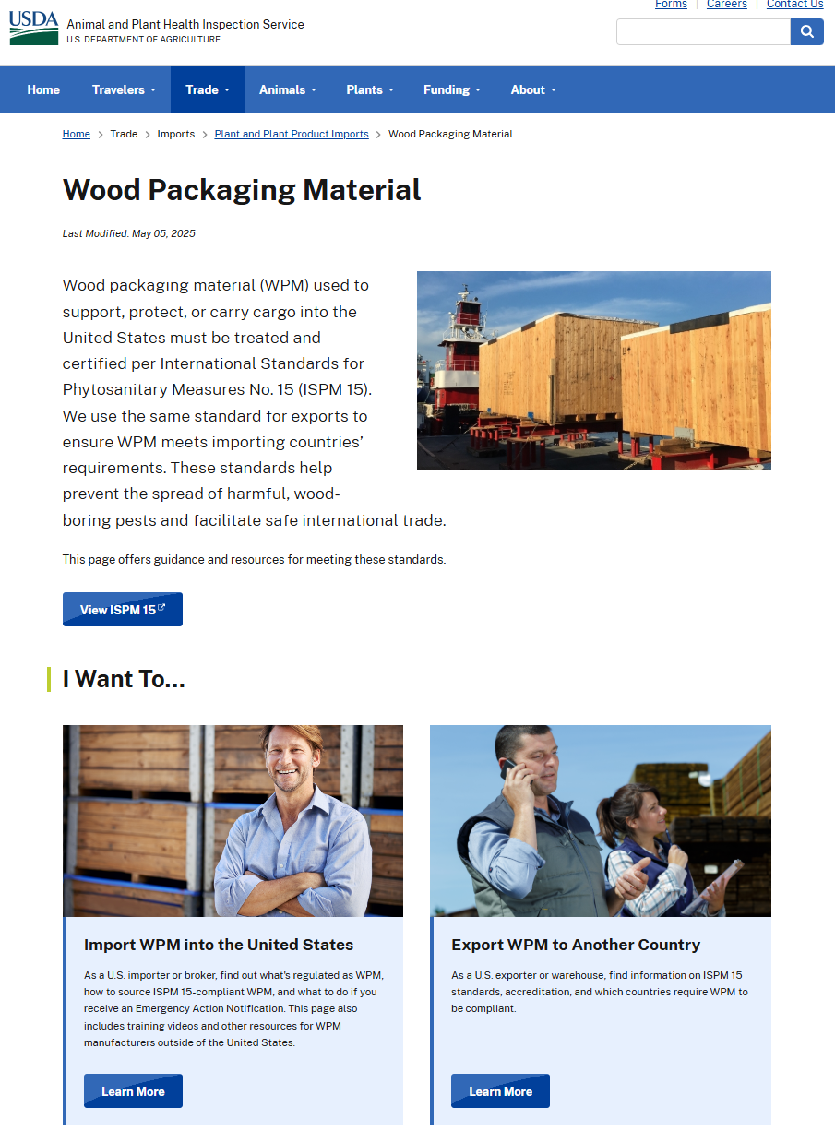
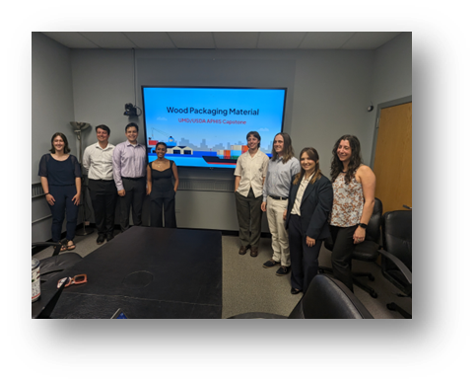

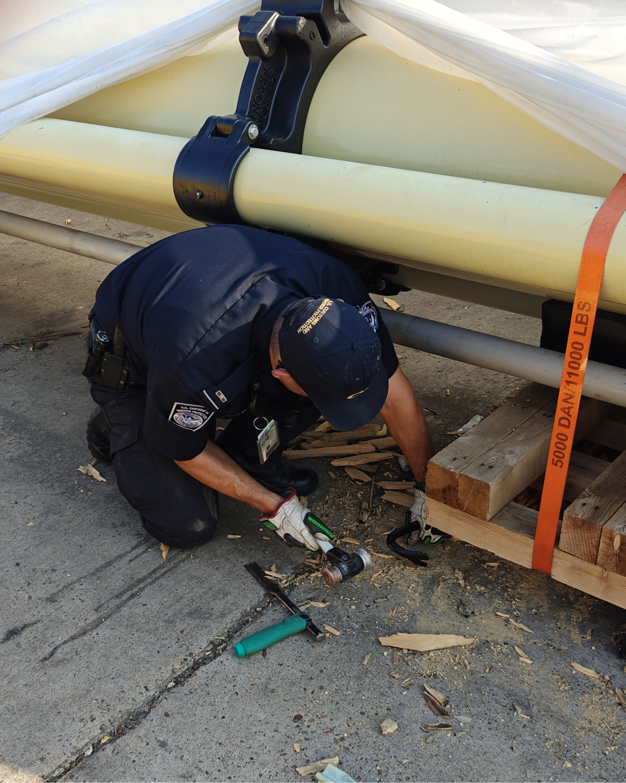
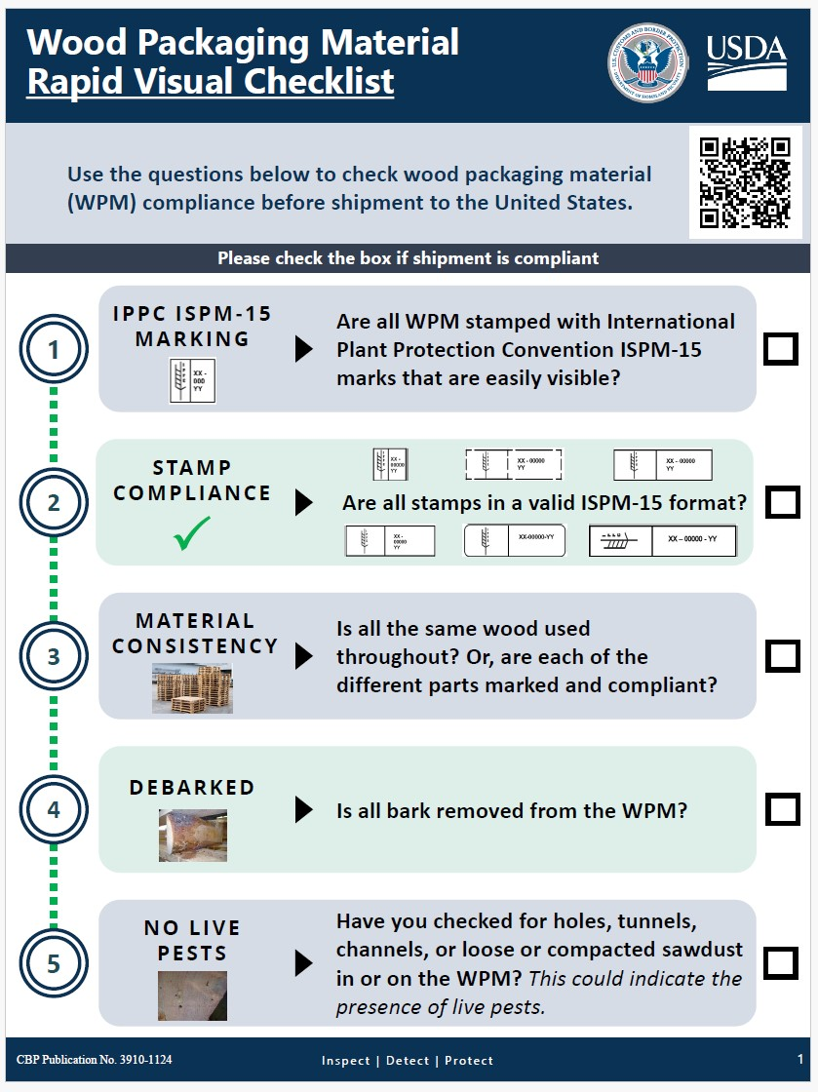
Empowering Industry Partners
Policy
Empower Trade
Invest in
outreach
Knowledge transfer
Work with industry/stakeholders

Slide 11

Wood Packaging Material Program
No need to fear data sharing
Benefits:
Opportunity to improve
Keeps us (regulatory agencies) accountable
Builds trust
Supports data-driven policy
Empowers trade (self-regulation)
Improves biosecurity awareness
Forces regulatory authorities to engage
Opportunities to innovate
Notes:
1. Enhances Government Transparency
Demonstrates USDA APHIS’s commitment to openness in its enforcement of phytosanitary regulations.
Builds public trust by showing how the agency monitors and responds to violations.
2. Promotes Accountability
Holds importers, exporters, and supply chain actors responsible for compliance with ISPM 15 standards.
Encourages better industry practices by making non-compliance visible and traceable.
3. Improves Biosecurity Awareness
Educates stakeholders and the public about the risks of invasive pests and diseases linked to untreated or improperly treated wood packaging.
Reinforces the importance of compliance in protecting U.S. agriculture and ecosystems.
4. Supports Data-Driven Policy and Research
Enables researchers, policymakers, and watchdog groups to analyze trends, identify high-risk trade routes, and recommend improvements.
Facilitates collaboration between government, academia, and industry to strengthen phytosanitary measures.
5. Encourages Industry Self-Regulation
Public exposure incentivizes companies to proactively ensure their packaging meets international standards.
Reduces repeat violations by creating reputational pressure.
6. Aligns with Global Trade Standards
Demonstrates U.S. leadership in adhering to international transparency norms under the IPPC (International Plant Protection Convention).
Helps trading partners understand enforcement practices and align their own procedures.

Slide 12
Should we be Afraid to Share Data?
Providing more data to the public leads to accountability and transparency
Accountability: By publishing data on violations, regulatory officials show they are actively enforcing regulations and are linking evidence-based decision to measurable outcomes in pest prevention.
Transparency: proactively disclosing enforcement outcomes, enabling stakeholder scrutiny, and fosters trust in evidence-based pest prevention.

Slide 13
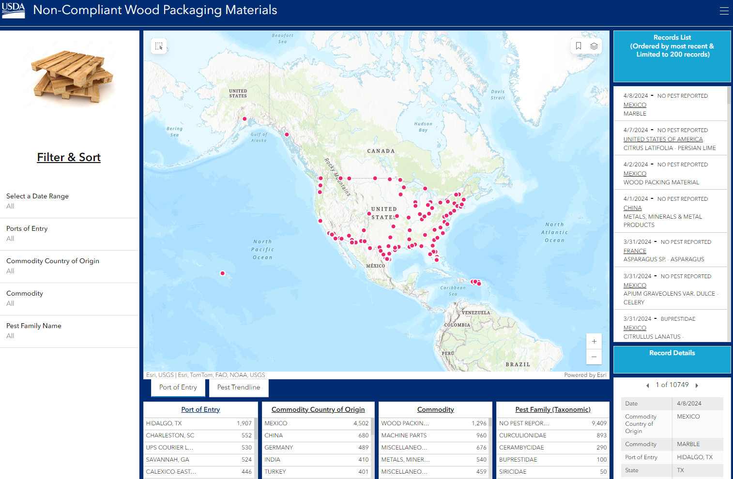
Wood Packaging Material Program
Video

Slide 14
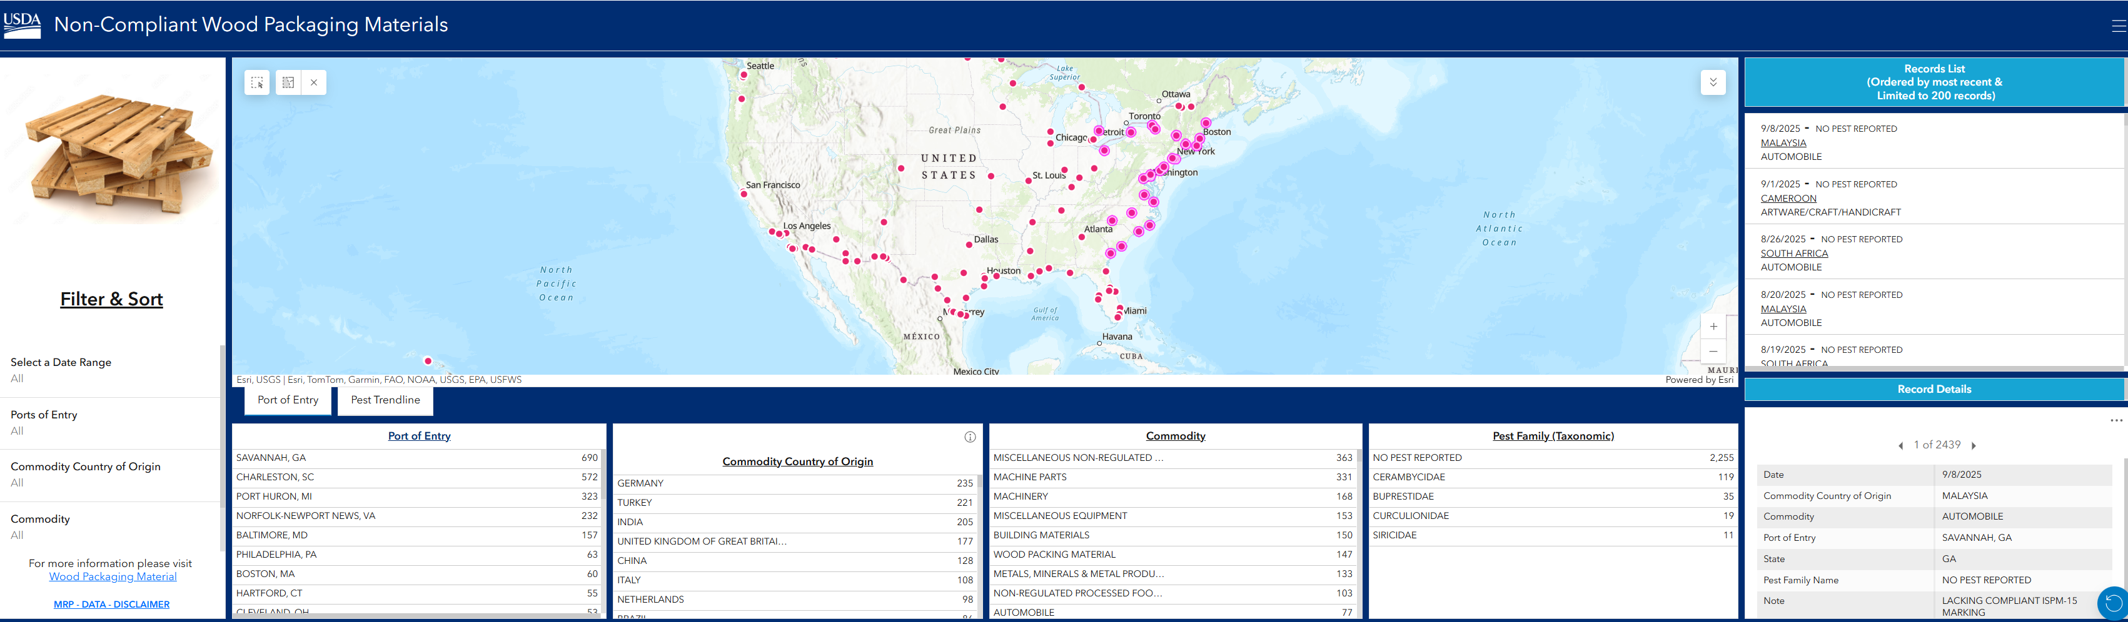
Non-compliant WPM data: Create an interactive webpage

Slide 15
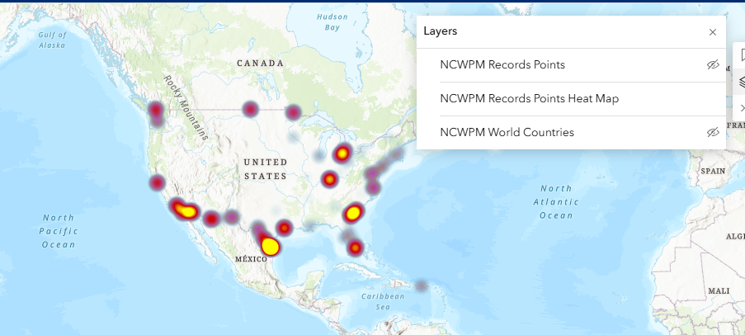
Non-compliant WPM and how best to present the data?
Data Gathering + Data Sharing!

Slide 16
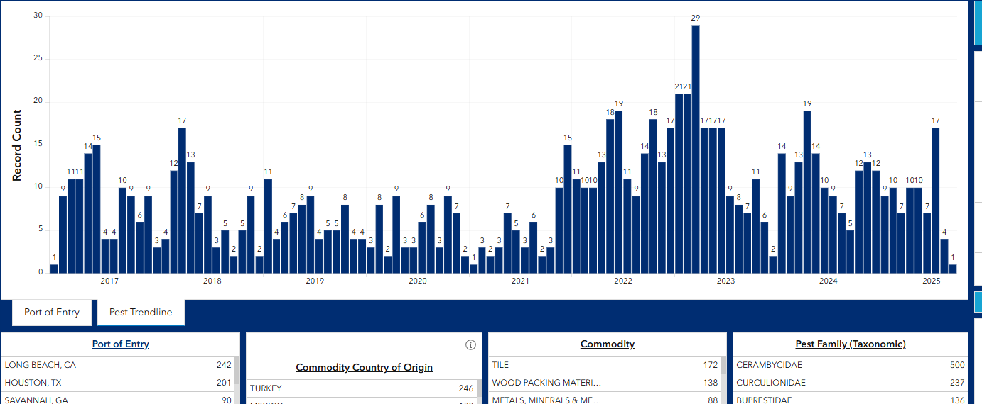
Non-compliant WPM data: Pest trend
Data Gathering + Data Sharing!

Slide 17
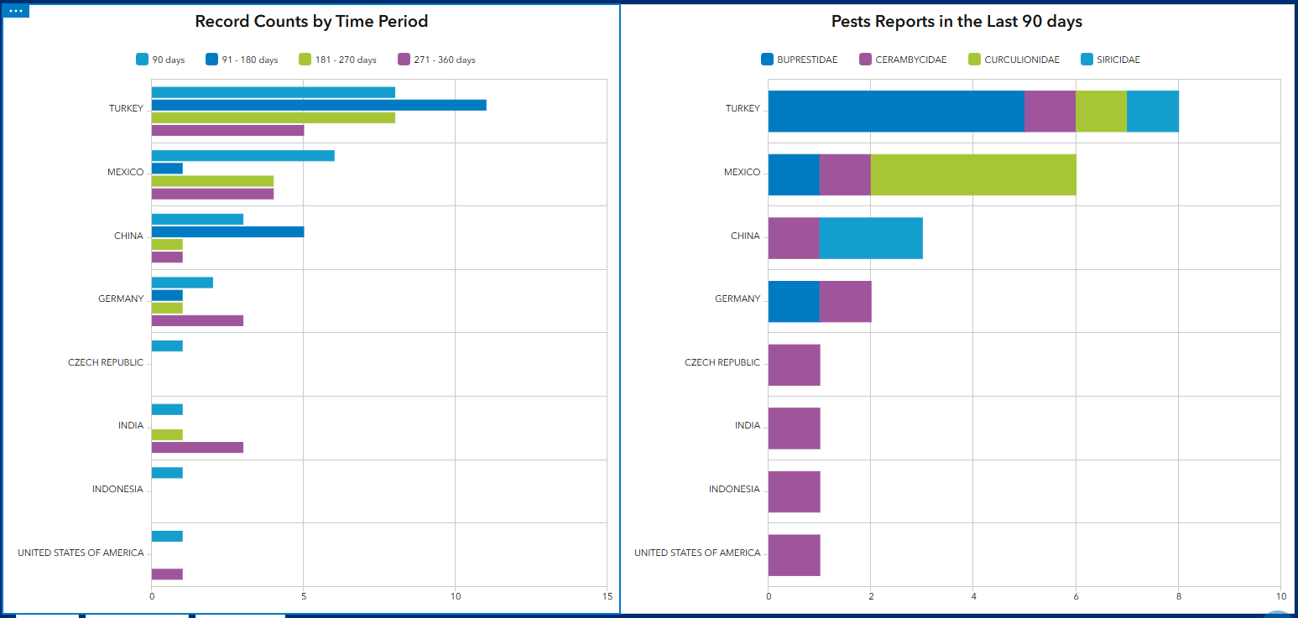
Non-compliant WPM and how best to present the data

Slide 18
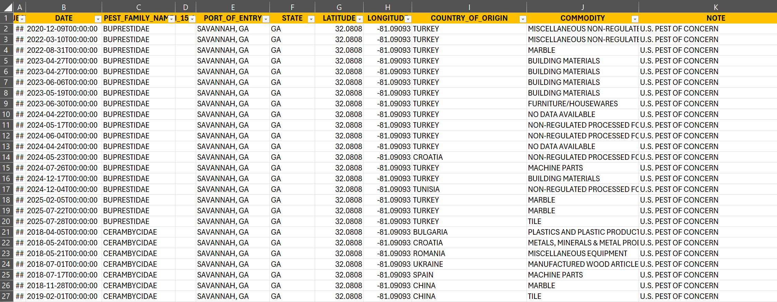
Non-compliant WPM and how best to present the data

Slide 19

Smarter Biosecurity, Stronger Trade: How data can drive innovation
When you know there is a problem you should seek to have solutions
Hybrid-Risk Based Sampling: Voluntary certification (SENASICA, NWPCA, APHIS) streamlined clearance.
Smarter Inspection: Tiered, data-driven sampling targets high-risk shipments while rewarding compliant shipments.
Unified Enforcement: Real-time data sharing between NAPPO, CBP, and industry partners ensures coordinated action.
Trade Facilitation & Efficiency: Trusted suppliers benefit from faster border processing, reduced delays, and predictable logistics.

Slide 20
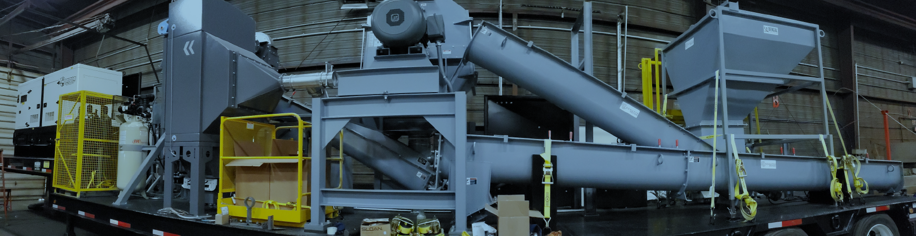
When you know there is a problem you should seek to have solutions
Shredder + Hammermill – mobile machine of destruction

Slide 21
Thank You

